Slide 1

SESSION TITLE
GOES HERE
SPEAKER NAME, TITLE AND COMPANY GO HERE

Slide 3
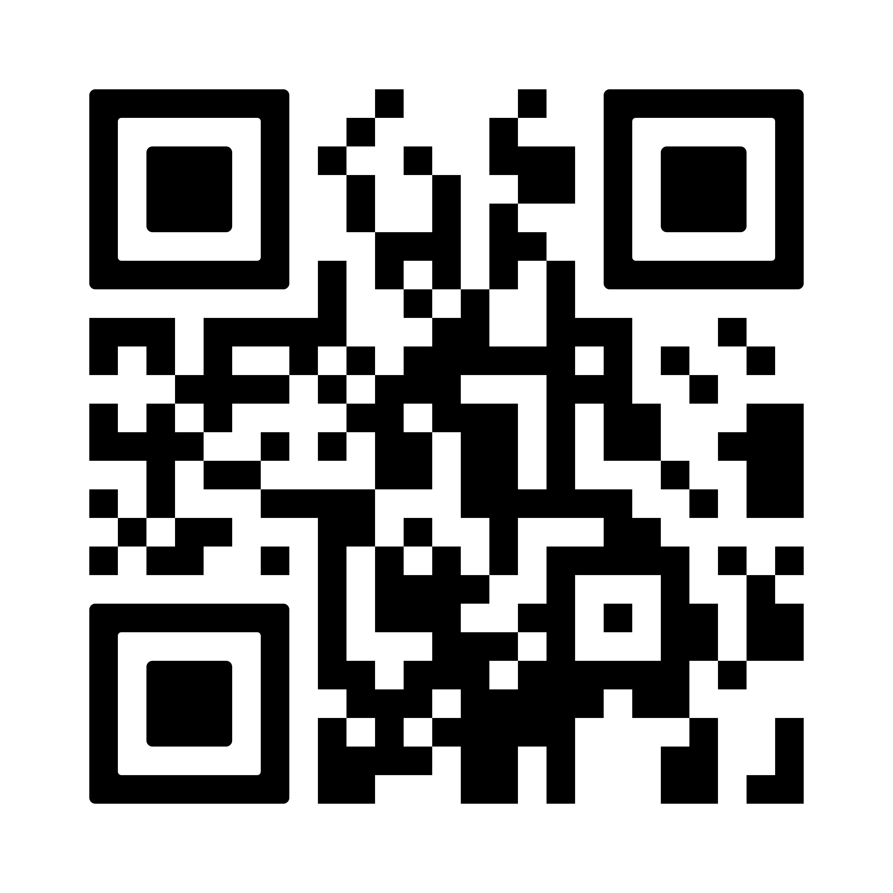

Thank you!
Have thoughts about SIA Education@ISC?
Please scan the QR code to complete our survey and share your feedback on this session.
Please scan the QR code to access live translations, captions & session summaries.

