Slide 1
Privacy by Design:
A Practical Guide for Systems Integrators in the Age of Data Protection

Slide 2




Zachary Klares
Vice President
PDQ
Jon Polly
Chief Solutions Officer
Protecht Solutions Partners
Sonia Siddiqui
Legal Director
Kohler
Travis Willis
Business Development Manager
LEGIC

Slide 3
How important is data privacy?

Slide 4
In 2024, there are 138 countries with data and consumer privacy laws.
As of July 2024, 20 states have passed comprehensive data privacy laws.
70% of US and UK organizations have designated internal officers to lead and implement data privacy measures.
As of 2023, about 46% of consumers worldwide are aware of their country’s data privacy laws.
66% of global consumers feel that tech companies have too much control over their data.
Source: https://edgedelta.com/company/blog/data-privacy-statistics

Slide 5
What laws currently impact the security industry?

Slide 6
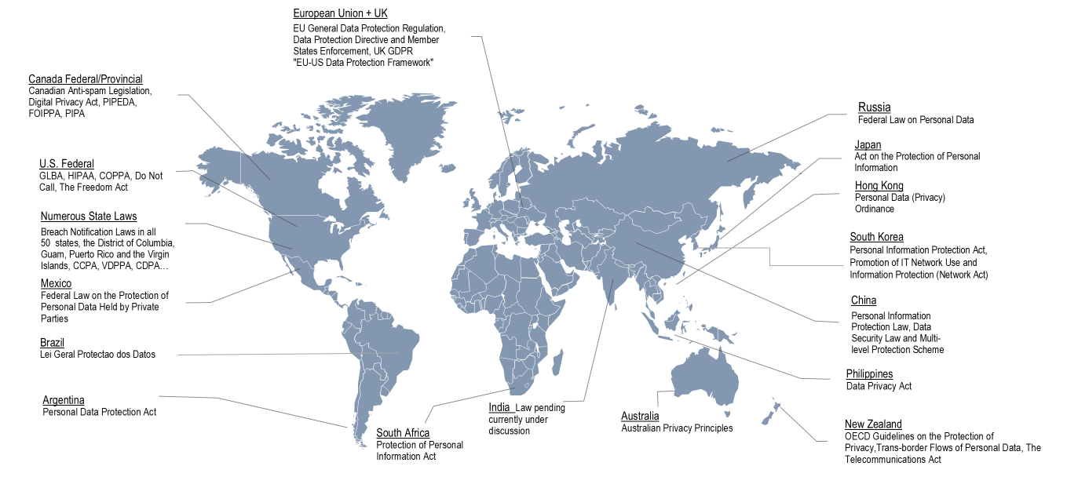
Why Does Data Privacy Matter?

Slide 7
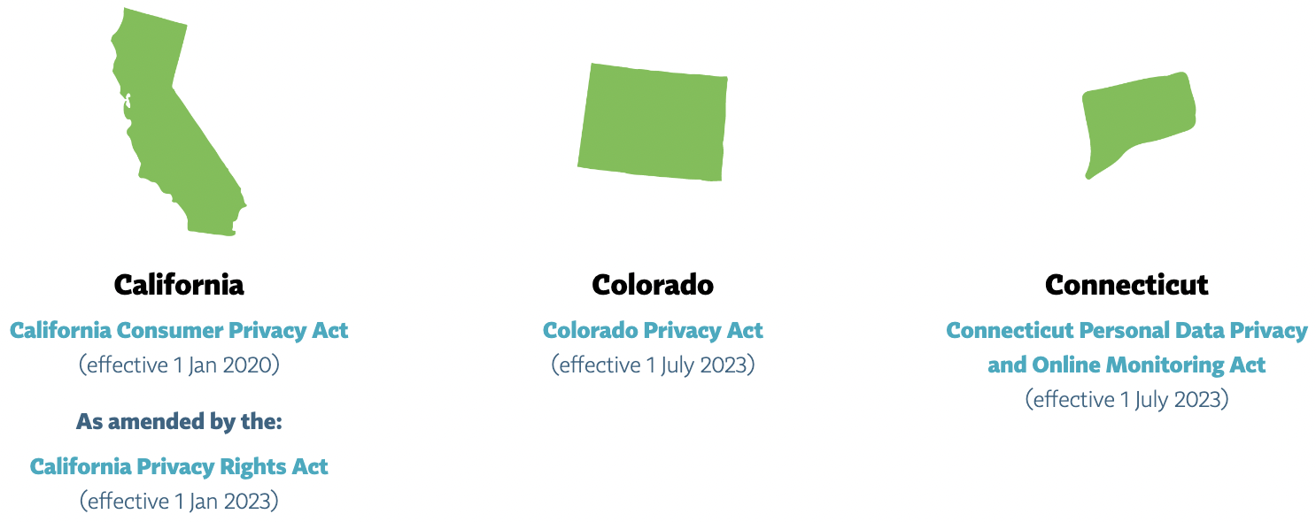

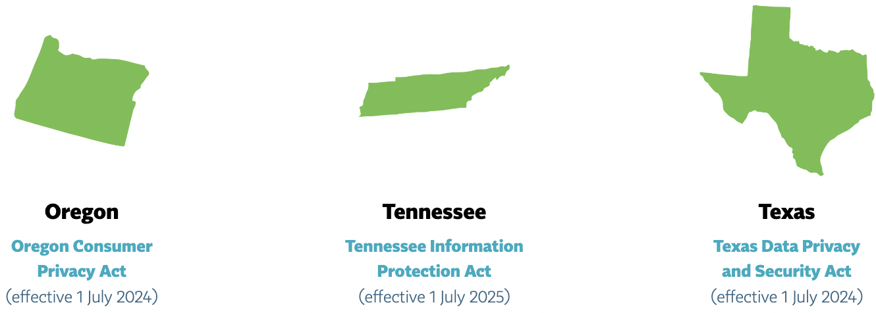
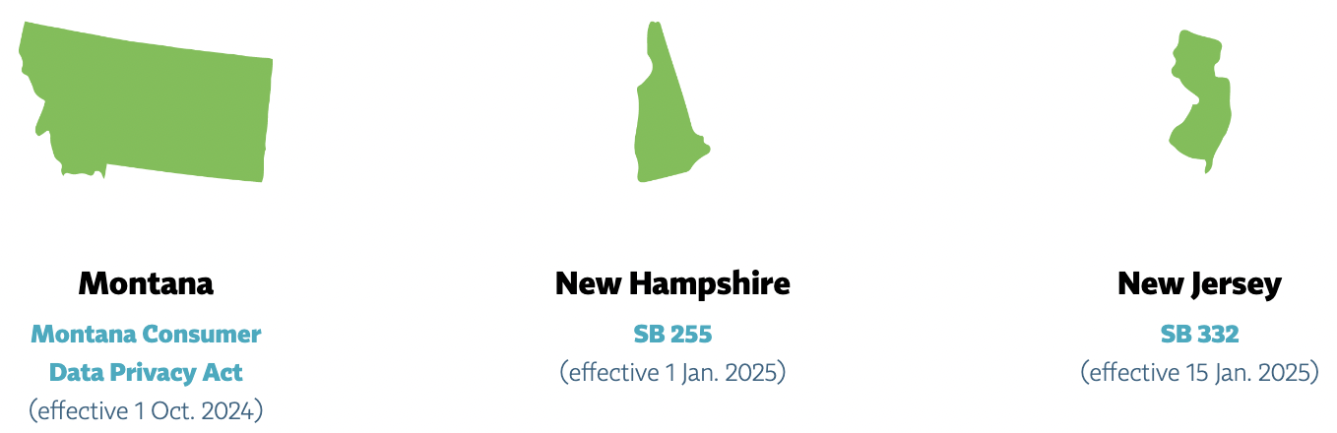
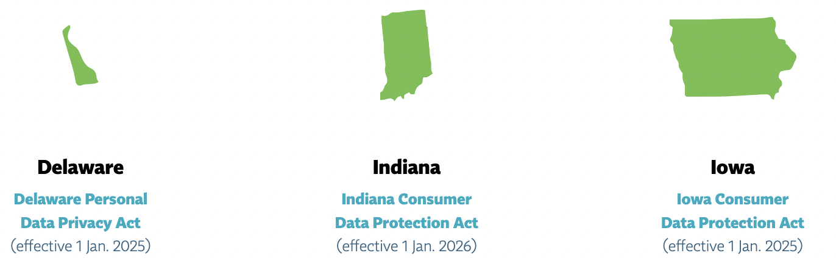
Newly Enhanced Privacy Laws in US States

Slide 8
What is Privacy by Design?

Slide 9
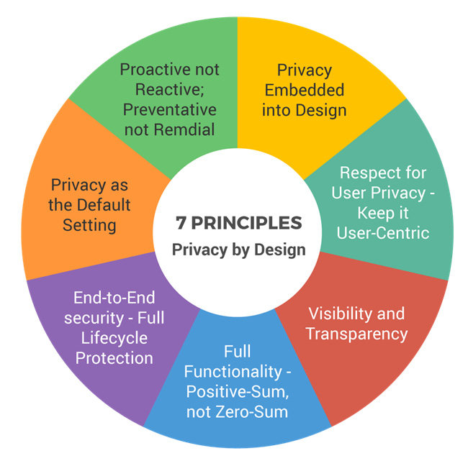
Examples:
Conducting Data Privacy Impact Assessments (DPIAs)
Implementing data minimization and anonymization techniques
Ensuring transparency and obtaining informed consent
Establishing data retention policies
Strengthening cybersecurity measures

Slide 10
What role does identity play at the intersection of data privacy and access control?

Slide 11
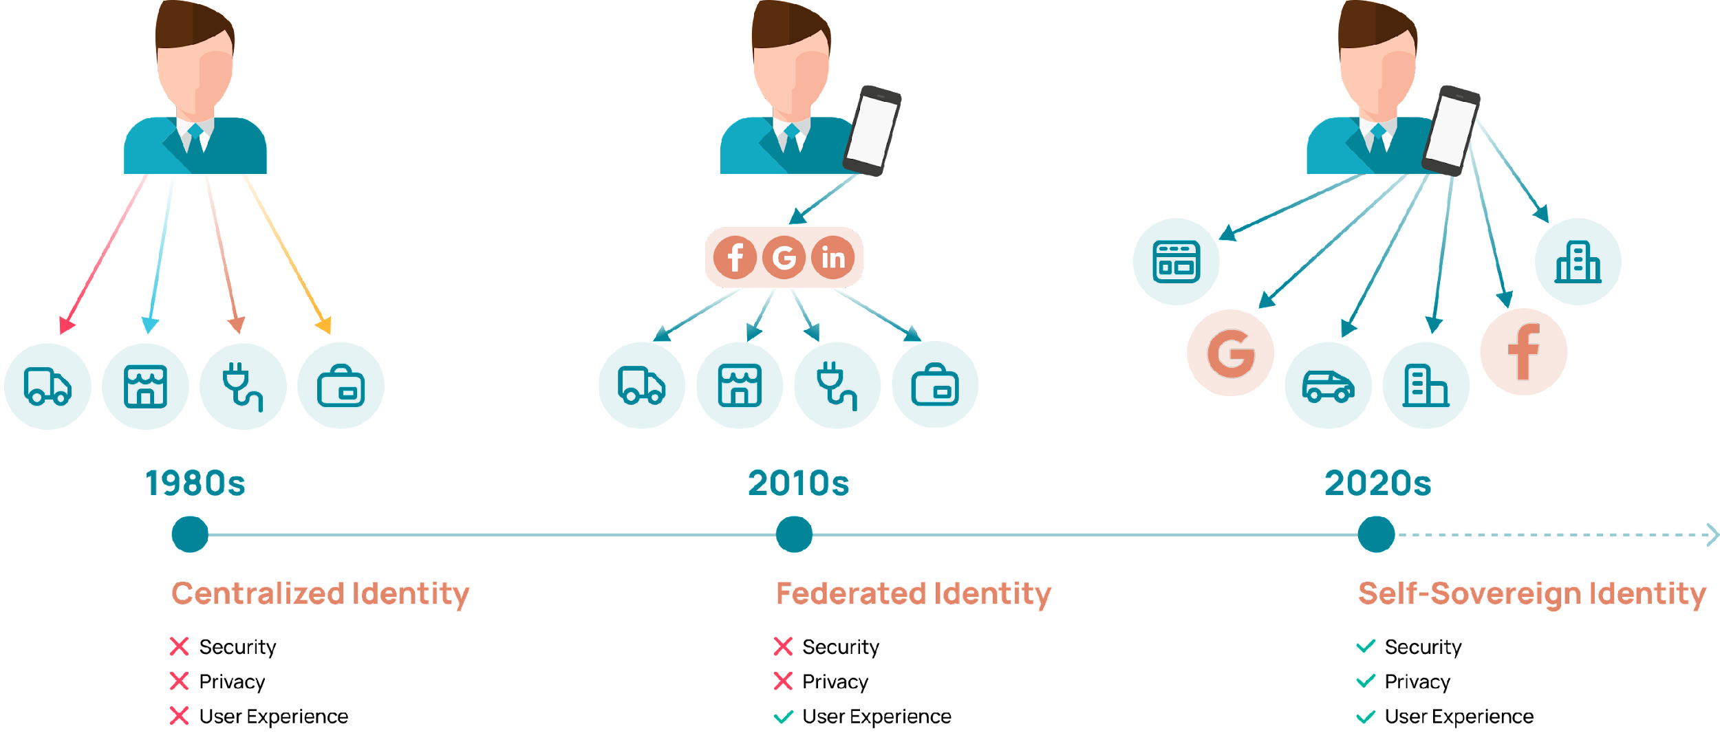
Evolution of Identity

Slide 12
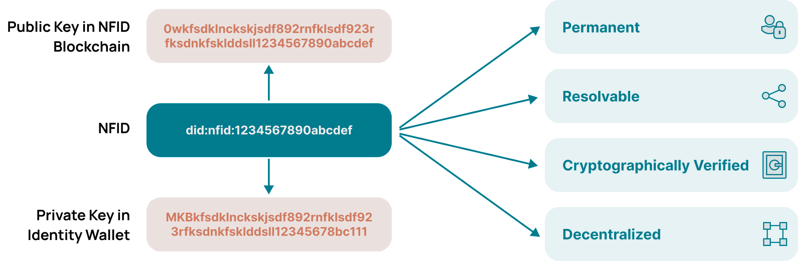
Decentralized Identifiers (DIDs)

Slide 13

Real World Applications?

Slide 14
Want to learn more?
www.nfid.foundation
www.nist.gov/identity-access-management
www.protechtsolutionspartners.com

Slide 15

Q&A
Thank you
Please scan the QR code below to complete our survey and share your thoughts and experiences.

