Slide 1
Lessons from the Frontlines: Cybersecurity Case Studies for the Physical Security World
Will Knehr, Sr Mgr Info Security and Data Privacy, i-PRO Americas

Slide 2

About Me
CyberSecurity at i-PRO Americas
20 years of DoD/NSA Cyber
CISSP, CEH, CASP, SICC, and many other cyber certs
MS Cyber, MBA, and Doctoral Candidate in IT
Primary Hobbies – Cars, Motorcycles, Home Rehab, and just about any hands on projects

Slide 3
Attack statistics in IoT, IioT, and OT
In 2023, there was a 400% increase in malware attacks on IoT and OT systems compared to the previous year. with manufacturing being the most attacked sector, accounting for 54.5% of all attacks.
A 2024 report revealed that 80% of attacks on operational technology (OT) infrastructure had physical consequences, with ransomware being the predominant method.
The United States and Mexico were the top two countries targeted in IoT/OT attacks in 2023, responsible for almost 70% of all malware activity. This geographical concentration emphasizes the vulnerability of North American infrastructure to these types of threats​

Slide 4
Attack vectors in IoT, IioT, and OT
Unpatched Vulnerabilities. In 2023, 34 out of 39 popular IoT exploits were more than three years old
Weak Authentication and Default Credentials. Many devices use weak authentication mechanisms or are left with factory-default usernames and passwords (e.g., "admin" or "1234").
Insecure Communication Protocols. Common communication protocols like MQTT, CoAP, and HTTP may lack encryption, making it easy for attackers to eavesdrop on or manipulate data in transit.
Remote Access Exploitation. Remote access tools are essential for managing OT environments, but they also introduce security risks.

Slide 5
Let’s get technical – What's under the hood
Kernels:
  Linux (Ubuntu Core, Yocto Project)RTOS (FreeRTOS, Zephyr)VxWorks (Used in critical infrastructure)
Software Platforms:
  EdgeX Foundry (IoT Edge Computing)Azure IoT Edge, AWS IoT Greengrass (Cloud Integration)Siemens MindSphere (Industrial IoT)
APIs:
  Azure IoT Hub, AWS IoT APIs (Device Management)OPC UA (Secure Data Exchange for OT/IIoT)
Applications:
  SCADA Systems (Ignition, Wonderware)Manufacturing Platforms (ThingWorx, GE Predix)MQTT Brokers (Mosquitto, HiveMQ)

Slide 6
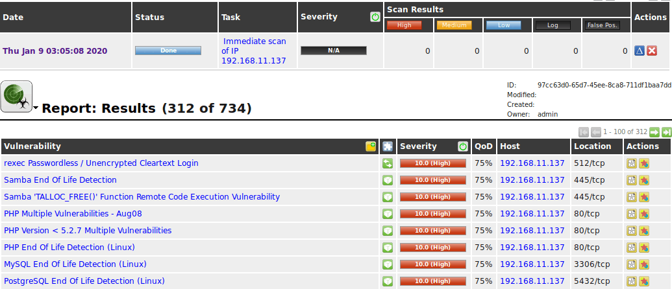

Slide 7
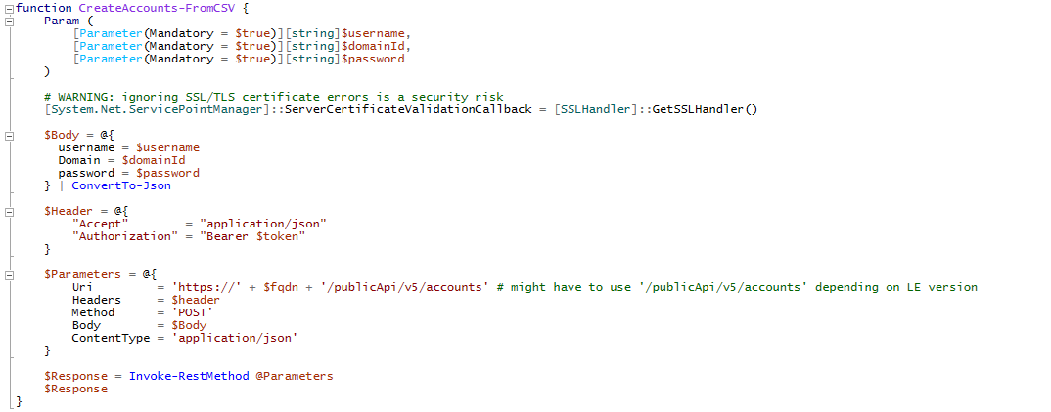





Slide 8
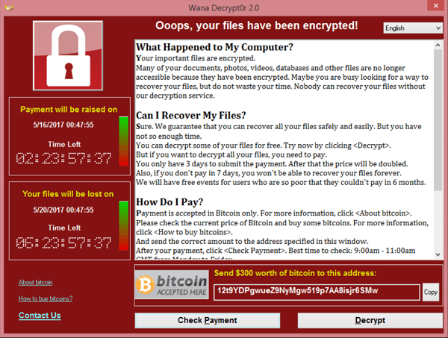
Ransomware Windows

Slide 9
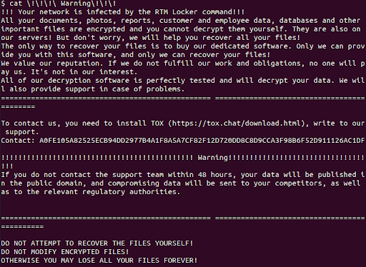
Ransomware Linux

Slide 10
How do hackers find these devices
Shodan & Censys:
  Search engines that scan and index internet-connected devices.
Unsecured Ports & Protocols:
  Scanning tools (e.g., Nmap) find devices with open ports using weak protocols like Telnet/HTTP.
Default Credentials:
  Many devices use default usernames and passwords (e.g., "admin"), making them easy to exploit.
Unpatched Vulnerabilities:
  Outdated firmware with known vulnerabilities (e.g., CVEs) are prime targets.
Exposed APIs:
  Hackers can access devices via unsecured or poorly configured management APIs.
Supply Chain Compromise:
  Devices may be infected during manufacturing or shipping with backdoors.
Social Engineering:
  Phishing and compromised remote access tools provide access to networks.

Slide 11
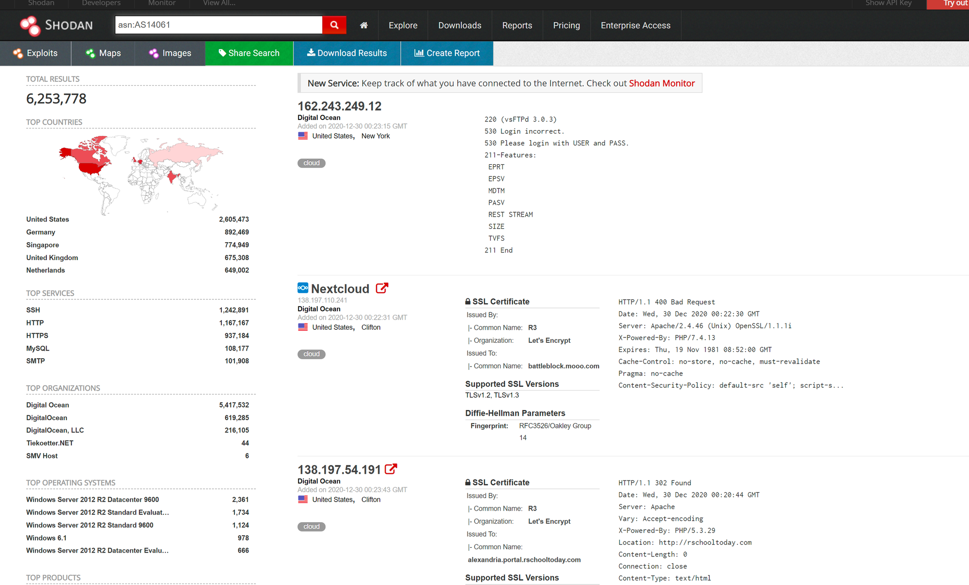
Notes:
Autonomous Systems number for Digital Ocean – cloud infrastructure for developers used by many IIoT/OT developers

Slide 12
Why target these devices
Easy Access: Many devices use default credentials or weak security, making them easy to compromise.
High Impact: Compromising critical infrastructure (e.g., factories, energy grids) can cause significant operational disruption.
Lateral Movement: Once inside, attackers can move from less secure IoT/IIoT devices to critical OT systems.
Data Theft: Devices collect valuable data (e.g., sensor data, video feeds) that can be stolen or sold.
Botnets: Compromised devices can be used in botnets for DDoS attacks (e.g., Mirai).
Ransomware: Ransomware attacks on OT can cripple operations, forcing victims to pay.
Sometimes just because…

Slide 13
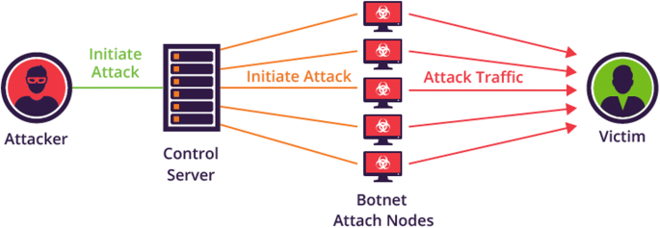
Mirai Botnet

Slide 14
Mirai Botnet
Attack Type: Distributed Denial of Service (DDoS) using compromised IoT devices.
How It Worked: The Mirai malware scanned the internet for IoT devices (cameras, routers) using default credentials (e.g., "admin" and "password"). Once infected, these devices formed a massive botnet capable of launching DDoS attacks.
Target: Major websites and services, including Twitter, Netflix, and Reddit.
Impact: One of the largest DDoS attacks in history, causing widespread service outages across popular websites and highlighting the risks of unsecured IoT devices.
Motivation: Primarily financial gain for the creators through rented botnet services; also targeted specific services for disruption.
Takeaway: Change default credentials on all IoT devices, implement strong password policies, and monitor network traffic for unusual activity to prevent IoT devices from being hijacked.

Slide 15
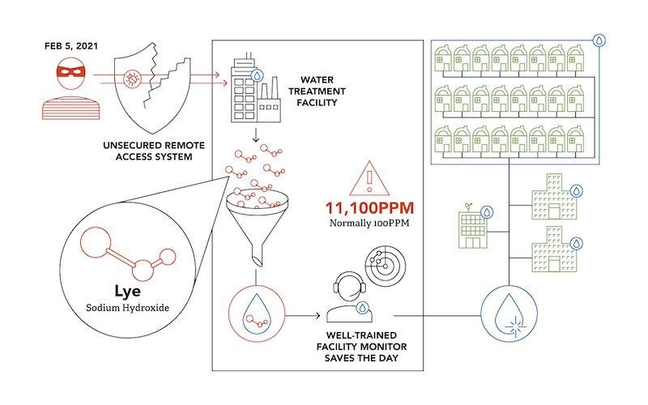

Slide 16
Oldsmar Water Treatment Plant
Attack Type: Unauthorized remote access to an operational technology (OT) system.
How It Worked: Attackers exploited weak security measures, including the use of outdated software and shared passwords, to gain remote access to the water treatment plant's control system. They attempted to increase the sodium hydroxide (lye) concentration in the water supply to dangerous levels.
Target: The water treatment facility in Oldsmar, Florida, serving approximately 15,000 residents.
Impact: The malicious changes were quickly detected and reversed by an alert operator, preventing harm. However, the incident exposed significant vulnerabilities in critical infrastructure systems.
Motivation: The exact motivation remains unclear, but the attack underscores the potential for cyber threats to public health and safety.
Takeaway: Implement robust cybersecurity practices for critical infrastructure, including updating software, enforcing strong password policies, and restricting remote access to essential personnel only.

Slide 17
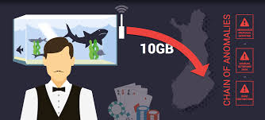
Notes:
Pokemen Ekans

Slide 18
Casino Data Breach via IoT Thermometer
Attack Type: Unauthorized access through an IoT device (smart thermometer).
How It Worked: Attackers accessed the casino’s network through a vulnerable smart thermometer in a fish tank, which was connected to the casino’s main network. Once inside, they moved across systems to reach and exfiltrate the high-roller database.
Target: A North American casino’s network, targeting sensitive customer data.
Impact: The breach exposed sensitive information from the casino’s high-roller database, demonstrating how even non-traditional IoT devices can be exploited for data theft.
Motivation: Likely financial gain from accessing and potentially selling high-value customer data.
Takeaway: Segment IoT devices from critical networks, use strict access controls, and apply strong security practices to seemingly harmless devices like thermostats.

Slide 19

Notes:
Aimed at Critical Infrastructure

Slide 20
Flipper Zero Access Control Attacks
Attack Type: Unauthorized access using radio frequency (RF) replay attacks.
How It Works: The Flipper Zero is a versatile hacking tool that can intercept, store, and replay RF signals. Attackers can use it to clone key fobs or access cards by capturing their signals and then replaying them to gain unauthorized entry.
Target: Access control systems that use RF-based key fobs or proximity cards for entry, particularly those without encryption or signal protection.
Impact: Allows attackers to bypass physical security by replicating or replaying RF access credentials, leading to unauthorized entry and potential security breaches.
Motivation: Gaining unauthorized physical access for theft, espionage, or other malicious intents.
Takeaway: Use encrypted access control systems with rolling codes or MFA to defend against replay attacks. Educate security teams on the risks of RF-based attacks.

Slide 21
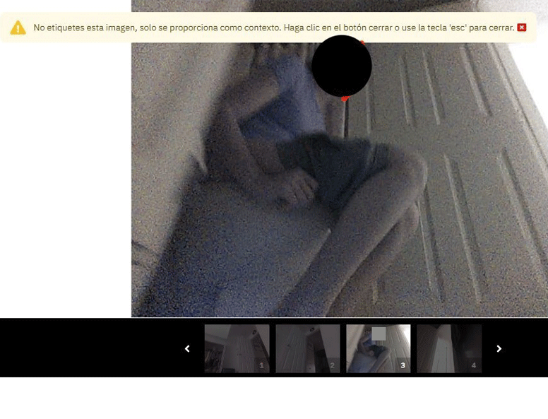
Notes:
Taken from a smart vacuum

Slide 22


Slide 23
Unsecured Camera Feed – Voyeurism Attack
Attack Type: Unauthorized access to unsecured camera feeds.
How It Works: Many security cameras are left unsecured, transmitting video feeds without encryption or protection. Attackers can use simple online tools to find these feeds or exploit default credentials to view live footage, often with voyeuristic intentions.
Target: IP security cameras, baby monitors, and other networked cameras, especially those with default credentials or lacking encryption.
Impact: Exposure of private and sensitive footage, leading to privacy violations and potentially dangerous breaches of personal or corporate security.
Motivation: Voyeurism, espionage, or gathering information for malicious purposes.
Takeaway: Encrypt camera feeds to prevent interception, change default passwords, and restrict remote access with multi-factor authentication (MFA). Regularly audit and monitor camera networks for unauthorized access.

Slide 24
How to protect and defend
Network Segmentation: Isolate IT and OT networks to prevent lateral movement of ransomware.
Regular Patching: Keep all IoT, IIoT, and OT devices updated with the latest security patches and firmware.
Multi-Factor Authentication (MFA): Implement MFA for critical systems, especially remote access tools.
Backup and Recovery: Regularly back up OT systems and test recovery plans to ensure quick restoration.
Access Control: Limit privileges and enforce strong password policies, especially for devices with default credentials.
Security Monitoring: Use intrusion detection systems (e.g., Security Onion or Wazuh) to monitor for anomalies in OT traffic.
Incident Response Plan: Develop a ransomware-specific response plan and train teams with tabletop exercises.

Slide 25

Q&A
Thank you
Please scan the QR code below to complete our survey and share your thoughts and experiences.

