Slide 1
Ransomware Goes Physical: How Cyber Threats Can Disrupt Facilities and Critical Systems
Will Knehr, Sr Mgr Info Security and Data Privacy, i-PRO Americas

Slide 2

About Me
CyberSecurity at i-PRO Americas
20 years of DoD/NSA Cyber
CISSP, CEH, CASP, SICC, and many other cyber certs
MS Cyber, MBA, and Doctoral Candidate in IT
Primary Hobbies – Cars, Motorcycles, Home Rehab, and just about any hands on projects

Slide 3
Attack statistics in IoT, IioT, and OT
In 2023, there was a 400% increase in malware attacks on IoT and OT systems compared to the previous year. with manufacturing being the most attacked sector, accounting for 54.5% of all attacks.
A 2024 report revealed that 80% of attacks on operational technology (OT) infrastructure had physical consequences, with ransomware being the predominant method.
The United States and Mexico were the top two countries targeted in IoT/OT attacks in 2023, responsible for almost 70% of all malware activity. This geographical concentration emphasizes the vulnerability of North American infrastructure to these types of threats​

Slide 4
Attack vectors in IoT, IioT, and OT
Unpatched Vulnerabilities. In 2023, 34 out of 39 popular IoT exploits were more than three years old
Weak Authentication and Default Credentials. Many devices use weak authentication mechanisms or are left with factory-default usernames and passwords (e.g., "admin" or "1234").
Insecure Communication Protocols. Common communication protocols like MQTT, CoAP, and HTTP may lack encryption, making it easy for attackers to eavesdrop on or manipulate data in transit.
Remote Access Exploitation. Remote access tools are essential for managing OT environments, but they also introduce security risks.

Slide 5
Let’s get technical – What's under the hood
Kernels:
  Linux (Ubuntu Core, Yocto Project)RTOS (FreeRTOS, Zephyr)VxWorks (Used in critical infrastructure)
Software Platforms:
  EdgeX Foundry (IoT Edge Computing)Azure IoT Edge, AWS IoT Greengrass (Cloud Integration)Siemens MindSphere (Industrial IoT)
APIs:
  Azure IoT Hub, AWS IoT APIs (Device Management)OPC UA (Secure Data Exchange for OT/IIoT)
Applications:
  SCADA Systems (Ignition, Wonderware)Manufacturing Platforms (ThingWorx, GE Predix)MQTT Brokers (Mosquitto, HiveMQ)

Slide 6
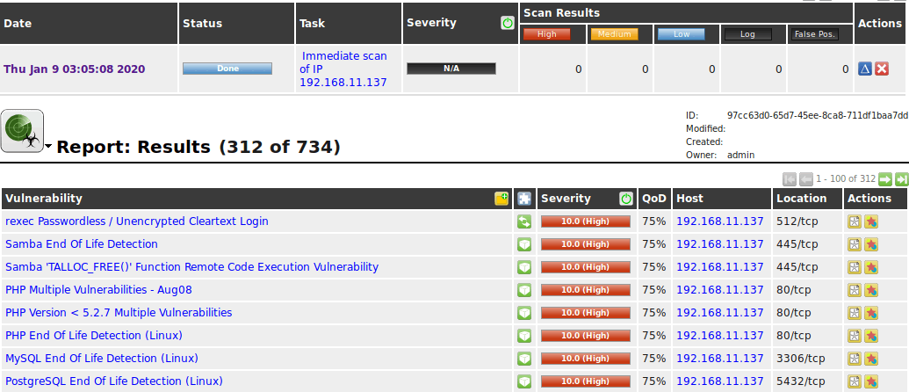

Slide 7
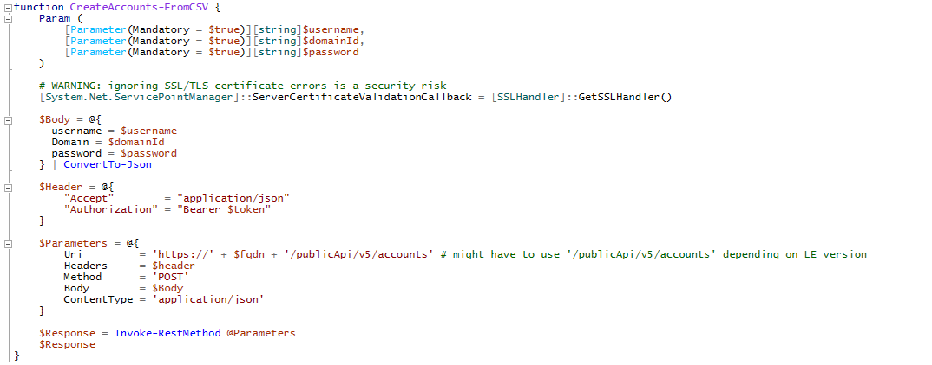





Slide 8
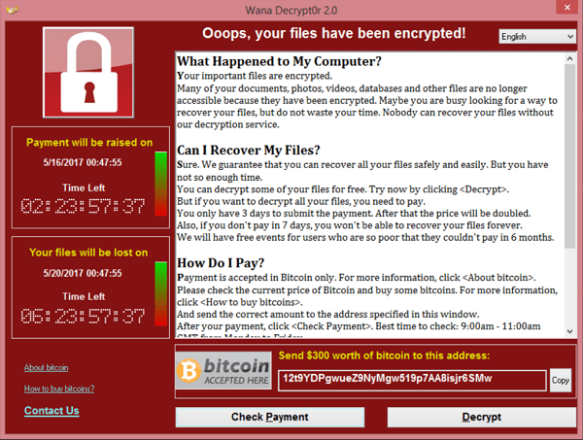
Ransomware Windows

Slide 9
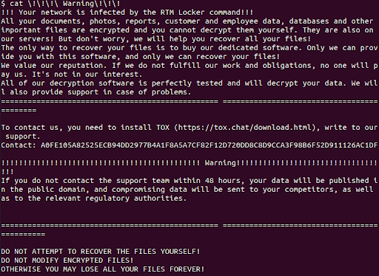
Ransomware Linux

Slide 10
How do hackers find these devices
Shodan & Censys:
  Search engines that scan and index internet-connected devices.
Unsecured Ports & Protocols:
  Scanning tools (e.g., Nmap) find devices with open ports using weak protocols like Telnet/HTTP.
Default Credentials:
  Many devices use default usernames and passwords (e.g., "admin"), making them easy to exploit.
Unpatched Vulnerabilities:
  Outdated firmware with known vulnerabilities (e.g., CVEs) are prime targets.
Exposed APIs:
  Hackers can access devices via unsecured or poorly configured management APIs.
Supply Chain Compromise:
  Devices may be infected during manufacturing or shipping with backdoors.
Social Engineering:
  Phishing and compromised remote access tools provide access to networks.

Slide 11
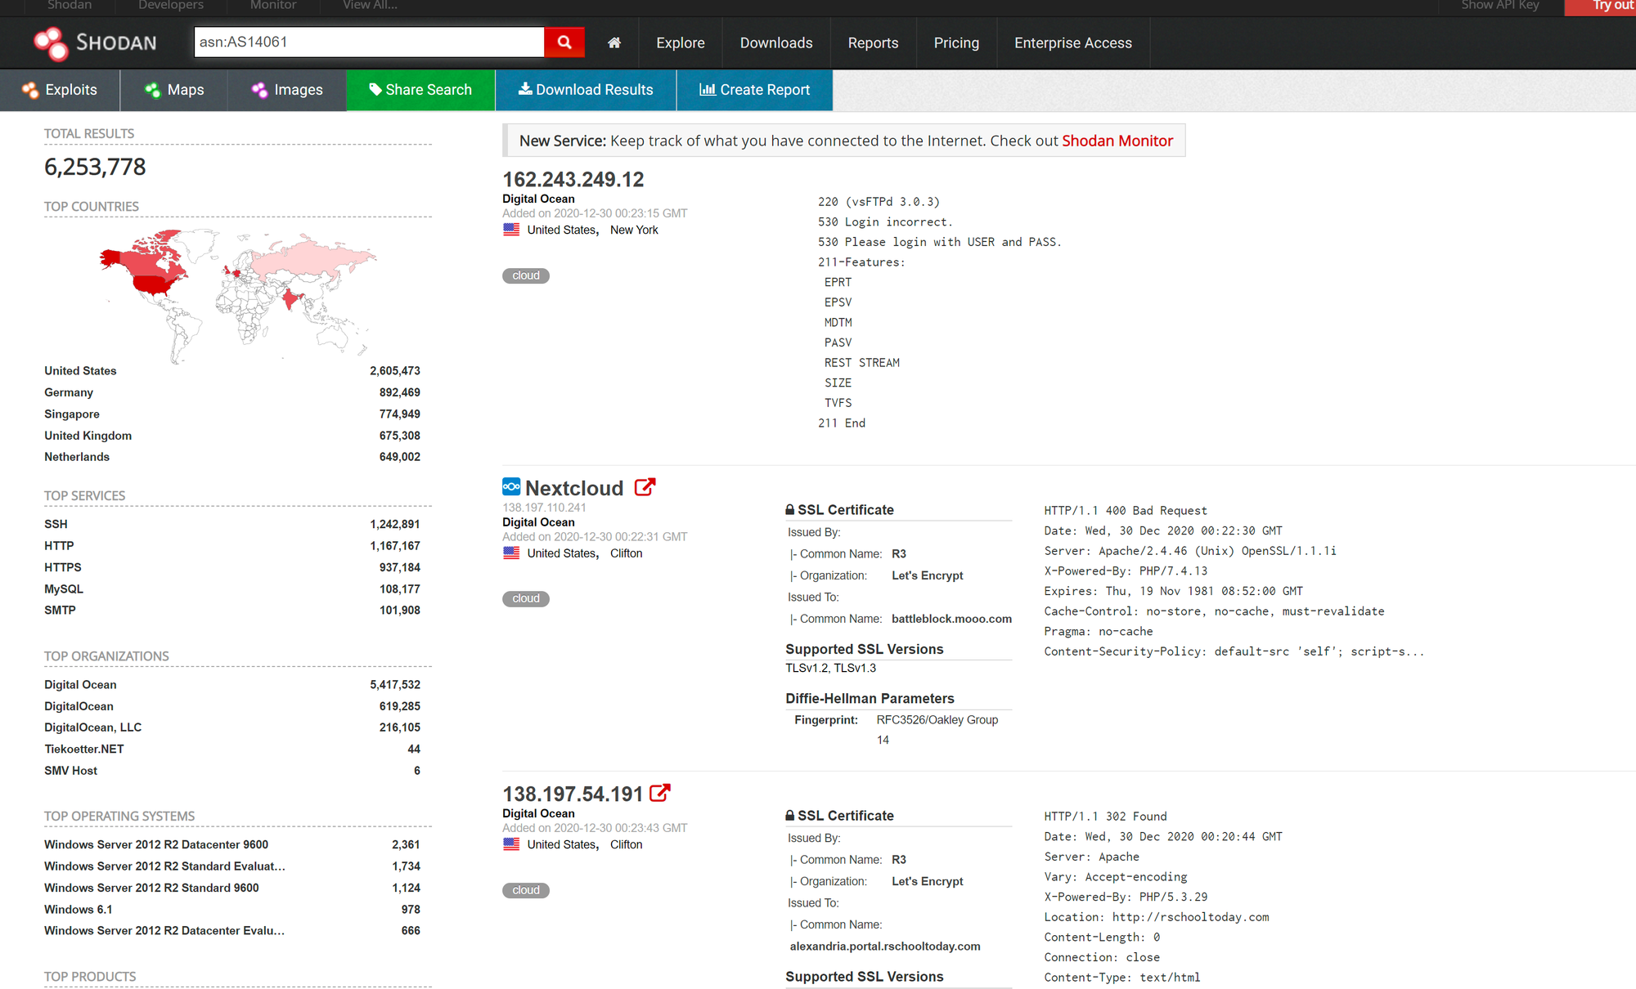
Notes:
Autonomous Systems number for Digital Ocean – cloud infrastructure for developers used by many IIoT/OT developers

Slide 12
Why target these devices
Easy Access: Many devices use default credentials or weak security, making them easy to compromise.
High Impact: Compromising critical infrastructure (e.g., factories, energy grids) can cause significant operational disruption.
Lateral Movement: Once inside, attackers can move from less secure IoT/IIoT devices to critical OT systems.
Data Theft: Devices collect valuable data (e.g., sensor data, video feeds) that can be stolen or sold.
Botnets: Compromised devices can be used in botnets for DDoS attacks (e.g., Mirai).
Ransomware: Ransomware attacks on OT can cripple operations, forcing victims to pay.
Sometimes just because…

Slide 13


Slide 14
Cases - Honda
Attack Type: Ransomware targeting IIoT systems.
How It Worked: Attackers leveraged the Snake (Ekans) ransomware variant to impact Honda's global production network, including IIoT systems used for automation and manufacturing.
Target: Honda's manufacturing plants, disrupting car production across North America, Japan, Europe, and other regions.
Impact: Shutdown of factories, halting production lines, affecting vehicle manufacturing and assembly. The attack also caused delays in customer service and financial systems.
Motivation: Likely financial gain, with the ransom demanded in exchange for system decryption.
Takeaway: The attack highlights the vulnerability of IIoT in industrial environments, showing how a single ransomware infection can halt global production.

Slide 15

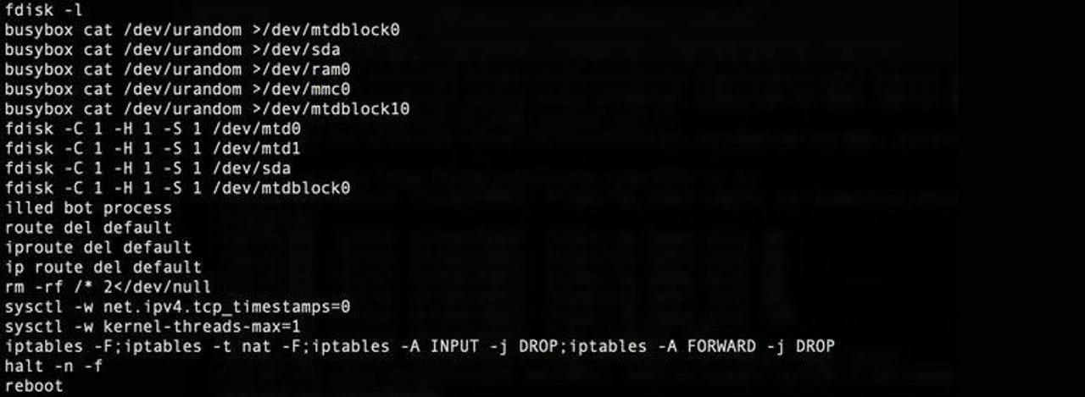

Slide 16
Cases - Silex
Attack Type: Destructive malware targeting IoT devices.
How It Worked: Silex wiped device storage, killed networking stacks, and made devices unrecoverable without a manual reset.
Target: Thousands of IoT devices, including routers, security cameras, and embedded systems.
Motivation: Caused by a 14-year-old hacker aiming to disrupt IoT devices for fun, similar to the BrickerBot attacks.
Impact: Rendered over 2,000 devices unusable within hours, and the attack spread rapidly.
Takeaway: Highlights the vulnerability of IoT devices with default configurations, lack of security patches, and the ease with which destructive attacks can cripple infrastructure.

Slide 17

Notes:
Pokemen Ekans

Slide 18
Cases - Ekans
Attack Type: Ransomware targeting OT systems.
How It Worked: Ekans specifically attacked industrial control systems (ICS), halting operations by killing processes linked to OT environments.
Target: Critical infrastructure like manufacturing plants and energy sectors.
Impact: Shutdown of key industrial processes, causing major operational disruptions.
Motivation: Likely financial gain through ransom demands, with a focus on industries where downtime is costly and urgent restoration is critical.
Key Feature: Designed to disable OT-specific processes, which can endanger production and safety.
Takeaway: Ekans showcases the evolving ransomware threats against both IT and OT systems, highlighting the need for enhanced OT security.

Slide 19
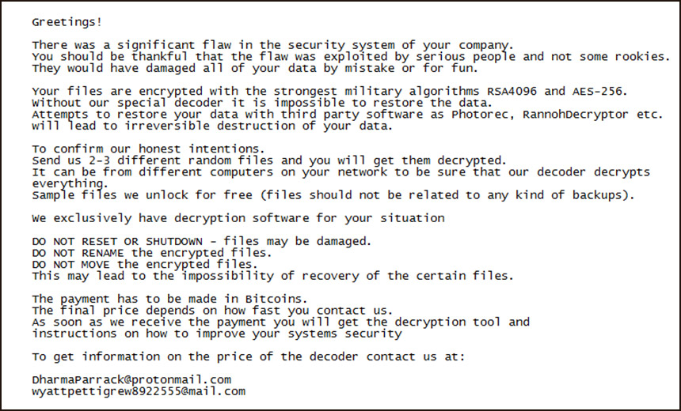
Notes:
Aimed at Critical Infrastructure

Slide 20
Cases – Norsk Hydro
Attack Type: Ransomware targeting IT and OT systems.
How It Worked: LockerGoga ransomware encrypted Norsk Hydro’s systems, impacting both IT operations and manufacturing processes across 170 locations in 40 countries.
Target: Global aluminum production and energy plants, affecting both administrative and operational systems.
Impact: Forced shutdown of automated production lines, transitioning to manual operations for days. Estimated losses of over $70 million.
Motivation: Financial gain through ransom demands, though Norsk Hydro refused to pay.
Takeaway: The attack shows how ransomware can cripple critical infrastructure, halting industrial production and causing significant financial losses.

Slide 21


Slide 22
Case Study: Romantik Seehotel Jaegerwirt
Attack Type: Ransomware targeting access control systems.
How It Worked: Hackers encrypted the hotel’s electronic key card system, locking guests out of their rooms and preventing new keycards from being issued.
Target: Luxury hotel in Austria, affecting both guest services and the booking system.
Impact: The hotel paid a ransom to regain access and restore operations, but the incident disrupted customer experience and caused operational delays.
Motivation: Financial gain through ransom demand.
Takeaway: Highlights the vulnerability of IoT-enabled systems (like electronic locks) and the real-world impact of ransomware on hospitality services.

Slide 23
How to protect and defend
Network Segmentation: Isolate IT and OT networks to prevent lateral movement of ransomware.
Regular Patching: Keep all IoT, IIoT, and OT devices updated with the latest security patches and firmware.
Multi-Factor Authentication (MFA): Implement MFA for critical systems, especially remote access tools.
Backup and Recovery: Regularly back up OT systems and test recovery plans to ensure quick restoration.
Access Control: Limit privileges and enforce strong password policies, especially for devices with default credentials.
Security Monitoring: Use intrusion detection systems (e.g., Security Onion or Wazuh) to monitor for anomalies in OT traffic.
Incident Response Plan: Develop a ransomware-specific response plan and train teams with tabletop exercises.

Slide 24

Q&A
Thank you
Please scan the QR code below to complete our survey and share your thoughts and experiences.

