Slide 1
No Standards, No Problem!
Embracing Interoperability in Commercial Real Estate Access Solutions
Andrew Campagnola, Former VP of Strategic Security Initiatives
Chris Wilson, Security Technology Consultant, Mead & Hunt
Tristin Vaccaro, Owner, Vaccaro Copywriting & Marketing Solutions

Slide 2
Introduction of Speakers

Slide 3
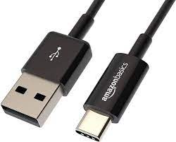
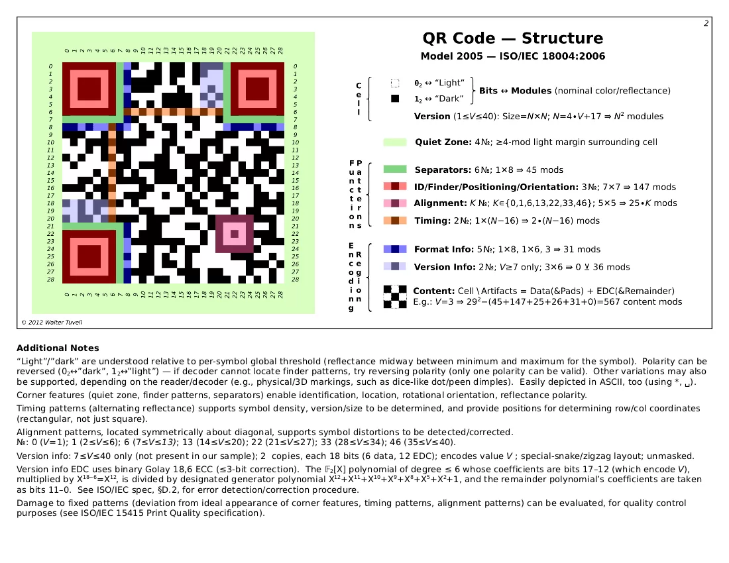
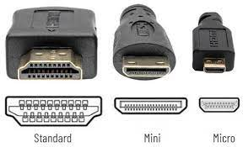
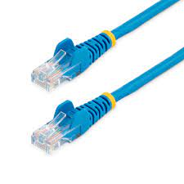



Standards and Interoperability

Slide 4
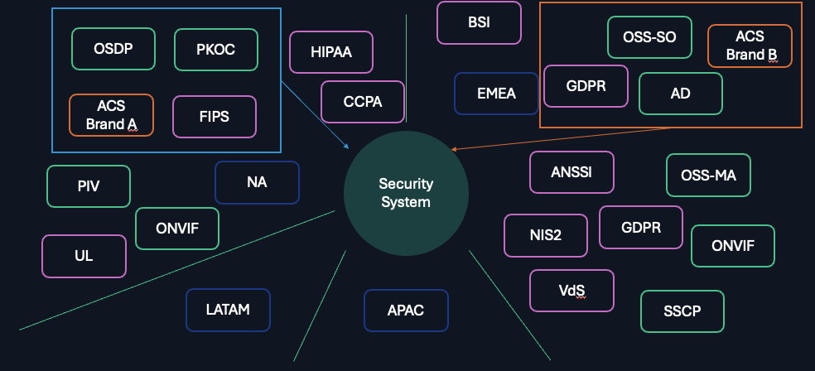
RFP Compliance
Notes:
What are the primary challenges you've encountered when integrating access control systems across multiple properties that use different standards?

Slide 5
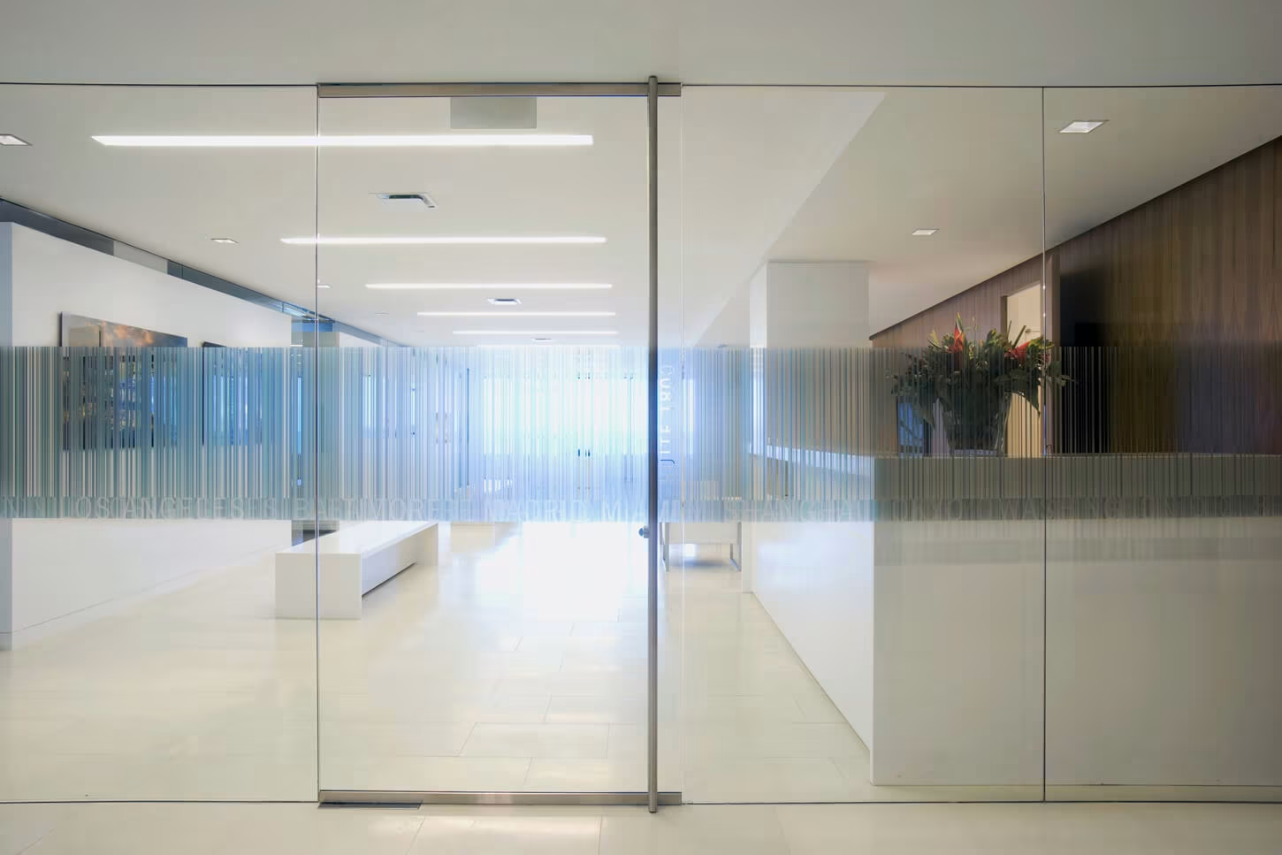
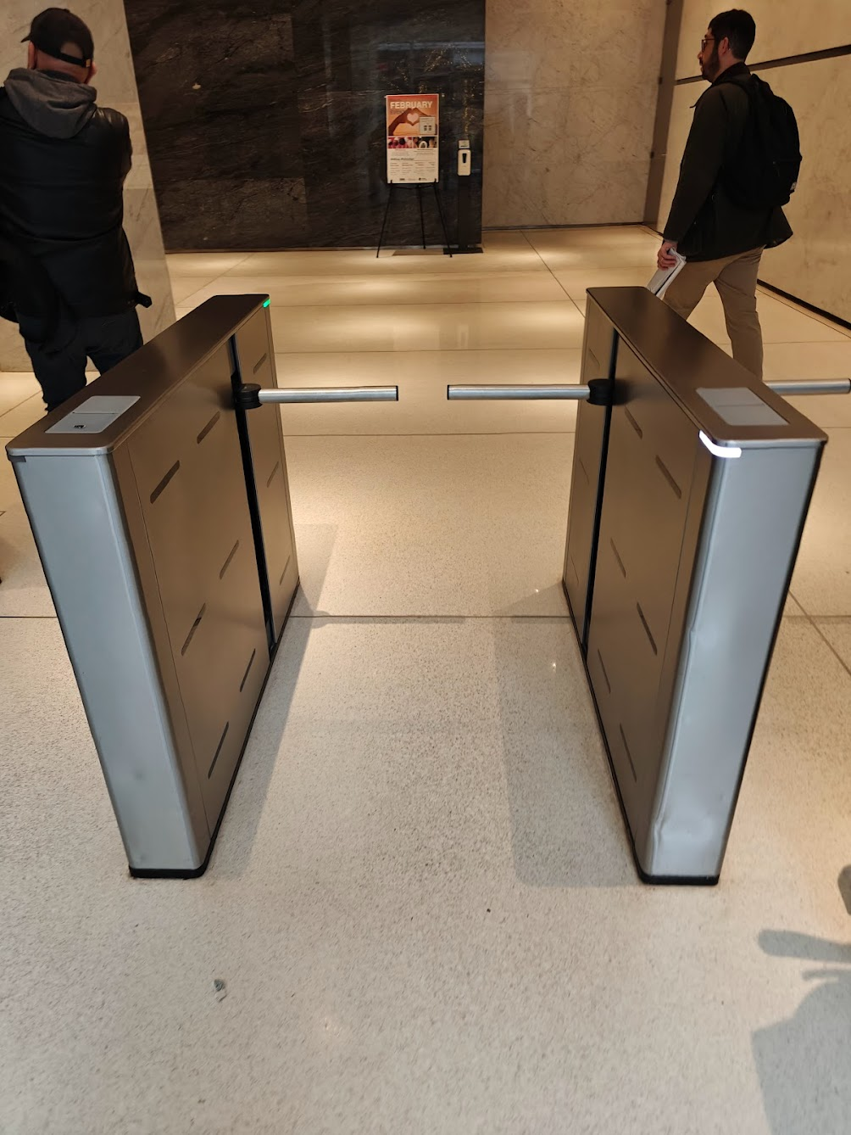
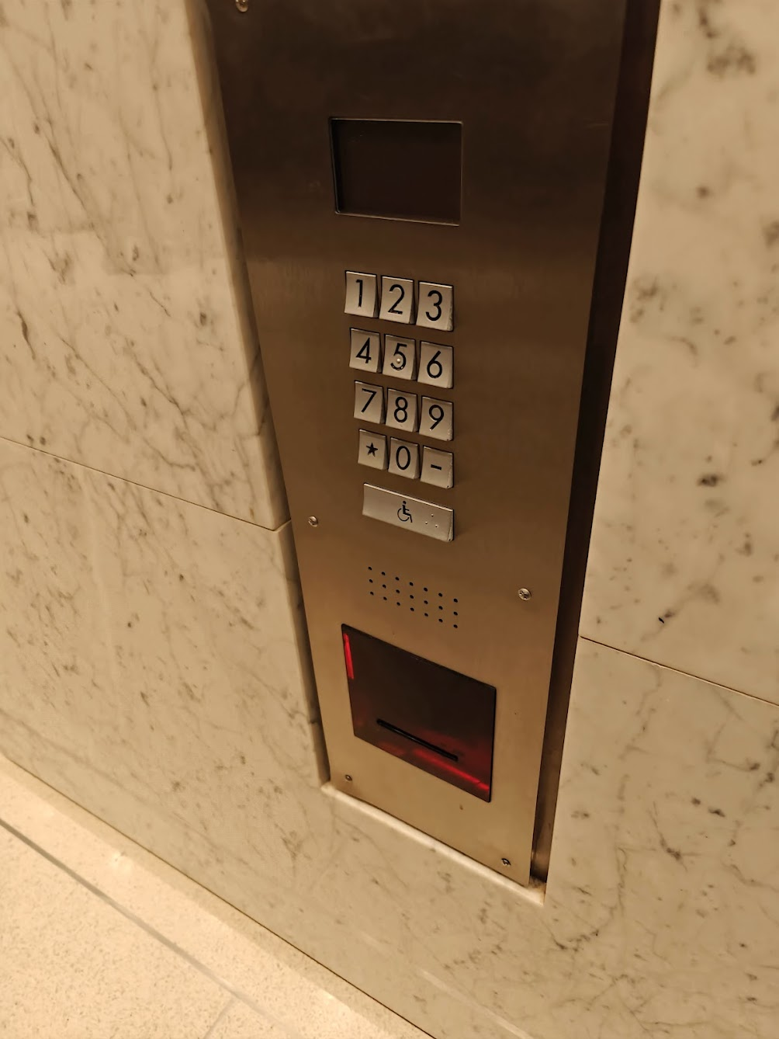
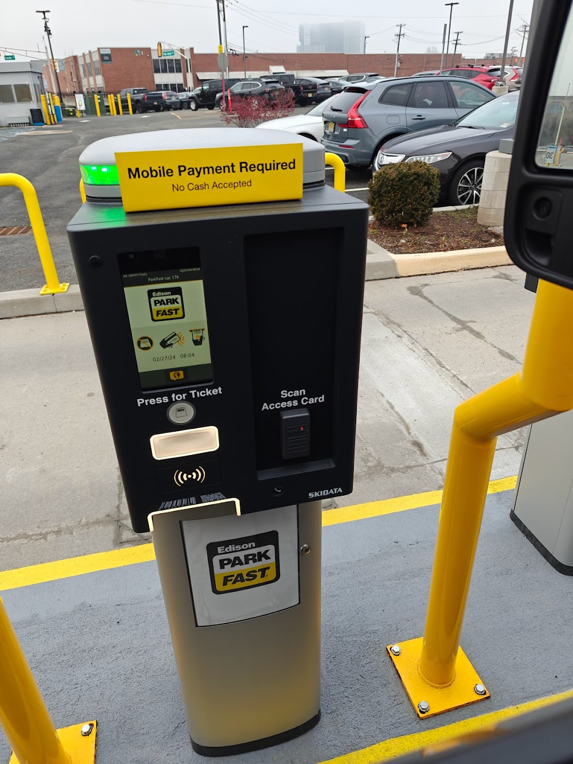
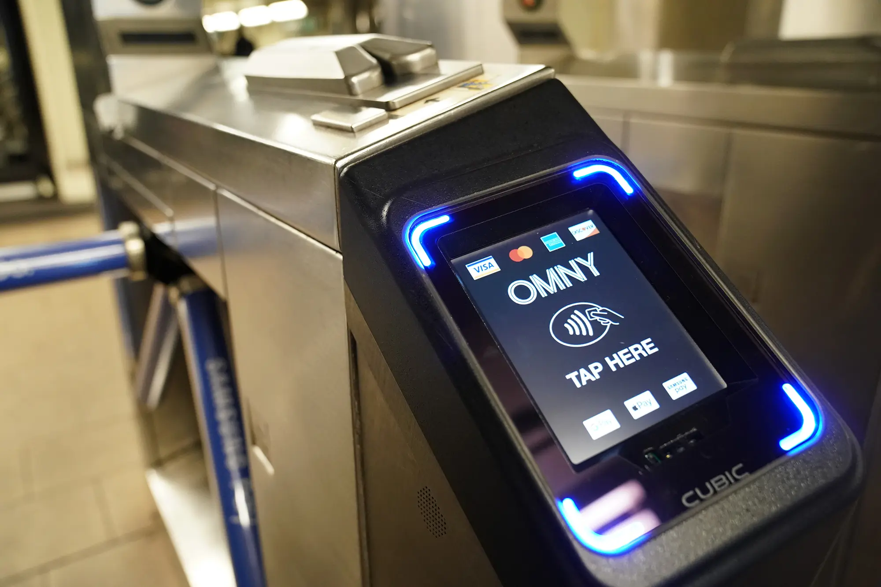
A Typical Commuter Journey
Tenant/Resident Owned
Tenant spaces that only employees, their visitors, and contractor access. Could be a system that spans multiple geographic locations.
Base Building
These are common use areas that all people in a building will flow through.
PM Employees
Tenants
Residents
Contractors
Visitors
Public Transit/ Private Parking Garage
Either controlled by the Base Building, private third party, or a government run program.
Notes:
What does the term 'street to suite' access mean to you, and what are the critical components of achieving this vision in a commercial building?
How do you present the long-term value of integrated access solutions to property owners and management companies, especially when dealing with up-front costs?
What strategies have you found effective in getting buy-in from multiple stakeholders (tenants, property owners, management) when proposing a unified access solution?

Slide 6


Bridging the Gap
Single Stack Solution
PACS 1
By using a vendor throughout the entire space circumvents the need for an interoperable system.
However, this very unlikely to be accomplished outside of a lab environment
(Physical Identity Access Management) systems allow multiple disparate systems to share data and give the illusion of interoperability
Mobile credentials ARE NOT NEW. Many vendors have solutions that are locked-in to their ecosystem.
PACS 2
PIAM
PACS 3
Mobile Credentials that are Vendor/PACS Agnostic
PIAM Solutions
PACS 4
Notes:
What role do mobile credentials, cloud solutions, or other emerging technologies play in facilitating this 'street to suite' integration?
In what ways can data from access control systems be used to demonstrate ROI to potential clients?
How can open standards help bridge the gap between proprietary systems and create a more seamless experience?
How does improving the access experience contribute to increasing property value from the perspective of real estate stakeholders?

Slide 7
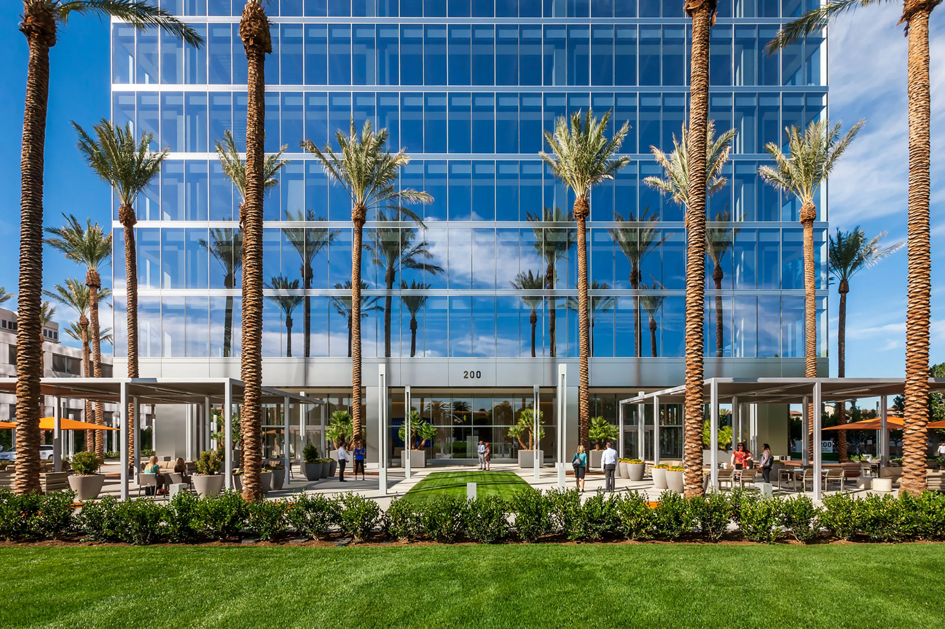
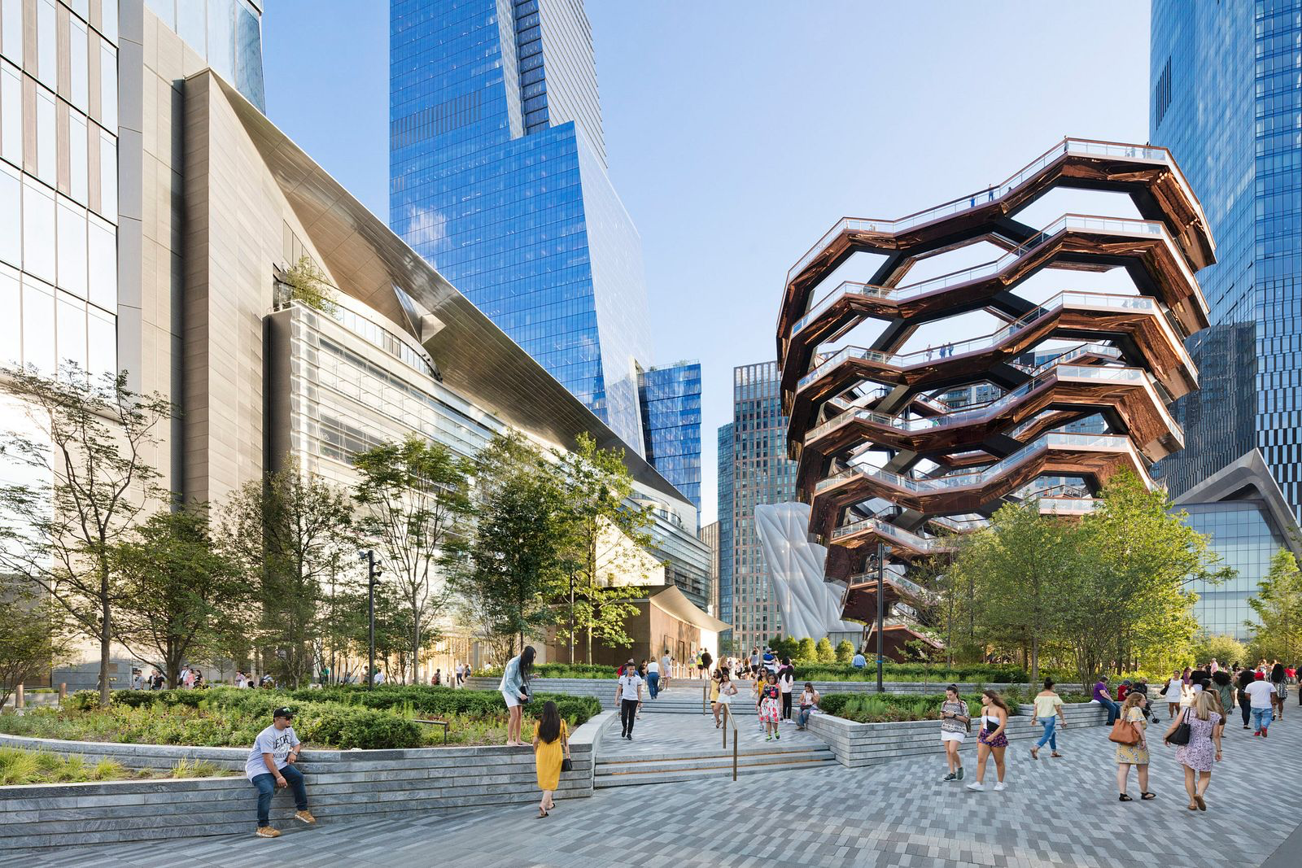
Use Cases
Large National CRE Owner
Iconic NYC Experience Center
125+ Apartment Communities | 65,000+ Apartment Homes
590+ Office Buildings | 40+ Retail Centers
9 Mixed Use Entertainment Venues
Notes:
Can you share an example of a successful integration where disparate systems were made to work together, and what factors led to that success?
In cases where full interoperability isn't possible, what are some effective workarounds or partial solutions that still enhance user experience?
Can you describe a situation where seamless integration of access control improved tenant satisfaction, and what was the impact on property management?

Slide 8
Q/A

Slide 9

Thank you
Please scan the QR code below to complete our survey and share your thoughts and experiences.

