Slide 1
Emerging Technologies That Reshape the Role of an Integrator
Tom LeBlanc, Executive Director, NSCA

Slide 2
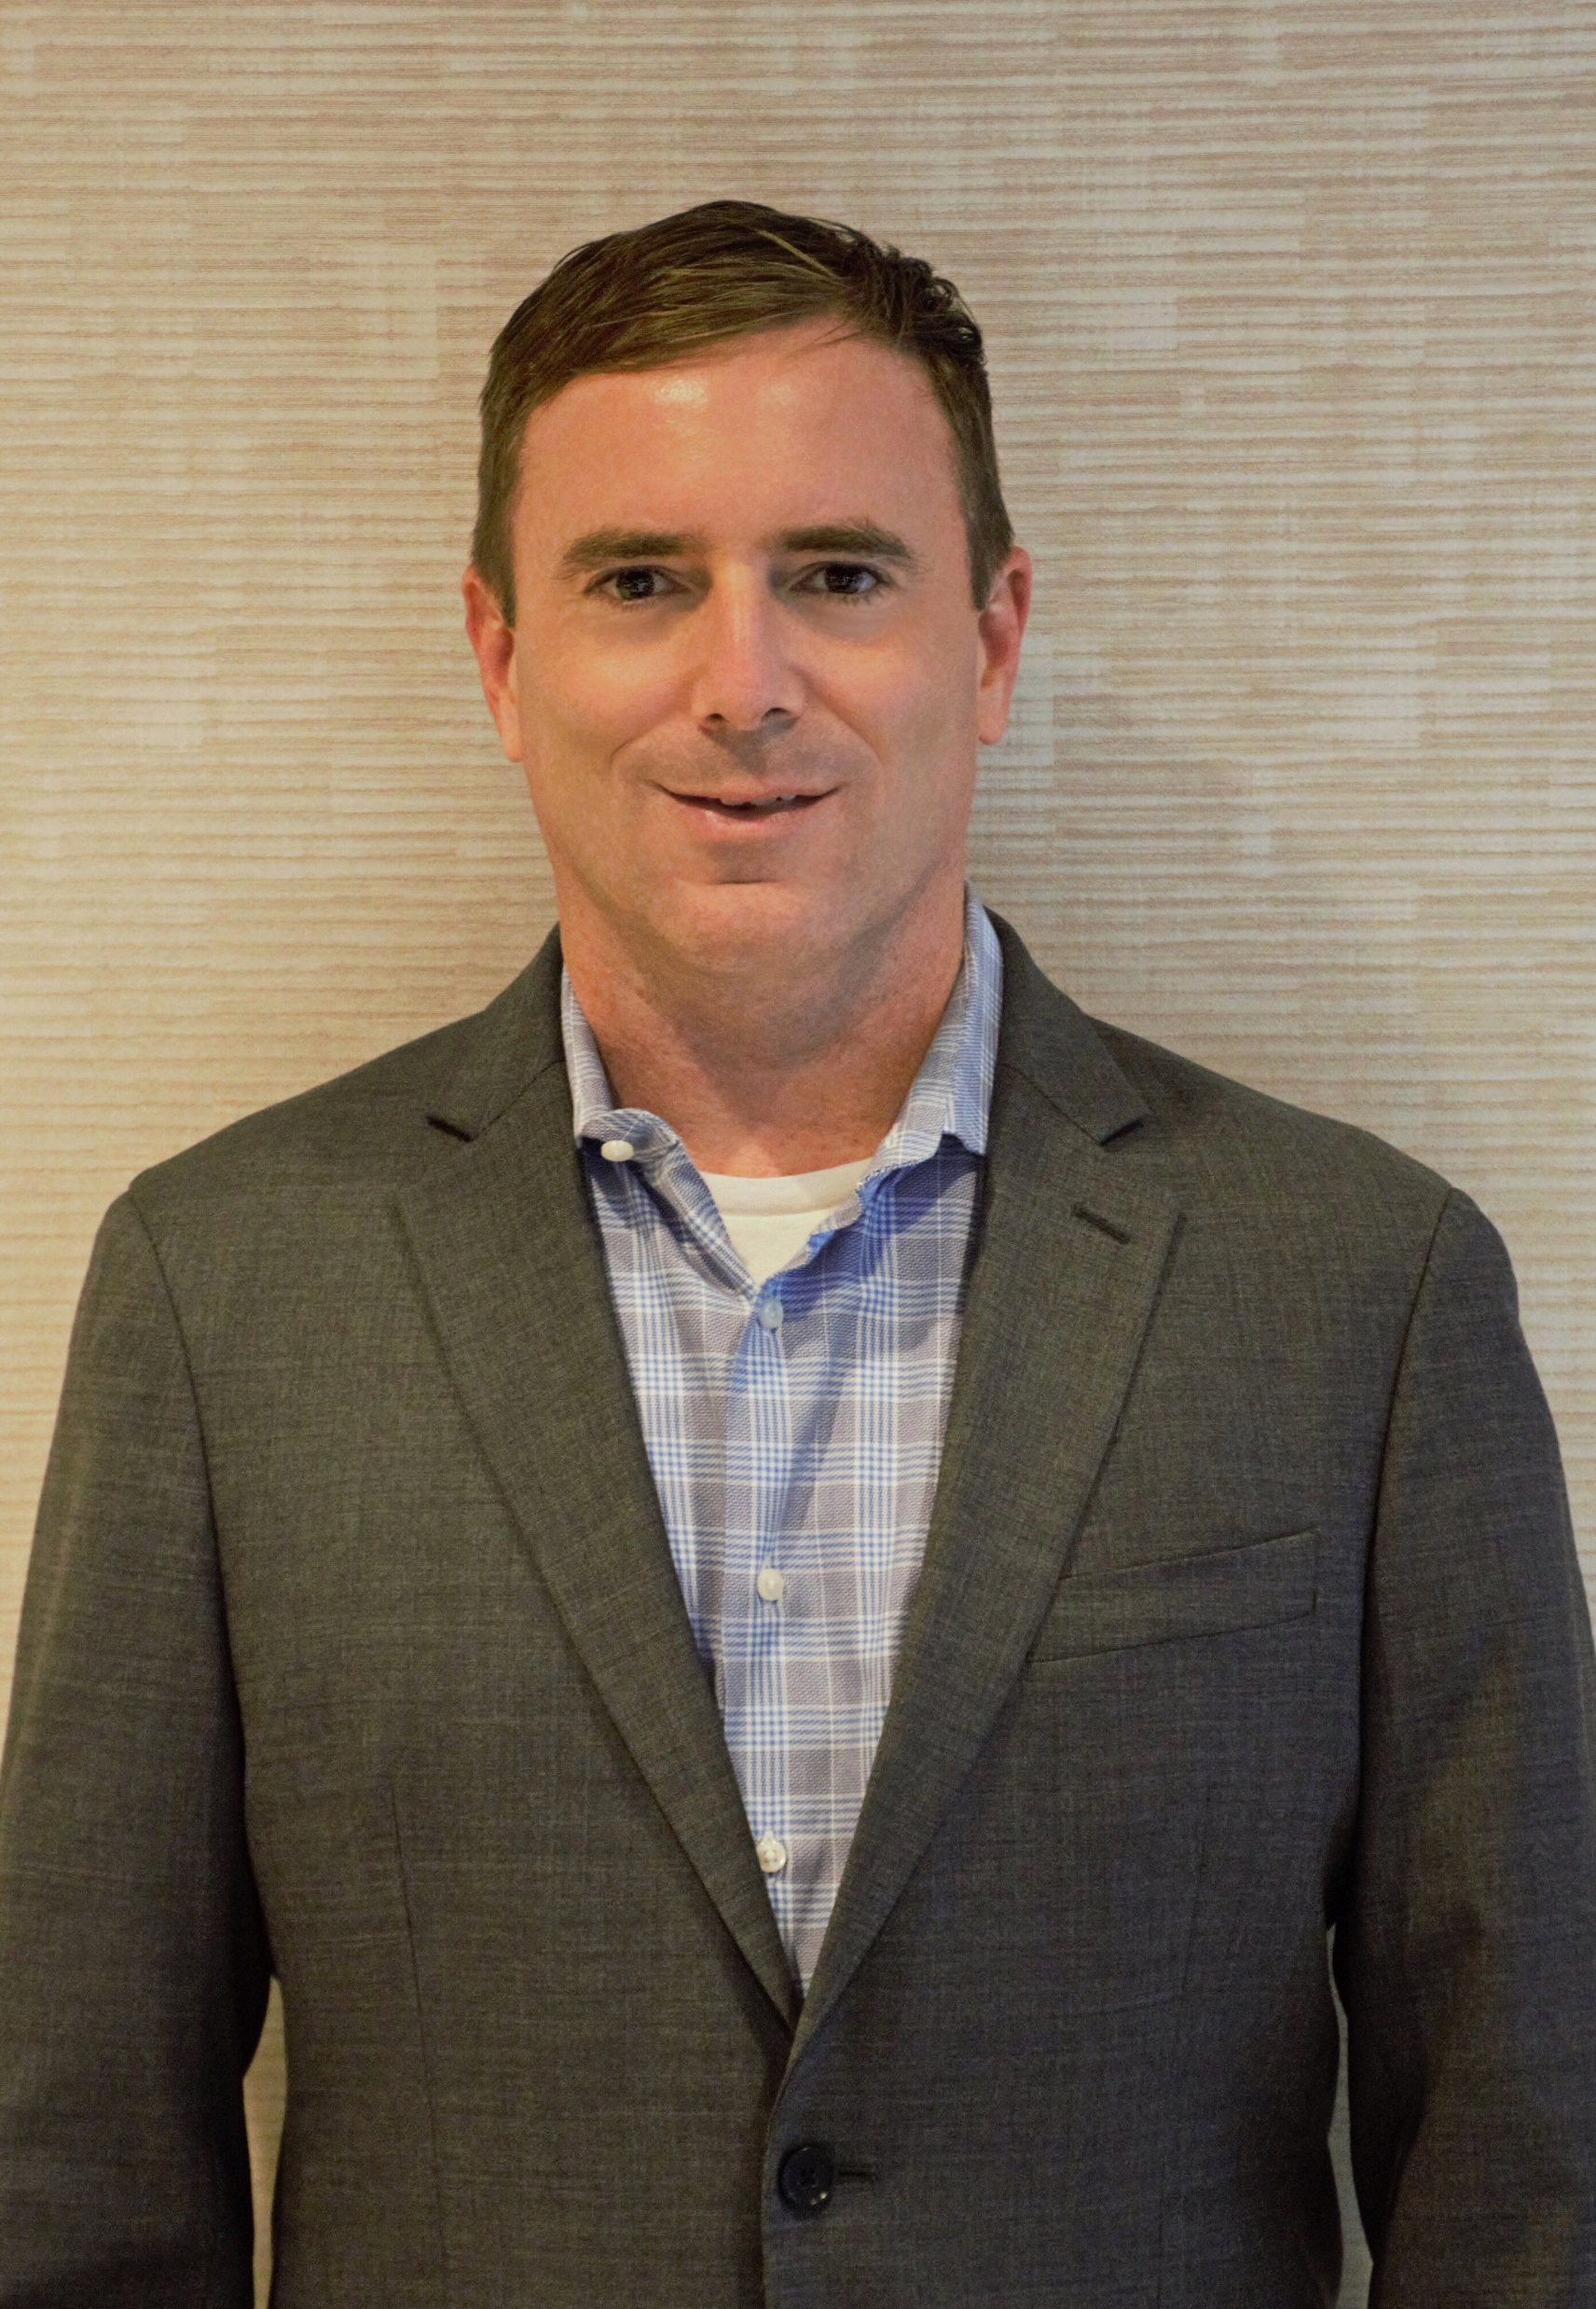
A Little Bit About NSCA
NSCA is the leading not-for-profit association representing the commercial systems integration industry.
NSCA provides benchmark studies on labor units, economic reports, vertical market trends, technology adoption, regulations and codes, etc.
NSCA provides great education and networking platforms with our Business & Leadership Conference and XBO Experience
NSCA is … Your voice, Your business resource, Your trusted advisor.
Tom LeBlanc
NSCA Executive Director
Tom LeBlanc
NSCA Executive Director

Slide 3

The Biggest Change Driver for Our Business Is _______.

Slide 4
AI

Slide 5


Topic of AI Remains Moving Target

Slide 6

We asked ChatGPT what to tell you about business challenges related to AI…
It told us to “address several key points:”
Quality & Accuracy
Training & Customization
Ethical Considerations
Data Privacy & Security
Integration & Scalability
Customer Support & Maintenance

Slide 7

Uncomfortable Conversations

Slide 8
Cybersecurity

Slide 9
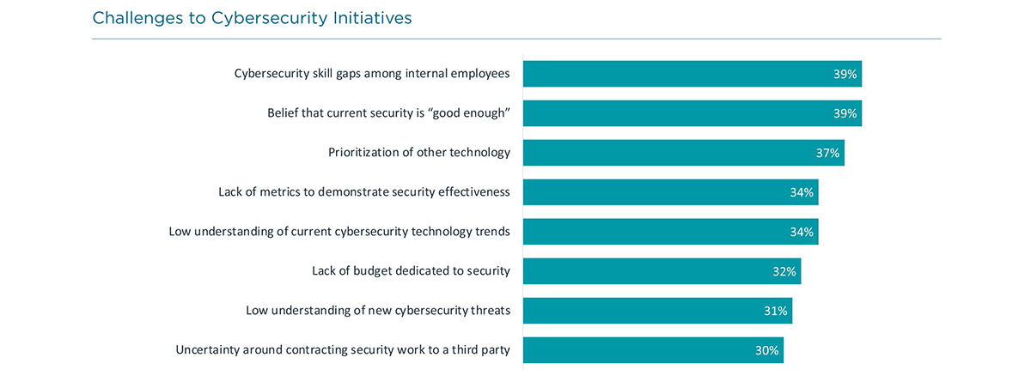
Source: CompTIA

Slide 10
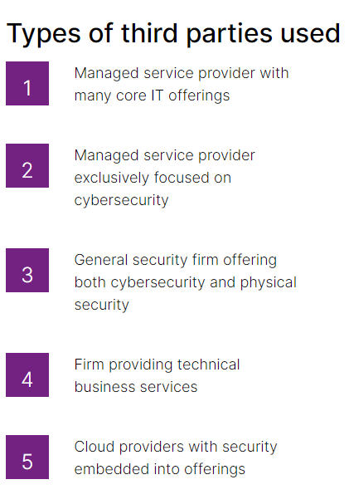

Source: CompTIA

Slide 11
Becoming ‘Mission Critical’

Slide 12
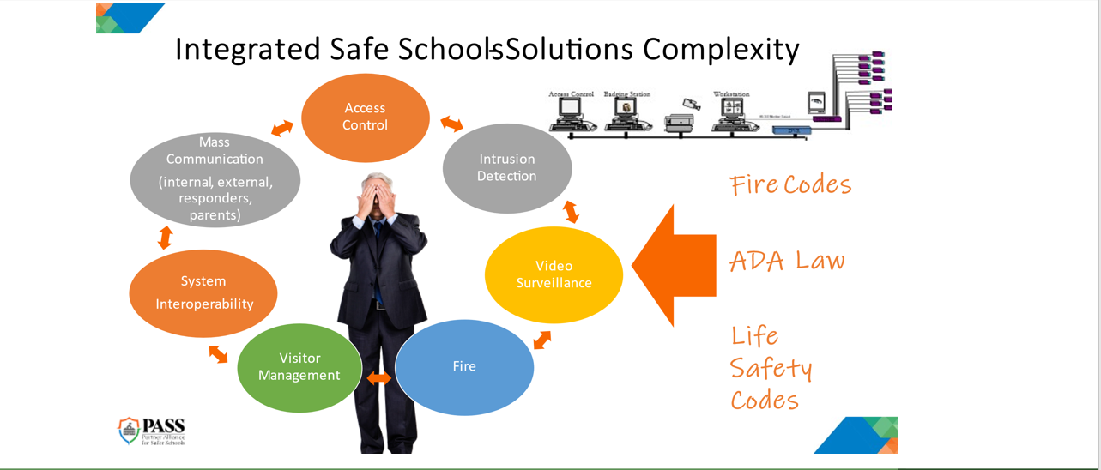

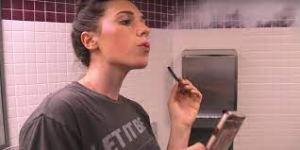
We are Mission Critical – Education Example

Slide 13
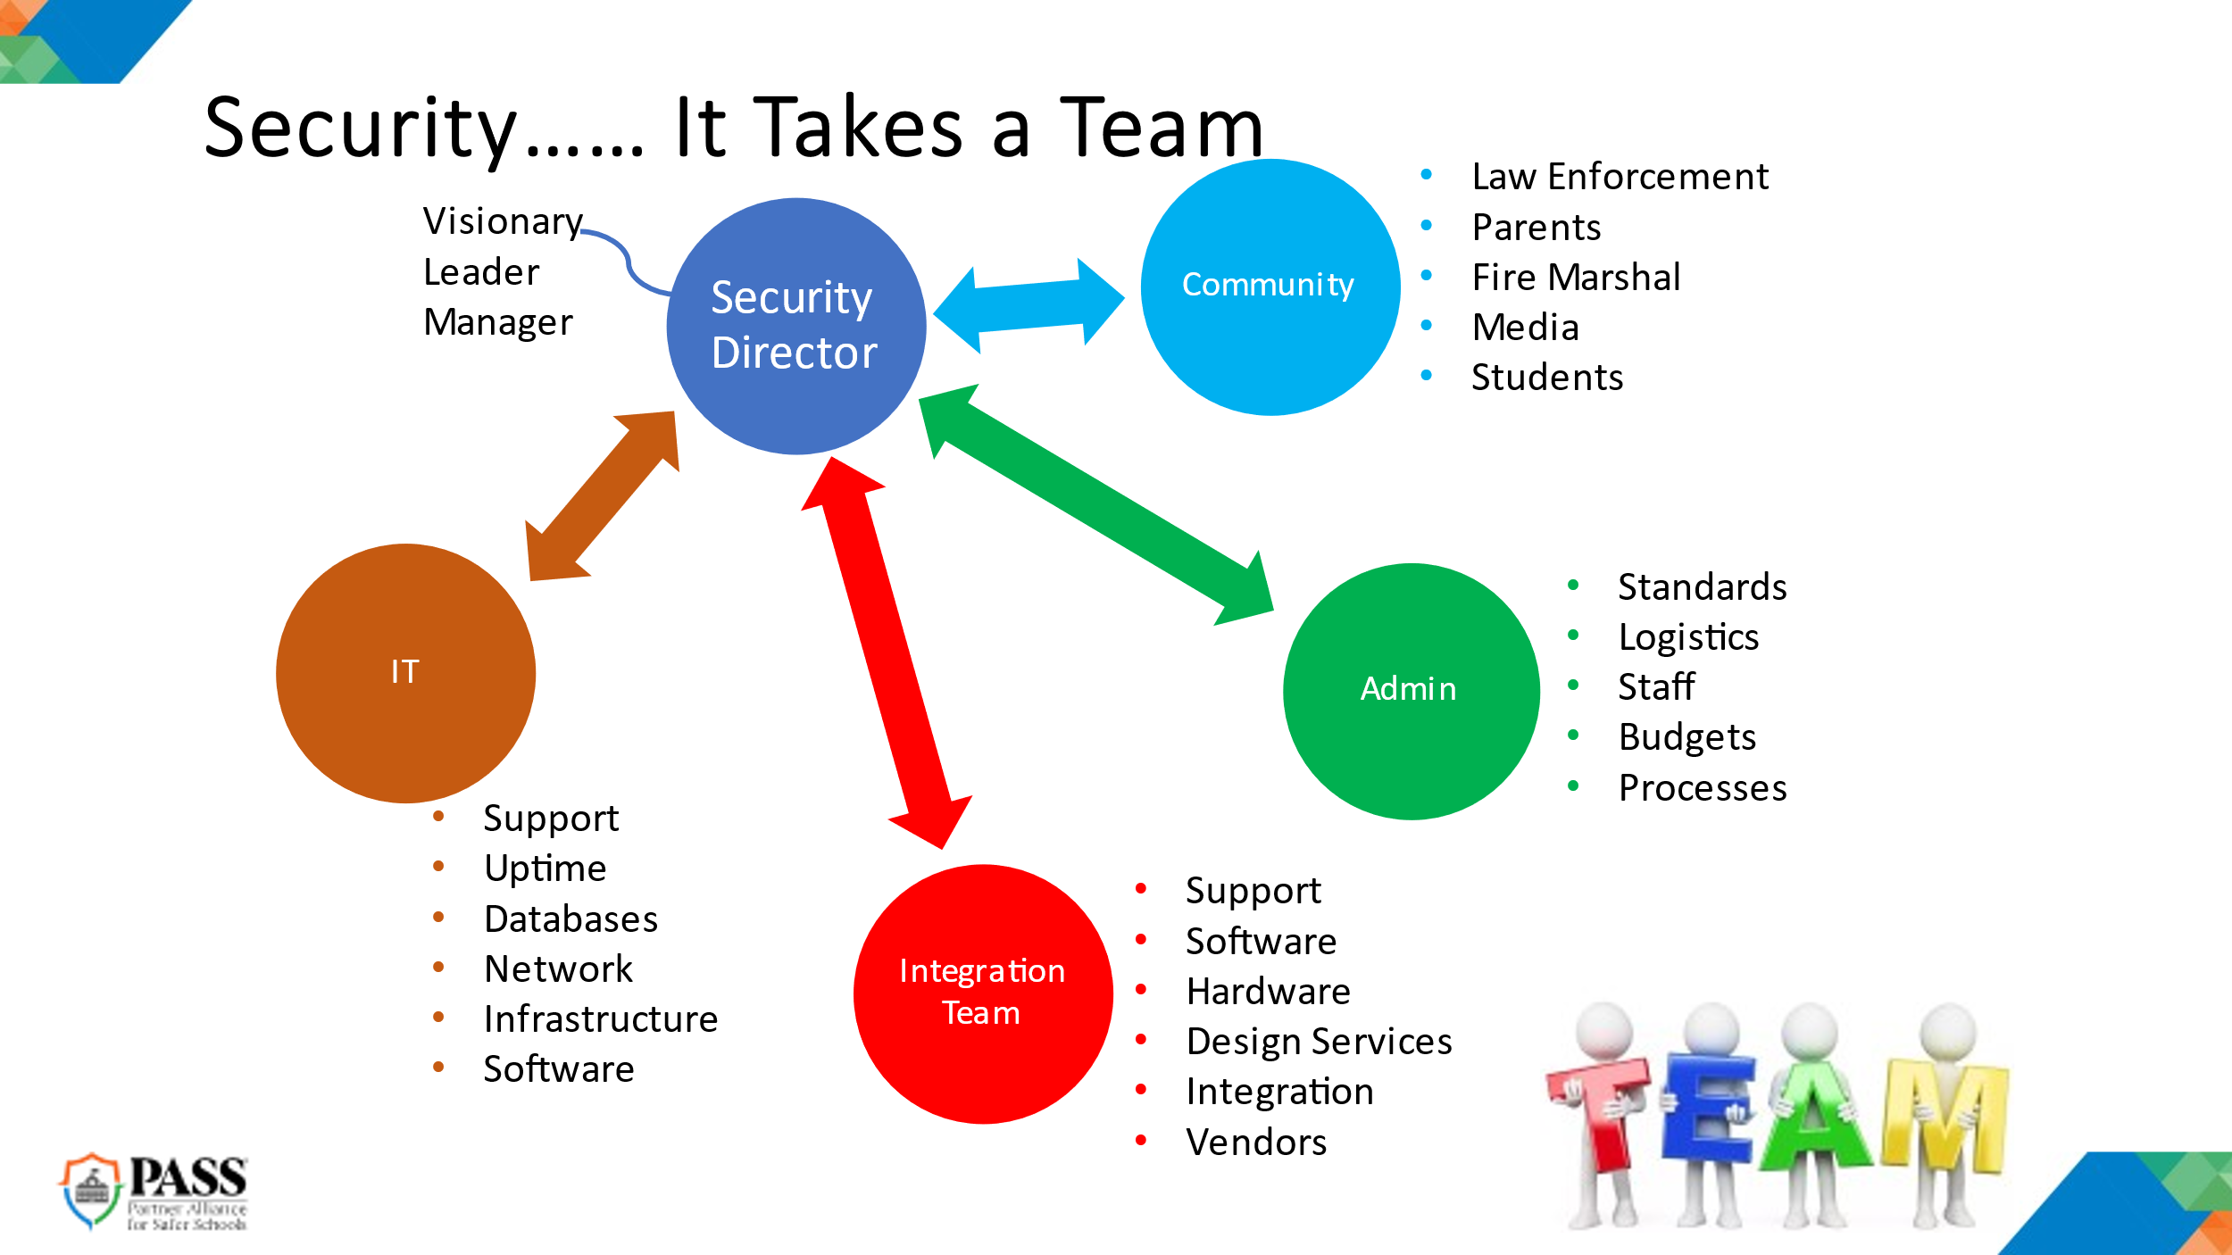

Slide 14

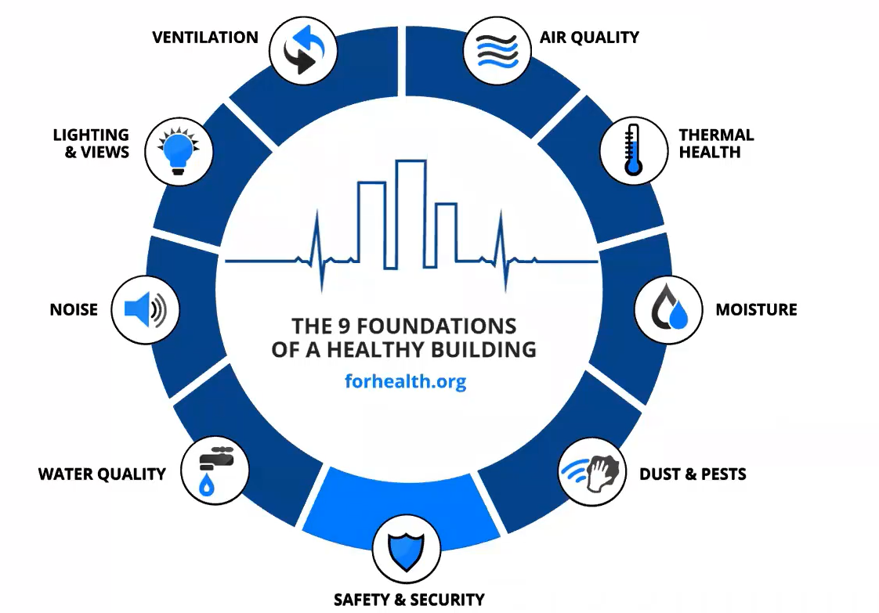
We Are Mission Critical – Corporate Example

Slide 15
Code Compliance

Slide 16
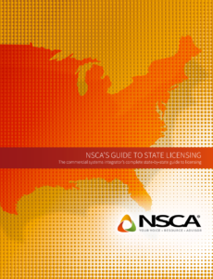
NSCA’s Guide to State Licensing

Slide 17
Legislative Agenda – Codes and Compliance
NSCA makes sure Commercial and Residential Systems Integrators can perform low voltage/limited energy systems in a regulated environment
Independent contractor status, new definitions, gig economy tax rules
Licensure and exemptions – apprenticeship mandates and exemptions
PoE and IoT ongoing scope of work “challenges” for integrators
Cyber credentialing and new regulations. 108 State/33 Fed.
School safety laws and new requirements. Increased funding. 95/10
Shift to cloud-based solutions and network applications
Much more… Currently Following over 400 Bills.

Slide 18
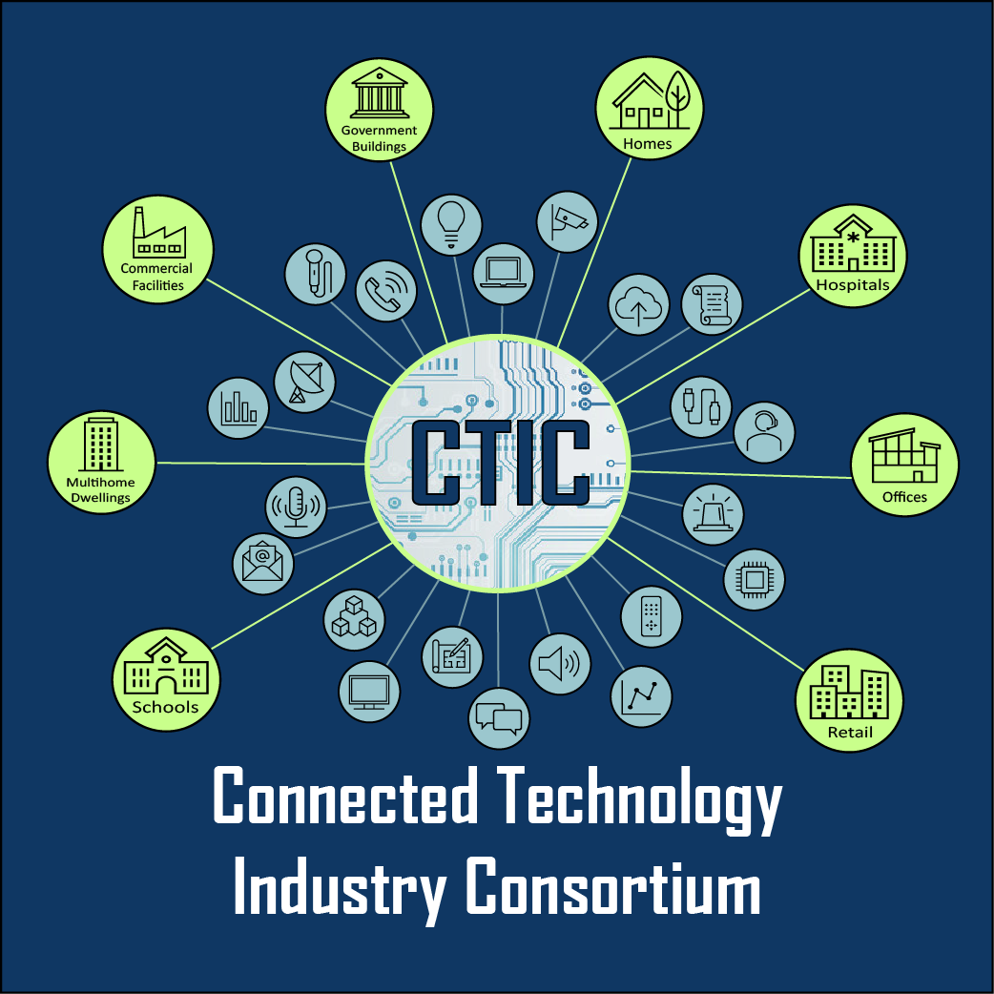
The entire Systems Integration Industry working together to advance the use of emerging technologies throughout North America.
Members include: NSCA, CEDIA, BICSI, CompTia, AVIXA, CTA, CCCA, SBA, etc.
Licensure, Regulatory, Workforce Development, Codes and Compliance.

Slide 19
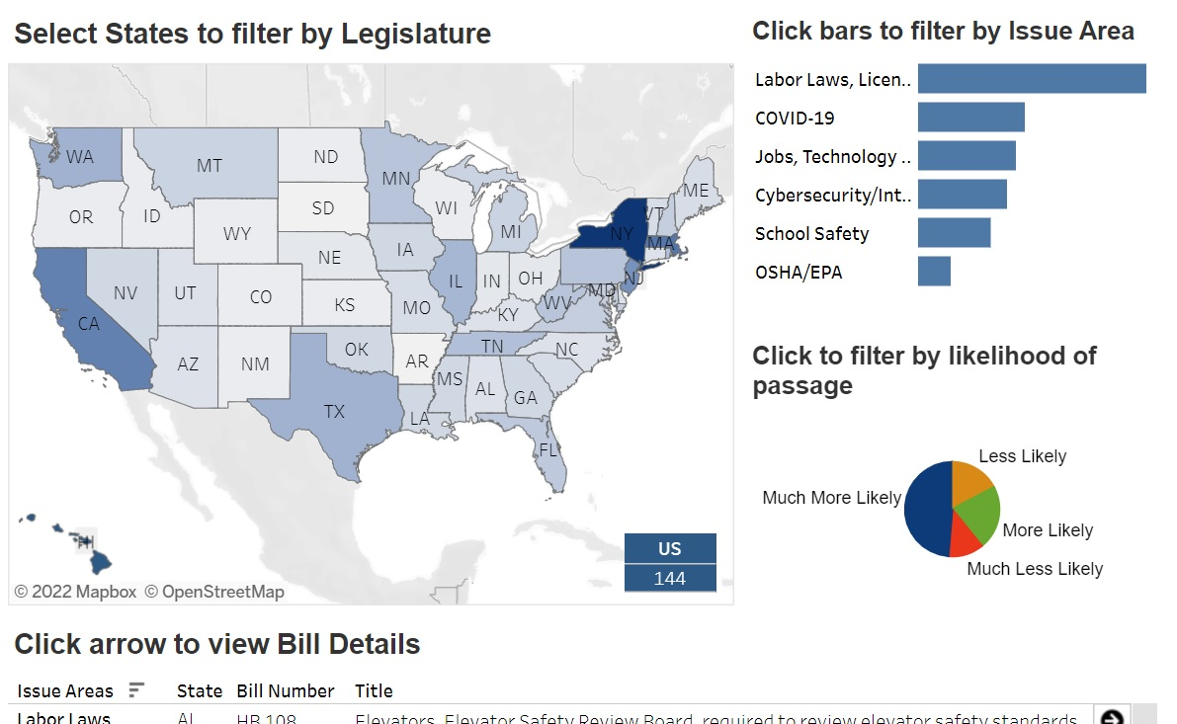
Go to NSCA.org
Click on “Advocacy” tab
Select “Track Regulation”

Slide 20
Explosion of IT Endpoints

Slide 21

Connectivity is Mission Critical
Are we ready?
What choice do we have?
IoT is the fastest growing technology trend in the connected technologies and smart buildings sector
IoT now connects over 50 billion devices in a $520 billion market
These devices will be connected primarily using PoE. A major opportunity and challenge

Slide 22
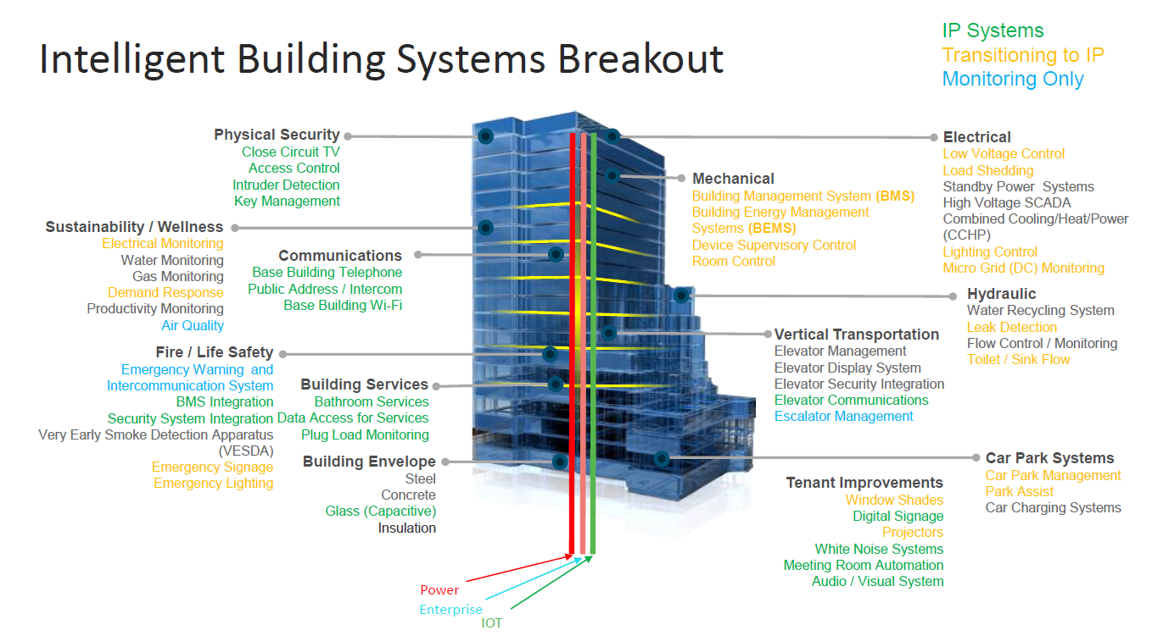
Remember - What we do is both mission critical and essential

Slide 23
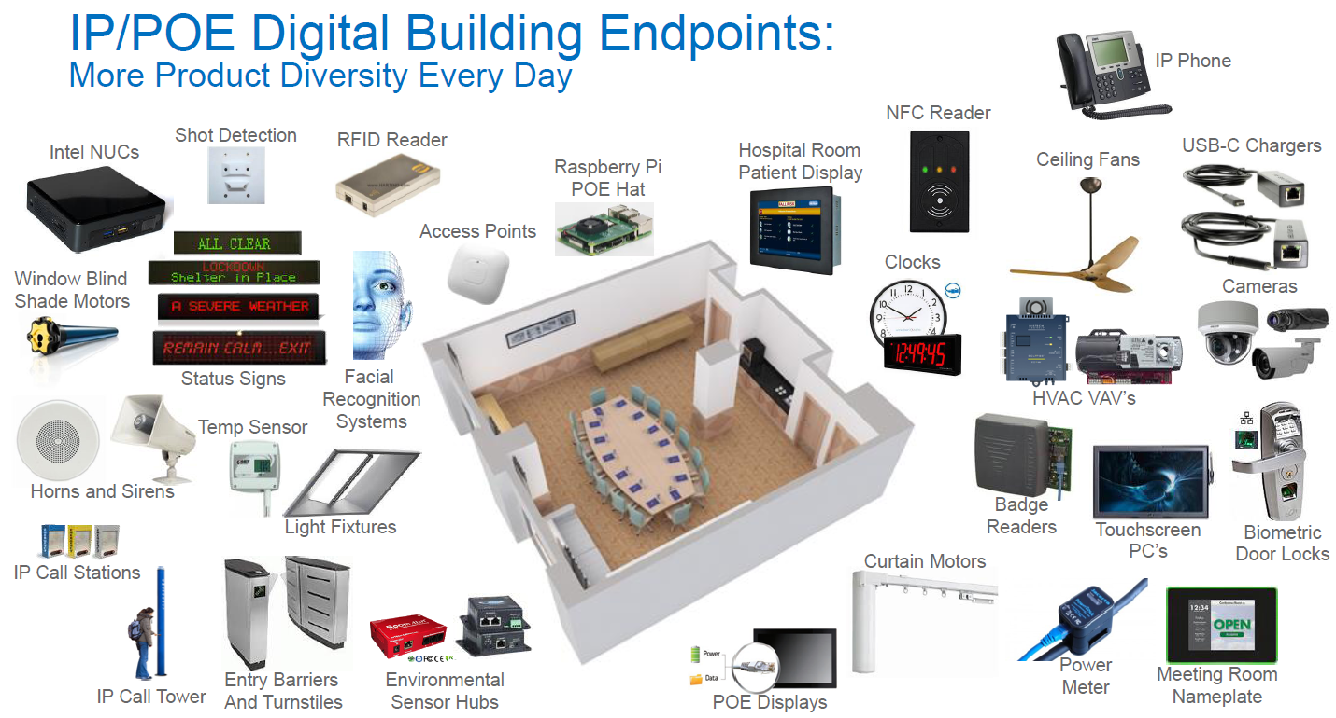

Slide 24
‘Prop Tech’

Slide 25
Digital Transformation and The Future of “PropTech”
Who and What?
Why?
Our role – IT platforms, cyber security, connectivity, adaptable workspaces, safety and security, mission critical communications, healthy building, asset management, improved workflows, etc.
Create higher value for tenants
Improved occupancy and income
The ideal workplace
Increased productivity and space allocation
Adaptable design and repurposing of space

Slide 26
Master Systems Integrator Concept

Slide 27

















Today’s “Building Information Network”
Building Systems
Lighting
Tenant Services
Elevators
High Speed Internet
24/7 Monitoring
Wireless
HVAC Sensors
Unified Communications
Fire Control (Control panel)
Interactive Media
Physical Security
Dashboards
Digital Signage
Energy Management
Submit
IP Telephony
Monitoring
Control
Maintenance Management

Slide 28
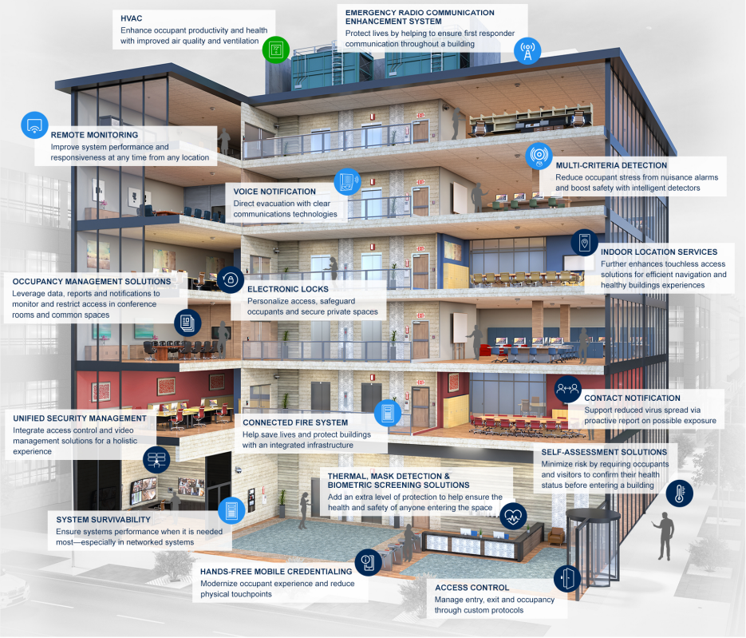
Intelligent Buildings to Healthy Buildings and The “Master Systems Integrator” Concept Healthy Buildings
A shift from the smart building designed to benefit the owner, to a safe and healthy building focused on the occupants
The “Master Systems Integrator” designing, connecting and managing the “system of systems”
AV integrators are now really paying attention

Slide 29
IT Spending Trends

Slide 31
Emerging Technologies Create Training Challenges

Slide 32
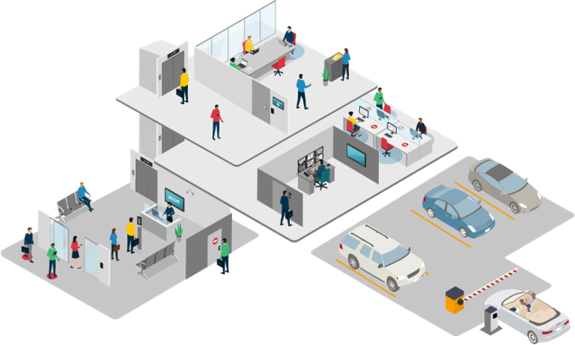
Keeping Pace While Falling Behind
Indoor Location Services​
Biometric
Solutions
Hands-free​
Mobile Credentialing​
Touchless Visitor​
Management
Hands-free​
Mobile Credentialing​

Slide 33
Chief Innovation Officer

Slide 34

Challenges Entering 2025
Most cited challenges still relate to finding and hiring staff
Supply chain concerns still relevant
Product procurement issues contribute to eroding margins, cash flow problems
Economic uncertainty
Dealing with post-COVID workforce expectations

Slide 35

Q&A
Thank you
Please scan the QR code below to complete our survey and share your thoughts and experiences.

