Slide 1
Megatrends in Cybersecurity Panel Discussion with SIA Cybersecurity Advisory Board
William Knehr, Senior Manager of Info Assurance and Data Privacy at i-PRO Americas Inc.
Min Kyriannis, Co-Founder & CEO, AMYNA Systems Inc.
Rachelle Loyear, VP, Integrated Security Solutions at Allied Universal
Teresa Wu, VP, Smart Credentials & Access at IDEMIA Public Security North America
Cybersecurity Advisory Board - Security Industry Association

Slide 2
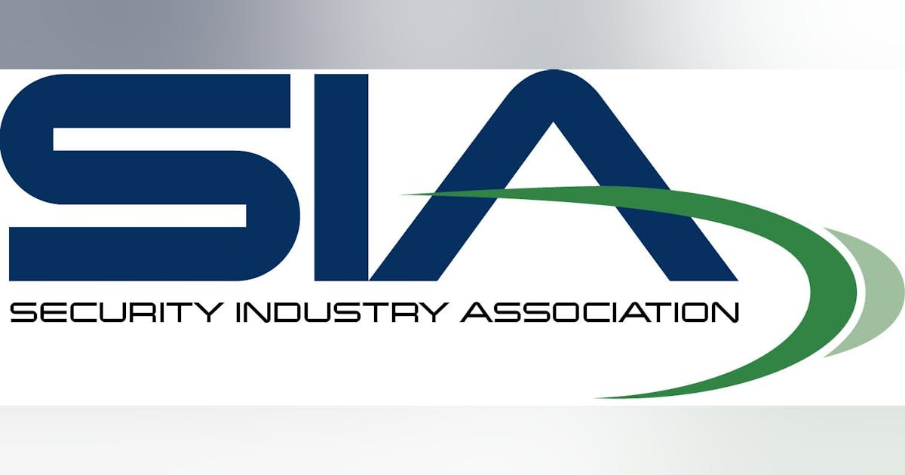
Cybersecurity Advisory Board https://www.securityindustry.org/committee/cybersecurity-advisory-board/

Slide 3
AI Threats
What are the most concerning aspects of AI-powered cyber attacks, such as deepfakes and generative AI, from your perspective?
How do these emerging threats differ from traditional cyber attacks, and what makes them particularly challenging to defend against?

Slide 4
Example of AI Threats….

Slide 5
Vulnerabilities in IoT, OT, and IT
What are the most critical vulnerabilities in IoT, OT, and IT systems that organizations need to be aware of?

Slide 6
MFA and Zero Trust Practices
Multi-factor authentication (MFA) is often recommended, but not all MFA solutions are equal. What are the key considerations when choosing an MFA solution?
How does the concept of Zero Trust architecture align with the current cybersecurity landscape, and what are the practical steps organizations can take to implement it?
What are the common pitfalls organizations face when deploying MFA and Zero Trust, and how can they be avoided?

Slide 7
Mitigation Strategies
Can organizations build and maintain a robust cybersecurity culture, and why is it essential for long-term security?

Slide 8
Blog Posts and Articles From the Cybersecurity Advisory Board:
SIA’s Cybersecurity Advisory Board Closes Out Cybersecurity Awareness Month (Oct. 28, 2024)
The ConfusedPilot Hack: A Wake-Up Call for Identity and Access Management and Physical Access Control (Oct. 23, 2024)
Make This October Count by Focusing on Cybersecurity (Oct. 7, 2024)
Chatting About Cybersecurity: A Conversation With ChatGPT on the Role of Artificial Intelligence (Oct. 1, 2024)
The Most Common Cybersecurity Errors Found in the Installation of Physical Security Technologies (Aug. 5, 2024)

Slide 9

Q&A
Thank you
Please scan the QR code below to complete our survey and share your thoughts and experiences.

