Slide 1
The AI-Enabled Security Program of the Future - How Will You Get There?
November 21, 2024 – 1pm
Rachelle Loyear– VP, Integrated Security Solutions, Allied Universal
Kevin A. Speed – VP of Technology, Critical Infrastructure Security, Industrial Enet

Slide 2


Introductions
Kevin Speed
IENET
Rachelle Loyear
Allied Universal

Slide 3
Agenda
Intro to AI Technologies in Security
Aligning AI with Business and Security Goals
Building a Scalable and Sustainable Security Roadmap
Project Management Strategies for AI Integration
Q&A
Conclusion and Key Takeaways

Slide 4
Intro to AI Technologies in Security
What are we REALLY going to be doing with AI in the next 5 years?
  Automation and Efficiency
  Predictive Analytics for Proactive Threat Detection
  Data-Driven Decision-Making

Slide 5








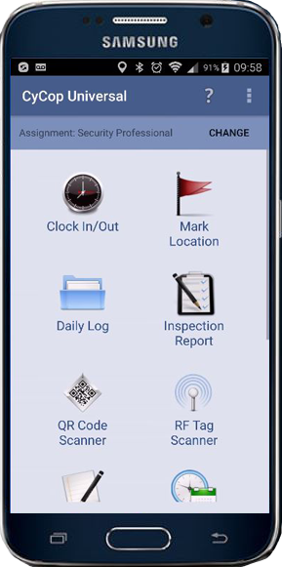







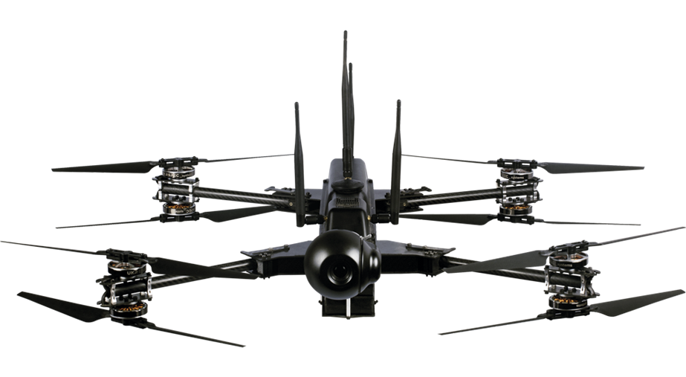
Automation Capabilities That Streamline Security
Cameras, Access Control, Monitoring Sensors, etc. “watch themselves”
Systems Feed Centralized Control
AI-enabled/Automated dispatch
AI-enabled/Automated recommended actions for personnel
AI-enabled prioritization of “interest” activity
Video
Analytics
Alarms and Alerts
Robots
Uniformed security
reporting
Access control reports
Social Media/
Dark Web monitoring
GPS reporting
Centralized security operations
Situational Awareness information GSOC / GSOCaaS
Drone Visuals
Notes:
Mike Devita - Madden to Chime in with color commentary
Strong enough that we aren’t staring at monitors
Reliable baseline alerting using AI – more effective to get to critical events – larger facilities with fewer people
Anomaly detection by analyzing “lakes” worth of data from end points to detect abnormal behavior that could indicate malicious activity.
AI augmenting humans: AI-enabled processing of data with the ability to provide recommended actions for more efficient security
AI identification of unstructured data, e.g., analyzing social media content for threats, or searching the web/dark web
AI for remote guarding to help prioritize “of interest” activity captured

Slide 6
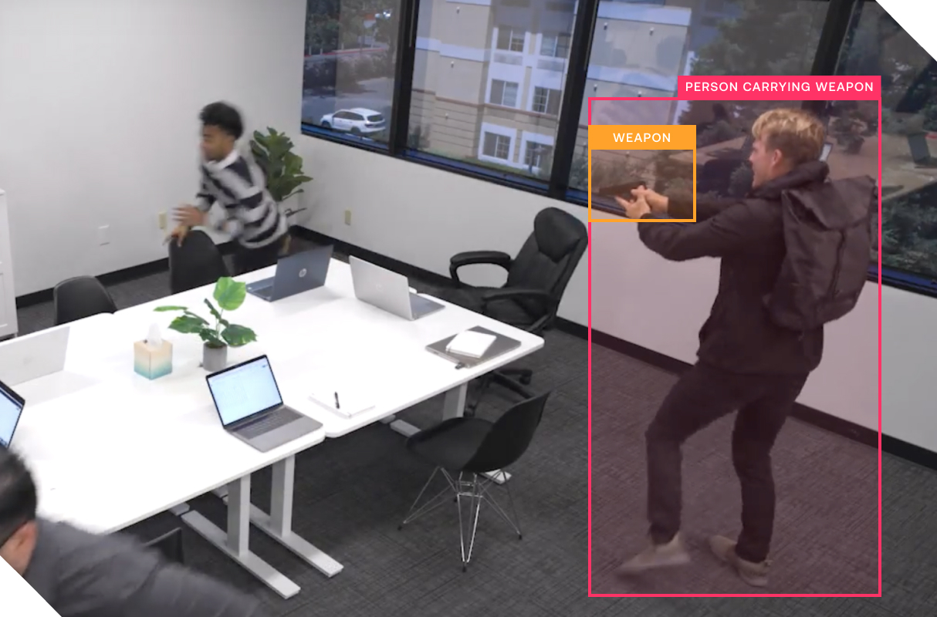
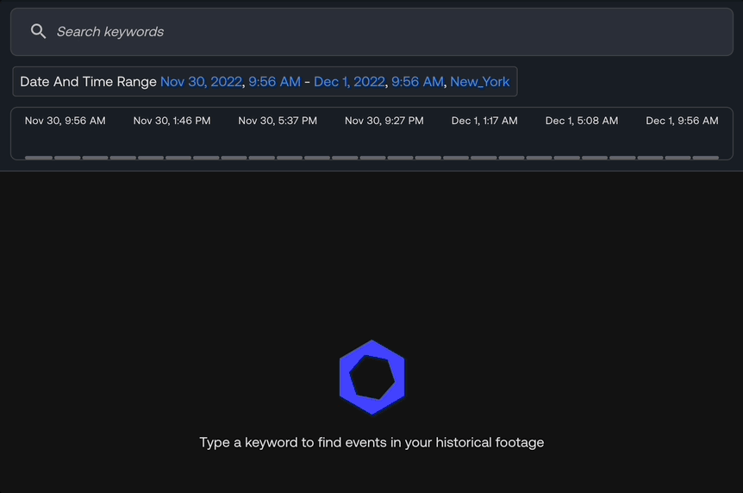
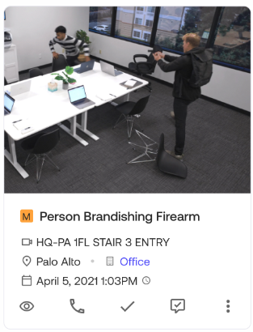

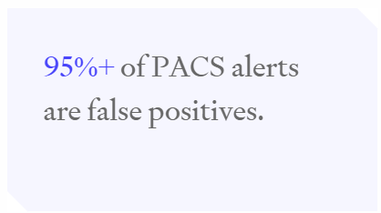
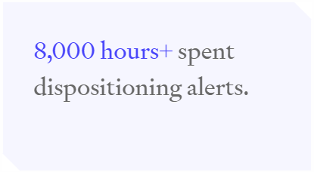
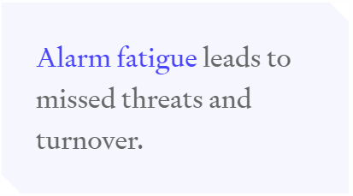
Analytics Capabilities That Improve Security
Advanced Video Forensics: “Find what you need”
Detect specific threats
Contextualize Access Control Alarms into Actionable Data with use of existing video
Notes:
Mike Devita

Slide 7
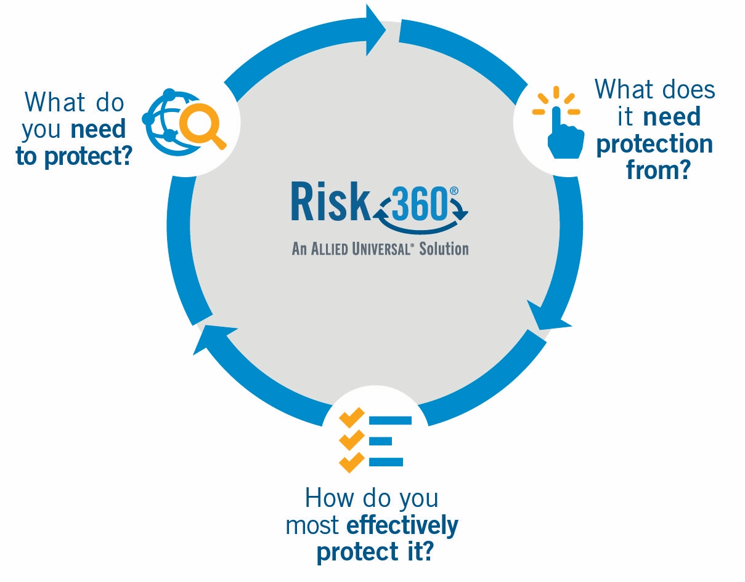



Risk Data That Drives Security Planning
Security controls apply to threats in different ways
One size does not fit all
A data-driven approach helps identify the unique, most efficient and cost-effective, mix of solutions that fit a risk profile
Notes:
Rachelle Loyear

Slide 8
Aligning AI with Business and Security Goals
What are the problems you are REALLY trying to solve with AI?
  Aligning AI Initiatives with Long-Term Business Goals
  Meeting Current and Future Security Needs
  Ensuring Scalability

Slide 9
Long Term AI Planning Links Business Goals to Security Risk Mitigation
Business Mission and Goals
Organization Assets That Support The Mission
Risks to Mission Critical Assets
AI-Enabled Risk Mitigation / Mission Protection Activities

Slide 10

Mission Alignment
To align to the business mission, we need to fully UNDERSTAND the Business Mission at all levels.
  What are the products and services that provide revenue (or the other success measures)?
  Who are the mission-driving stakeholders at each level?
  How do the assets that Security is tasked with protecting enable the mission of the enterprise / departments?

Slide 11











Scale Over Time
Don’t adopt everything, everywhere, all at once!
AI Assisted intelligence and threat analysis
Aerial or ground drone and drone detection
Smart access control and identity management systems
Intelligent video solutions
AI
Remote monitoring, system administration, data analysis and dispatch
Development of policies and SOPs, including emergency preparedness and disaster recovery
Physical automation through
Integration with ACS / VMS
Environmental monitoring through intelligent video and sensors
Fire and safety monitoring

Slide 12

Building a Scalable and Sustainable Security Roadmap
  Creating a Long-Term AI Security Plan
  Key Phases of AI Integration
  Sustainability and Future-Proofing

Slide 13

Building a Scalable and Sustainable Security Roadmap for AI
  Strategic Objectives Relevant for AI
    Risk Management
    Regulatory Compliance
    Scale
    ???
  Common Gaps & Opportunities for AI
    False Alarm Reduction
    Predictive Threat Identification
    Efficiency

Slide 14
Building a Scalable and Sustainable Security Roadmap
  AI Feature vs Enterprise AI
  Assess Capabilities & Limitations, Current and Trending
    Sensor Analytics – Brandished Weapon, Drone, Behavior
    Alarm Contextualization
    Predictive Modeling
    Automation of Alarm and Incident Management
    Data Handling
  Capability & Maturity Development Considerations
    Integration of Detection & Assessment
    Digital Convergence – Data Organization for Association
Notes:
Predictive Modeling
Intelligence Analysis
Behavior Monitoring
Integration of Detection & Assessment
Access Control + Video
Radar + Video
Gunshot + Video

Slide 15

Program Management Strategies for AI Integration
  Program Development and Delivery
  Expectations Management
  Key Milestones for Successful AI Integration

Slide 16
Program Management Strategies for AI Integration
Project Delivery
  Expectation Management
    Special Handling Considerations
    Data & Compute Intensive
    Garbage In = Garbage Out
  Key Milestones
    Information System Convergence
    Development of Detect & Assess Control Schemas
Throughput Metrics
Monitor throughput to scale with demand.
Deliver
Install
Iterative Delivery
Implement approved solution architecture, including technical detail & services.
Engineer
Operate
Security
Technology
Architecture
Security
Technology
Operations
Architect
Analyze Results
Analyze solution results, create requirements for overall program roadmap.
Monitor
Ideate
Maintain
Initiate
Intake
Continuously align and prioritize roadmaps with internal needs and enterprise priorities.
Maintenance & Operation
Monitor solution performance, health and usage patterns.
Technical Product Management
Solution delivery connects need to value delivery.

Slide 17

Discussion

Slide 18

Q&A
Thank you
Please scan the QR code below to complete our survey and share your thoughts and experiences.

