Slide 1
Security Risk and Return on Investment: Are You Looking at Just the Tip of the Iceberg?
Rachelle Loyear– VP, Integrated Security Solutions, Allied Universal
James Marcella – Director, Industry Relations, Axis Communications

Slide 2


Introductions
James Marcella
Axis Communications
Rachelle Loyear
Allied Universal

Slide 3
Agenda
Risk-Led Security Design: Aligning Controls with Risks
Beyond Upfront Costs: Evaluating Long-Term Expenses
Balancing People, Process, and Technology for Optimal ROI
Q&A

Slide 4
Risk-Led Security Design: Aligning Controls with Risks

Slide 5
Risk-Led Planning Links Business Goals to Security Risk Mitigation
Business Mission and Goals
Organization Assets That Support The Mission
Risks to Mission Critical Assets
AI-Enabled Risk Mitigation / Mission Protection Activities

Slide 6
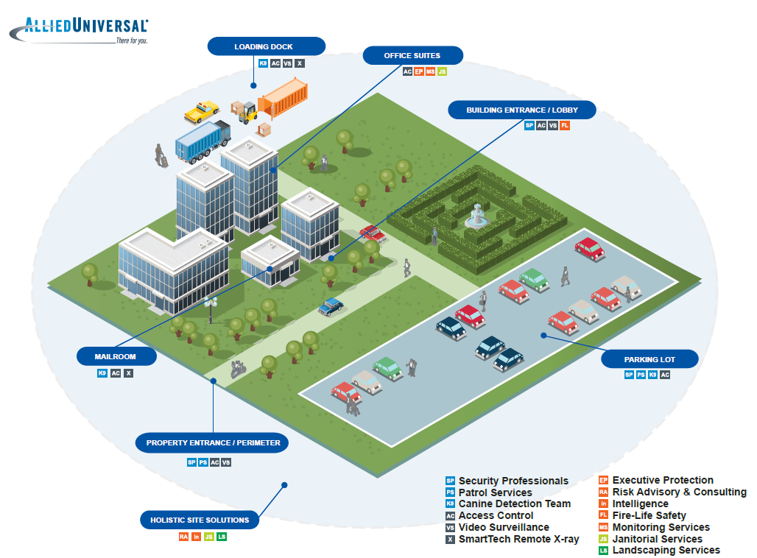
One Size Does Not Fit All
Risks are Typically Most Effectively
Mitigated by Integrated Solutions
People + Process + Technology
Which risk? Which control?

Slide 7







Functions of Countermeasures and Controls
Deter Make asset a less attractive target. |  | Control Access Keep the asset out of reach. |  | Detect Discover a harmful event happening.
Delay Slow progress or impact. | Assess Identify needed action. |  | Respond Interrupt or reduce impact. |  | Record For incident for follow-up.

Slide 8
Align the Threat to Be Mitigated to the Best Effect
Threat | Highest Impact Security Effects
Destruction/Vandalism | Deter, Detect, Record
Loitering | Deter, Control Access, Record
Trespassing | Deter, Control Access, Detect, Record
Civil Unrest | Control Access, Detect, Delay, Respond, Record
Demonstrations/Protests/Strikes | Control Access, Detect, Respond, Communicate
Local Violence (Drugs/Weapons) | Deter, Control Access, Detect, Delay, Respond, Communicate, Record
Burglary | Deter, Control Access, Detect, Delay, Respond, Record
Theft of Property | Deter, Control Access, Detect, Respond, Record
Counterfeiting/Forgery | Control Access, Detect, Respond, Record
Bribery/Espionage | Control Access, Detect, Respond, Communicate
Illegal Use of Company Property | Control Access, Detect, Respond, Record
Assault | Deter, Control Access, Detect, Delay, Respond, Record
Homicide | Control Access, Detect, Delay, Respond, Record
Robbery | Deter, Control Access, Detect, Delay, Respond, Record
Workplace Violence (Mass/Lethal) | Control Access, Detect, Respond, Record
Local Violence (Drugs/Weapons) | Deter, Control Access, Detect, Delay, Respond, Communicate, Record
Burglary | Deter, Control Access, Detect, Delay, Respond, Record
Assault | Deter, Control Access, Detect, Delay, Respond, Record
Threat | High Impact Security Effects
Destruction/Vandalism | Deter, Detect, Record
Individual Accidents/Injury/Death | Respond, Communicate
Non-Weather Disaster | Detect, Respond, Communicate
Severe Weather Disaster | Detect, Respond, Communicate
Pandemic/Epidemic | Detect, Respond, Communicate
Facility Fire/Industrial Accident | Detect, Respond, Communicate
Loitering | Deter, Control Access, Record
Trespassing | Deter, Control Access, Detect, Record
Civil Unrest | Control Access, Detect, Delay, Respond, Record
Demonstrations/Protests/Strikes | Control Access, Detect, Respond, Communicate
Motor Vehicle Theft | Deter, Control Access, Detect, Respond, Record
Theft of Property | Deter, Control Access, Detect, Respond, Record
Theft/Denial of Information | Deter, Control Access, Detect, Respond, Record
Counterfeiting/Forgery | Control Access, Detect, Respond, Record
Bribery/Espionage | Control Access, Detect, Respond, Communicate
Illegal Use of Company Property | Control Access, Detect, Respond, Record
Bomb Threat/Bombing | Control Access, Detect, Respond, Record
Homicide | Control Access, Detect, Delay, Respond, Record
Sexual Assault | Control Access, Detect, Respond, Record
*Example List

Slide 9

Pick the Control that Provides the Effect You Want
Detect
Respond
Control Access
Delay
  Intelligence and Awareness
  Video Surveillance
  Identity Based Access
  AI and Analytics
  Humans
  Advance Planning
  Training
  Supporting
  Infrastructure
  Humans
  Physical Barriers
  Access Control Technology
  Automation (Lock-down)
  Humans
  Physical Barriers
  Rapid / Mobile Deployment
  Humans

Slide 10
Let’s Discuss!!
Why go with risk-driven design over “best practice”?
How does this risk-driven approach help me understand long-term ROI?
How do I use this in a discussion of business impact?

Slide 11
Beyond Upfront Costs: Evaluating Long-Term Expenses

Slide 12

How many years do you expect to use a camera?
(on average)

Slide 13
Total cost of ownership (TCO)
ACQUISITION
OPERATION
DECOMISSION
“Quantify all costs, during the complete life cycle”

Slide 14
What costs contribute to the total cost of the system?

Slide 15
Some of the costs considered
Camera price
Server price
Deployment
Network costs
Accessories price
Software fees
DIRECT COSTS
INDIRECT COSTS
Monitoring
Maintenance
Electricity
Cabling
System design
Training and education
Documentation
INTANGIBLE COSTS
System failure cost
Downtime cost
Cybersecurity costs
Redesign costs
Decommissioning

Slide 16
What percentage of the costs appear after system start?

Slide 17
Where money is spent
⬆ BEFORE STARTING SYSTEM
70%
⬇ AFTER STARTING SYSTEM

Slide 18
TCO – a platform for informed decisions
Camera
System
Use
Business
Decision

Slide 19
Let’s Discuss
What are some ways of thinking about long-term impact that might resonate well with my stakeholders?
How do I even find my stakeholders for some of these impacts?
Long term impact as a residual risk – thoughts?

Slide 20
Balancing People, Process, and Technology for Optimal ROI

Slide 21
The Future is Technology + People
Technology is Good At:
People are Good At:
Repetitive tasks
Boring tasks
Scripted tasks
Interactive tasks
Complicated tasks
Decision making
“Hands On” tasks
Remote tasks
Notes:
A Security Efficiency Review is an organized approach to understanding your existing security program and finding areas where technology and process may be adjusted to make more efficient use of resources.
Efficiency is not about “cutting hours” It is about having the RIGHT SOLUTION for the job to be done.

Slide 22


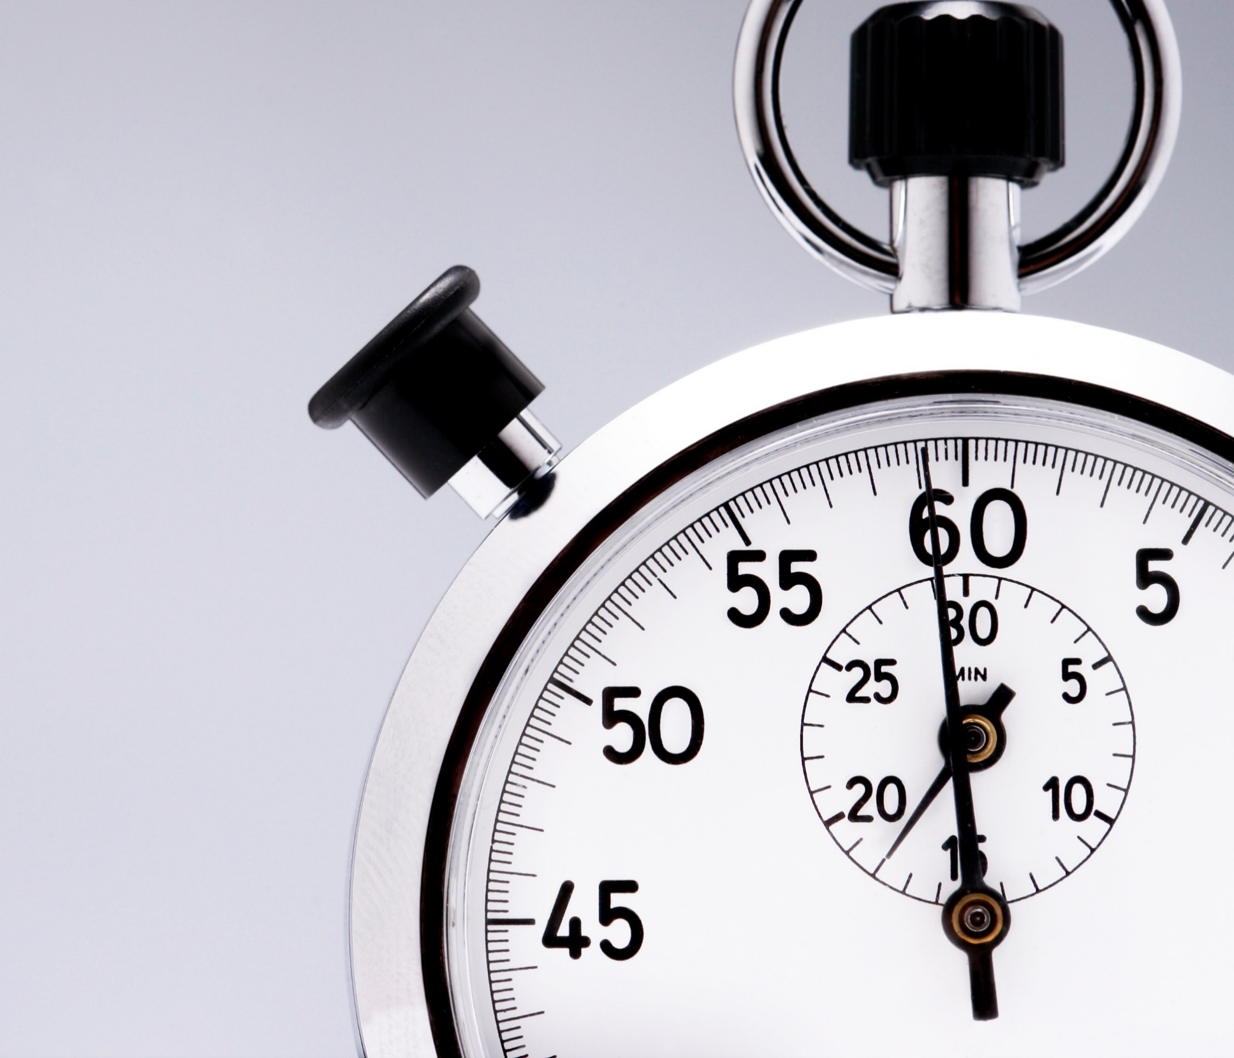
What Kinds of Efficiency Can Be Achieved?
Work Distribution Efficiency
Process Duration Efficiency
Hours-Per-Week Efficiency

Slide 23



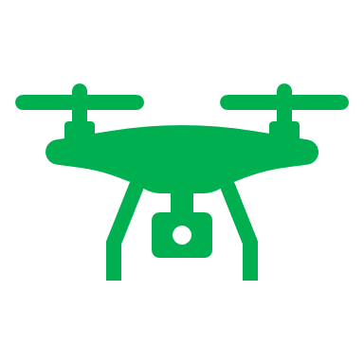



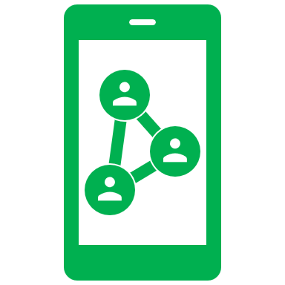



Big Picture ROI
Intelligence and threat analysis
Aerial or ground drone and drone detection
Smart access control and identity management systems
Intelligent video solutions
AI
Remote monitoring, system administration, data analysis and dispatch
Development of policies and SOPs, including emergency preparedness and disaster recovery
Physical automation through
Integration with ACS / VMS
Environmental monitoring through intelligent video and sensors
Security Enhancements Through People, Process, Technology
Connected Officer
Fire and safety monitoring
Notes:
Mike Madden
Tom Walton to tag on how we know this is the future of officers
RL to transition using “policy and procedure”

Slide 24
Let’s Discuss
How can I find the right mix of controls for the best security and financial outcome?
What are some current optimal ROI cases?

Slide 25

Q&A / Discussion

Slide 26

Thank you
Please scan the QR code below to complete our survey and share your thoughts and experiences.

