Slide 1

The Evolution of Physical Security: The Past, Present, and Future
Thanks to our Sponsor
Maureen Carlo, Global Director of Strategic Partnerships, Milestone
Kasia Hanson, CEO and Founder, KFactor Global
Mark Schweitzer, Manager, Solutions Strategy, Convergint
Ben Rowe, Head of Emerging Technology, Milestone

Slide 2

Today’s Speakers

Slide 3

The Journey
Where We've Been: The evolution of physical security and foundational trends that shaped today's landscape.
Where We Are: Current technologies, like cloud and AI, enhancing risk mitigation and driving adoption of modern practices.
Where We're Going: Emerging trends and innovations defining the future trajectory of security.

Slide 4
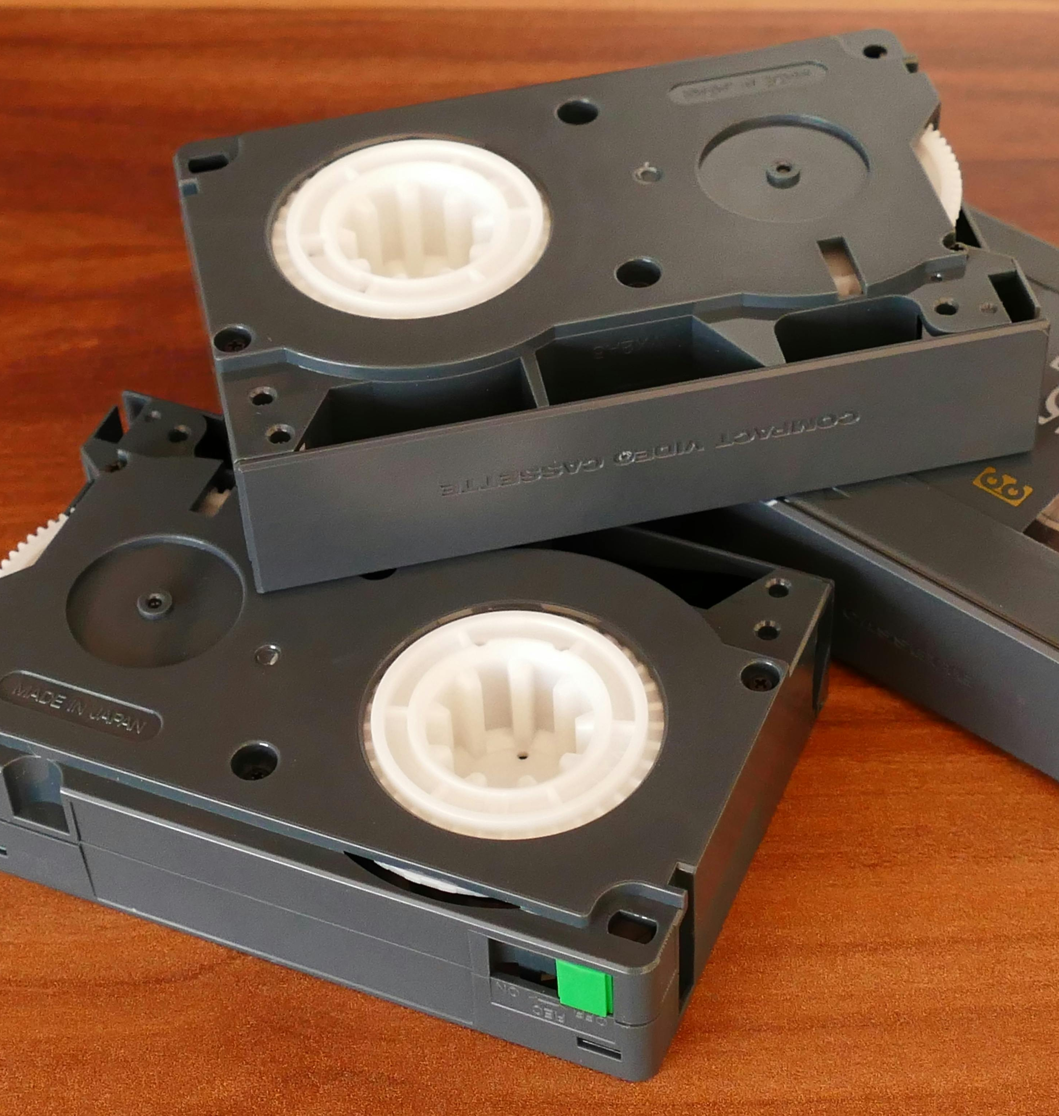
The Past
Key Milestones
Major developments that transformed physical security from its origins to the 2000s.
Legacy Technology Challenges
Specific limitations faced with on-premise systems and how they drove innovation.
Lessons Learned
Takeaways from the developments and innovations from the past.

Slide 5
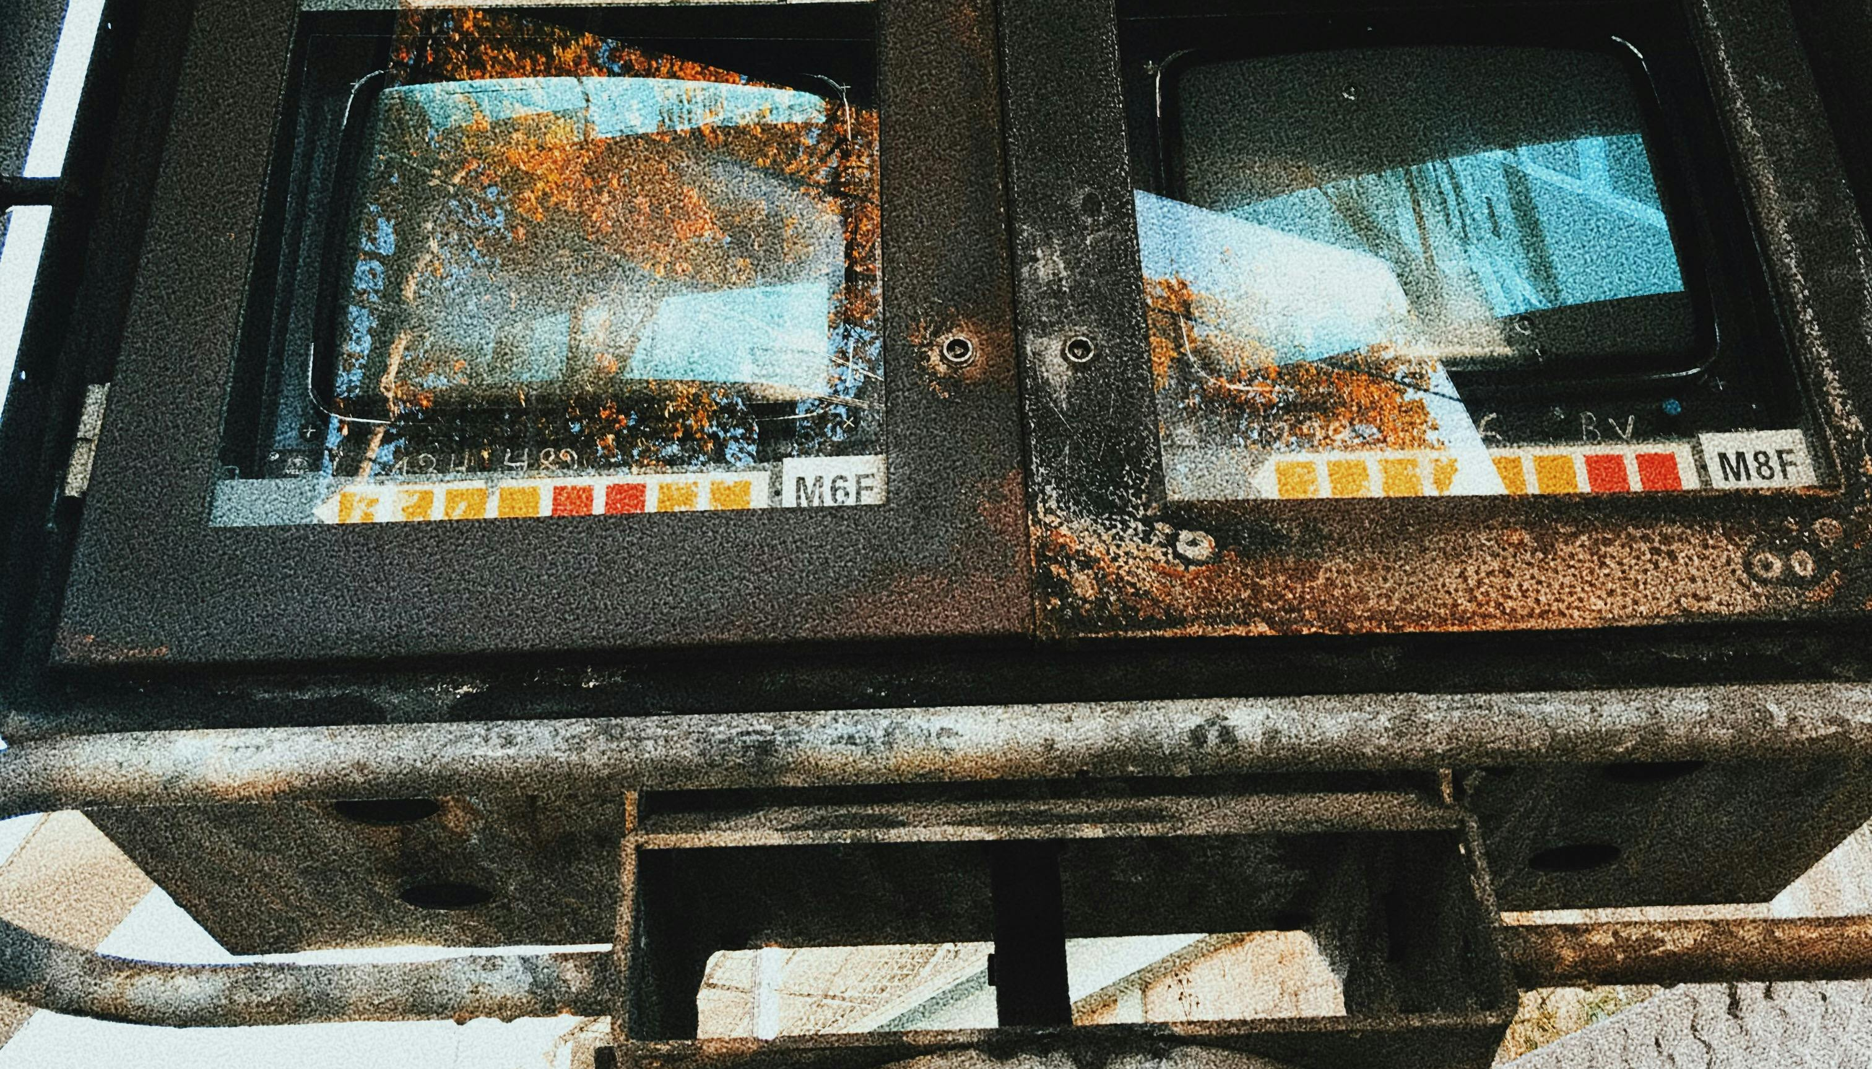




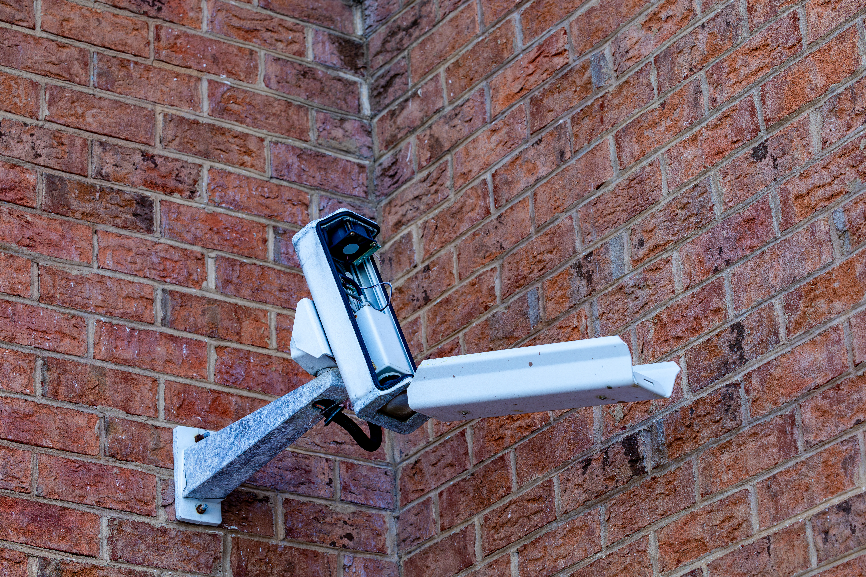

Slide 6
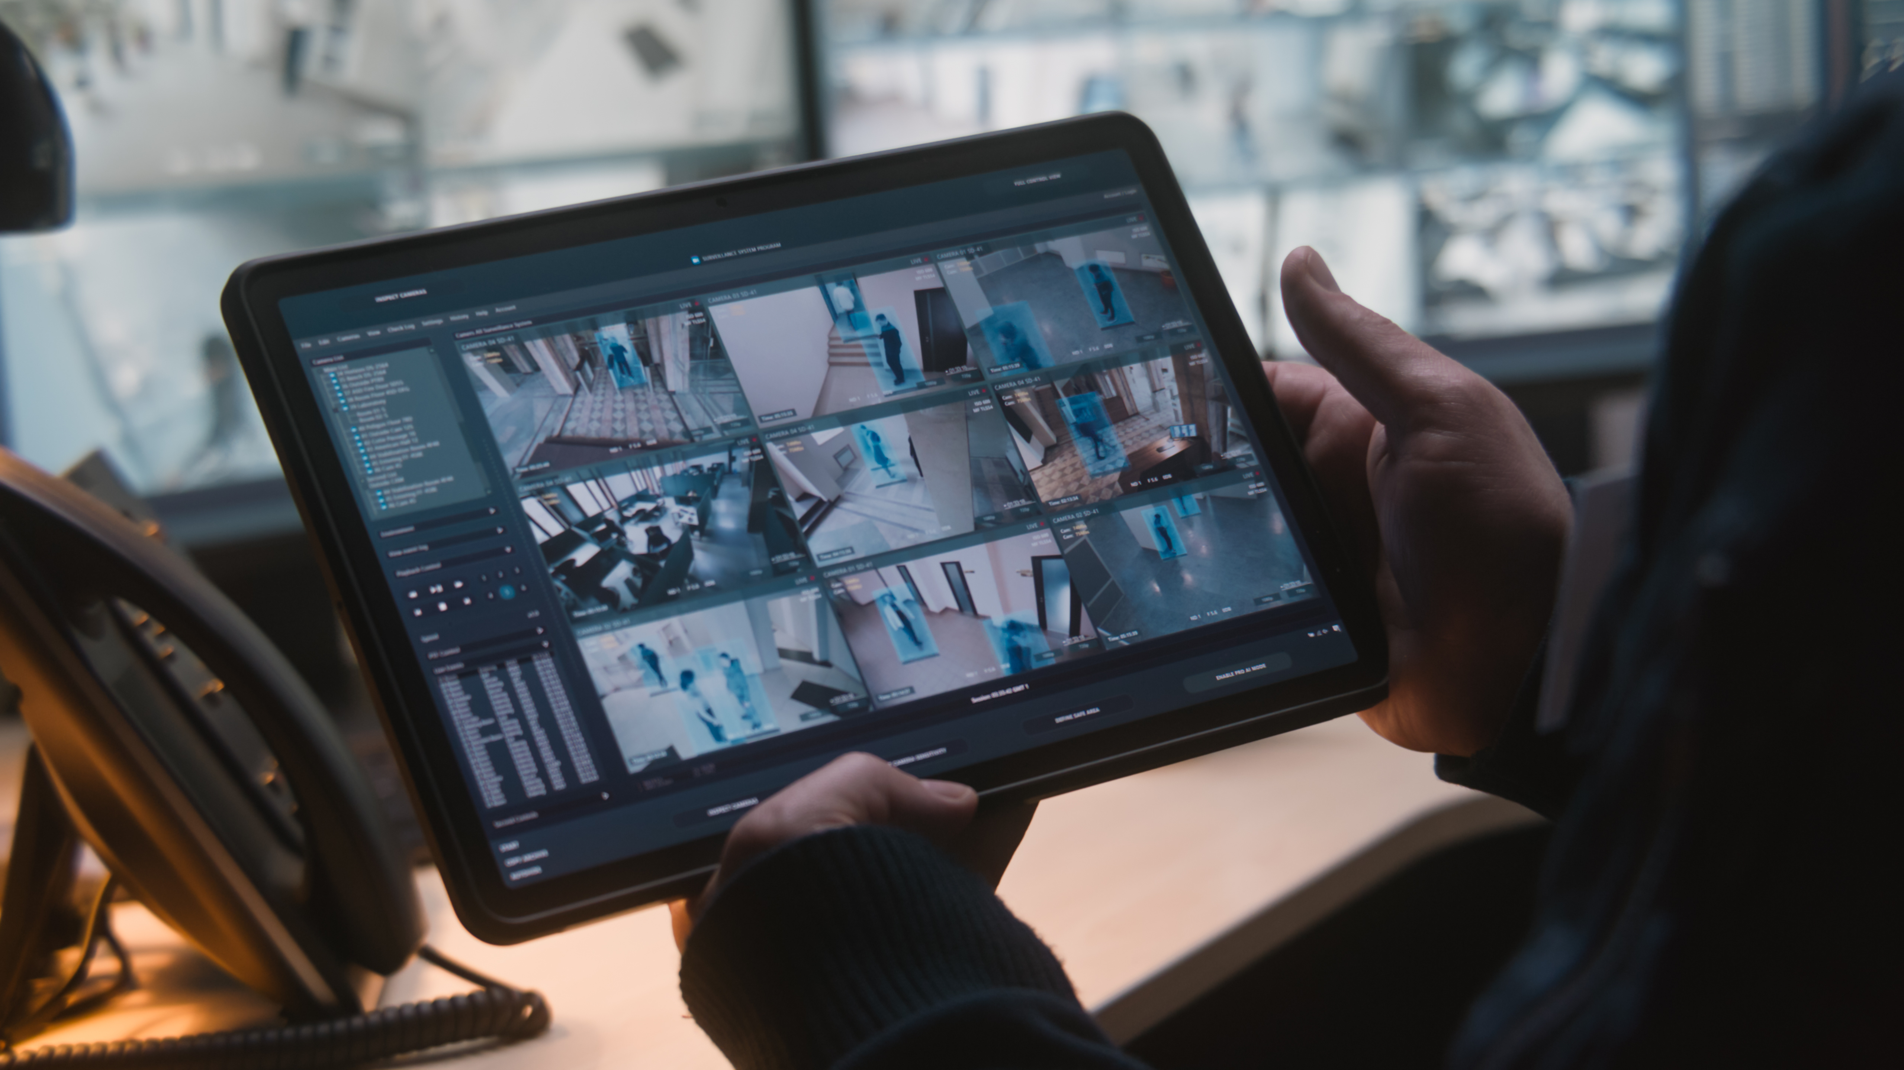
The Present
Software Solutions
How software, services and the cloud are transforming the security industry
AI Enhancements
The impact of intelligent advancements in video surveillance and security technologies
Modern, Open Infrastructure
How solutions address scalability, flexibility, and integration compared to legacy systems

Slide 7




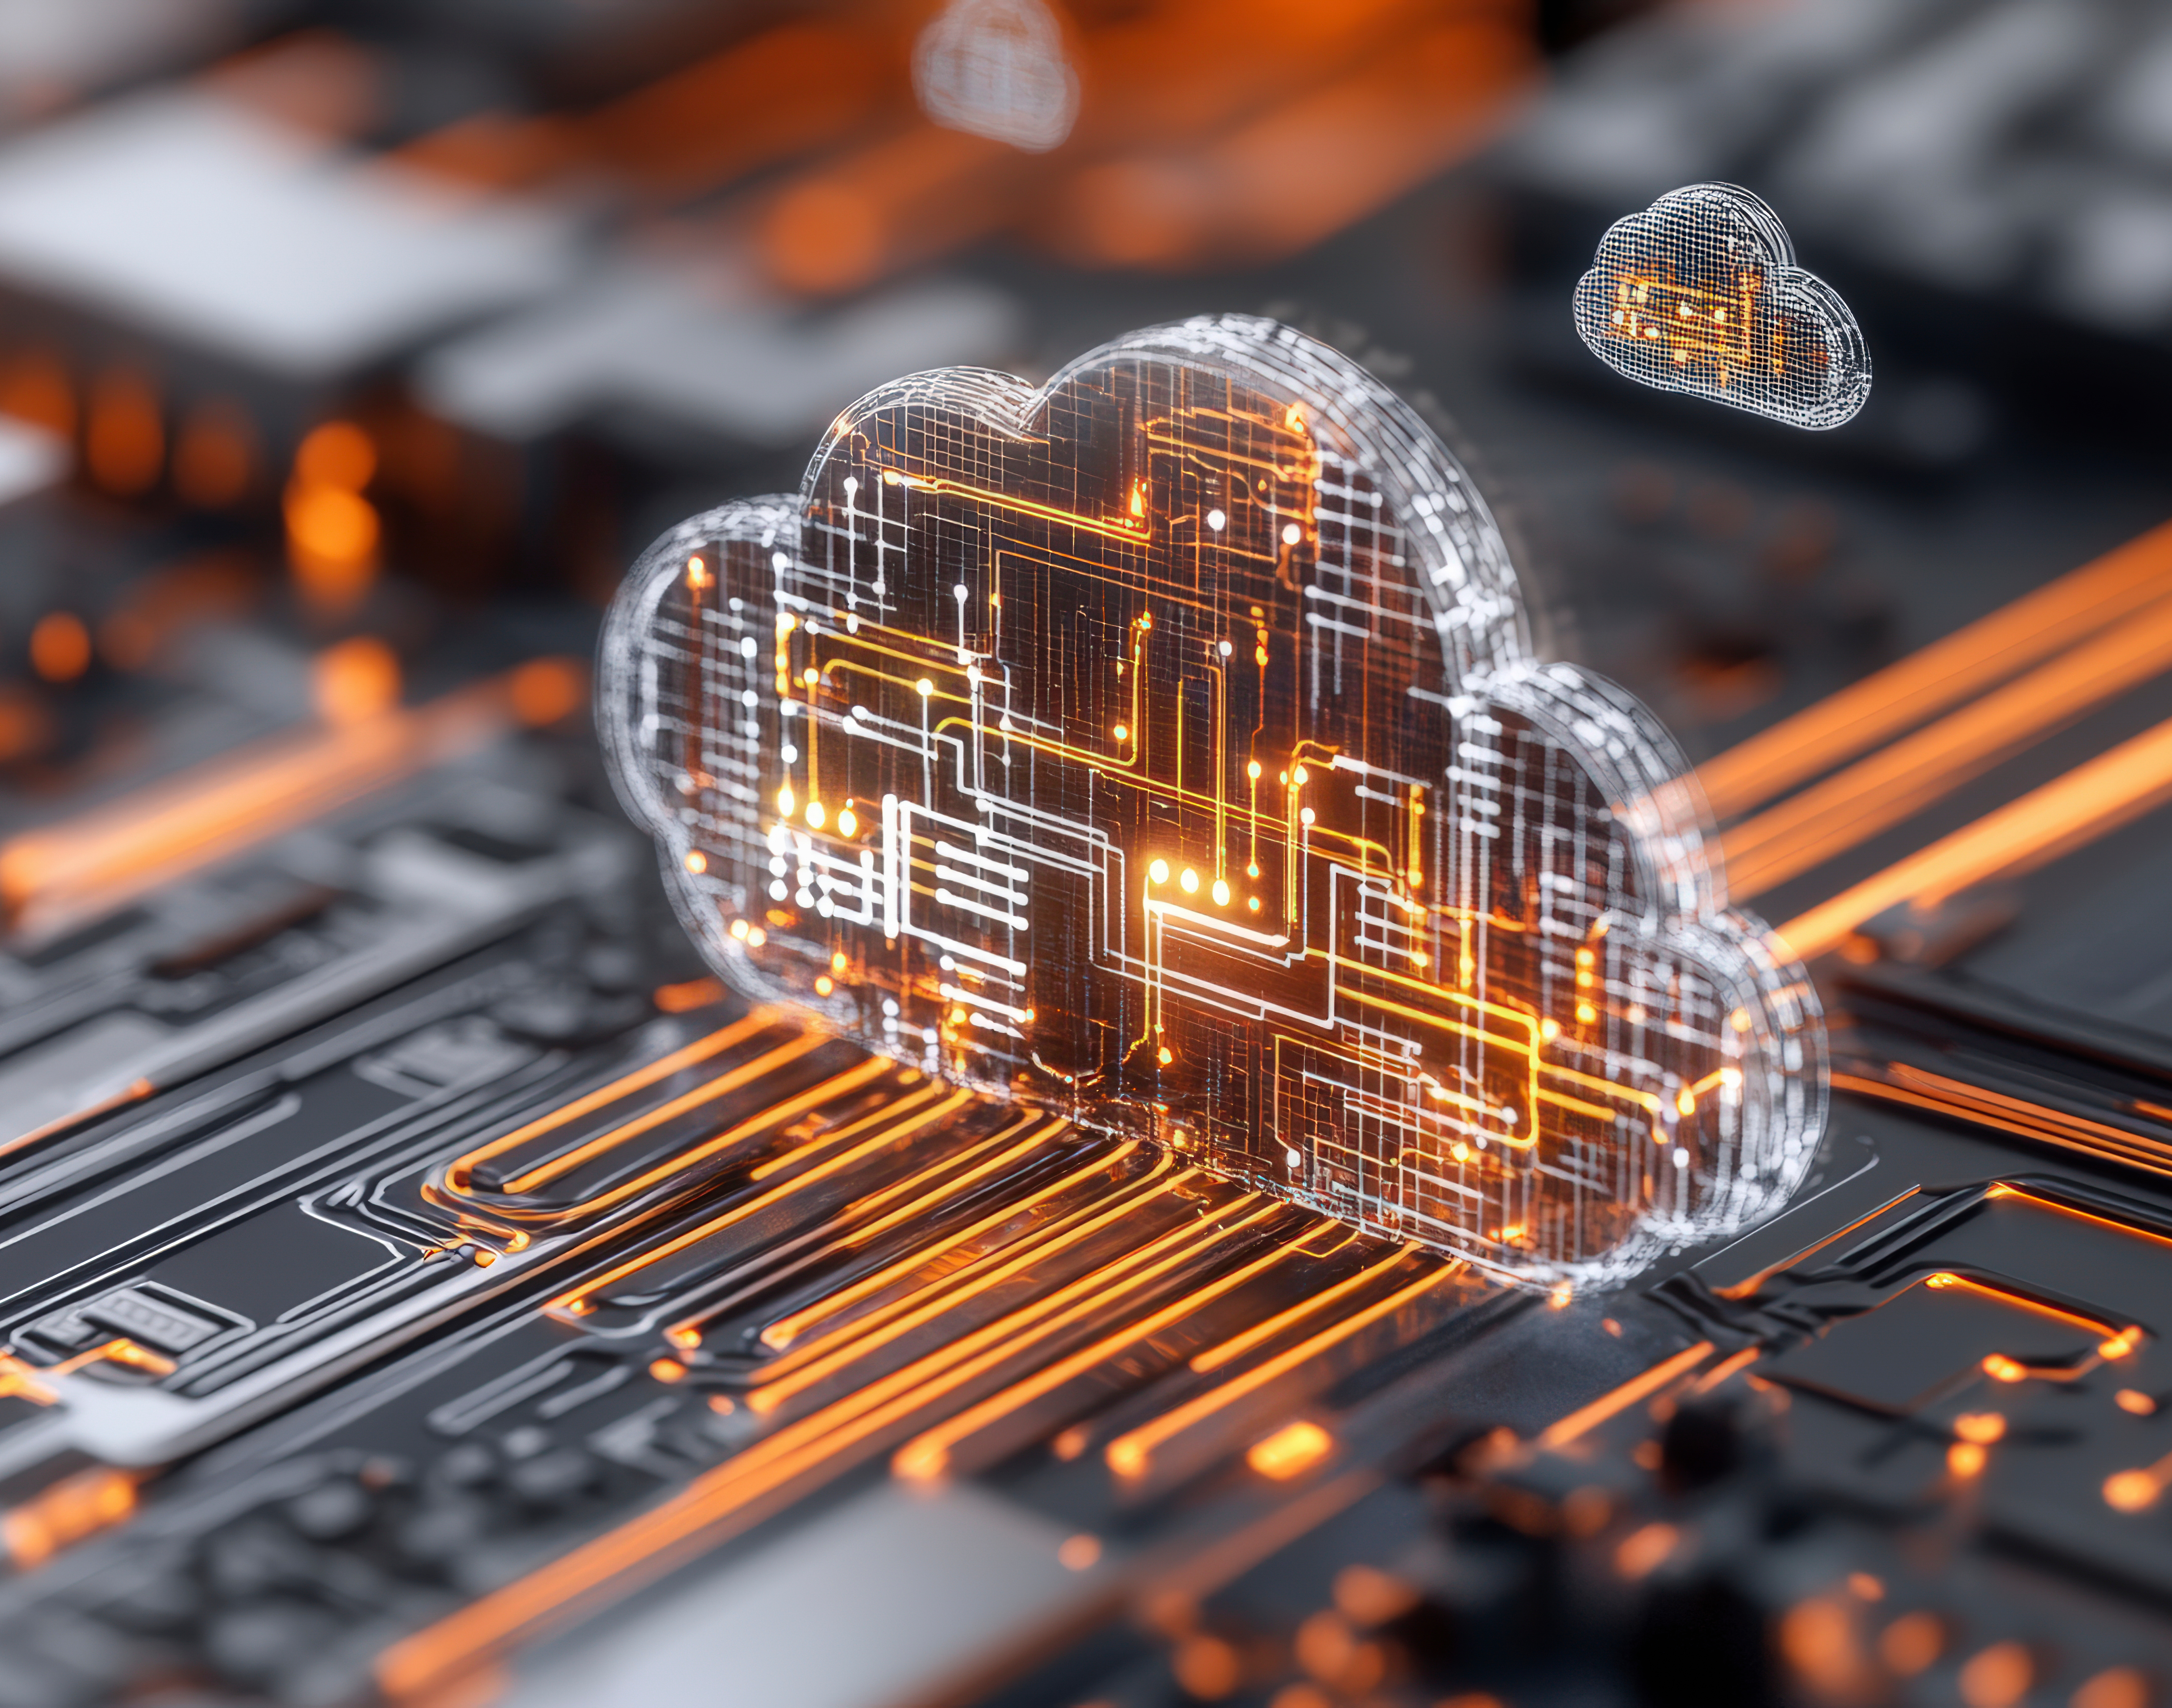

Slide 8

The Future
AI's Impact
How artificial intelligence will shape the evolution of physical security
Advances in Systems Integration
What does the security integrator of tomorrow look like?
Empowering Decision Intelligence
Leveraging security data and AI for smarter, real-time decision-making.

Slide 9





Slide 10
Preparing for the Future
Takeaways here (to come based on speaker discussions)

Slide 11
Q&A

Slide 12

Connect with Our Experts

Slide 14

Thank you
Please scan the QR code below to complete our survey and share your thoughts and experiences.

