Slide 1
Crisis Management: Is not Just A Checklist
An overview of effective crisis management strategies that go beyond traditional checklists and emphasize proactive planning, adaptability, and strategic decision-making.
Buffy Payne, Founder/CSO
Matt Payne, Founder/CSO

Slide 2




INTRODUCTION
Starts with a solid intelligence program
Understand the dynamic nature of crises
A solid intelligence program is the foundation to ensure a strong crisis management program, as crisis management will not work if the organization does not know something is wrong.
Crisis situations are often unpredictable, with rapidly evolving circumstances that require flexible and adaptive approaches.
Emphasize communication and coordination
Embrace a holistic perspective
Successful crisis response requires clear, transparent, and timely communication among all relevant parties, as well as effective coordination of resources and efforts.
Crisis management extends beyond immediate problem-solving and must consider the long-term implications and broader organizational resilience.
Crisis management is a complex and multifaceted challenge that demands a nuanced approach, going beyond simple checklists and focusing on adaptability, context, communication, and a holistic perspective.

Slide 3


THE ROLE OF TECHNOLOGY
Technology plays a crucial role in enhancing crisis preparedness and response. From early warning systems and disaster monitoring to real-time communication and resource coordination, technology can significantly improve our ability to anticipate, mitigate, and effectively respond to various emergencies and disasters.

Slide 4



IMPORTANCE OF NETWORKS
Coordination among departments within the organization
Information Sharing with Local Authorities
Private-Public Partnerships
Community Engagement
Industry connections

Slide 5




CRISIS SIMULATION DRILLS
Importance of Crisis Simulation Drills
Identifying Potential Crises
Designing Effective Drills
Evaluating and Improving
Regular crisis simulation drills help organizations prepare for and respond effectively to unexpected events, minimizing potential damage and ensuring business continuity.
Organizations should conduct thorough risk assessments to identify potential crises, such as natural disasters, cyberattacks, equipment failures, or supply chain disruptions, and develop appropriate response strategies.
Crisis simulation drills must utilize realistic scenarios, engage key stakeholders, and assess the organization's crisis communication, coordination, and execution capabilities. Additionally, these drills should test the crisis team's resilience by removing members to gauge how others respond.
After each drill, organizations should carefully evaluate their performance, identify areas for improvement, and incorporate lessons learned into their crisis management plans to enhance their readiness for future events.

Slide 6

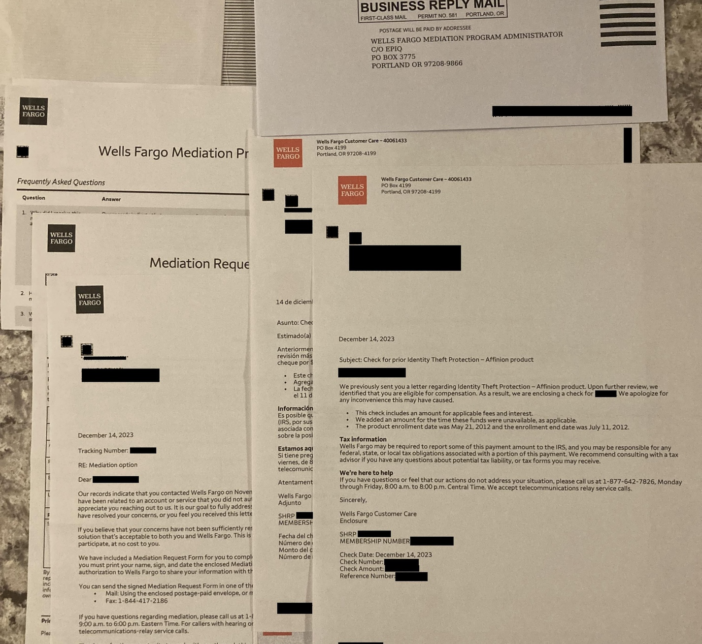
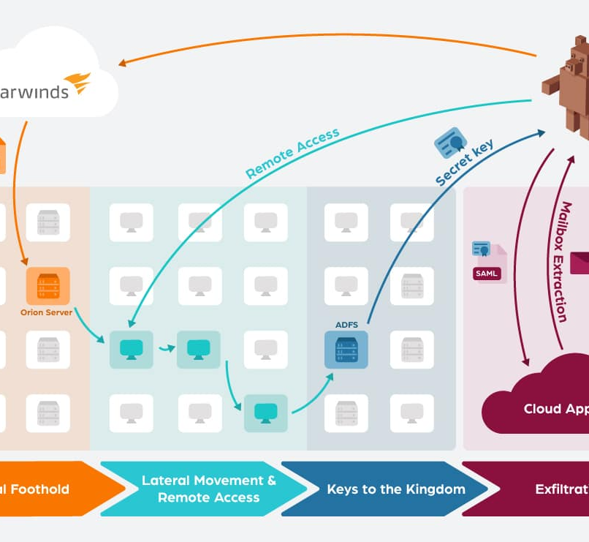
LESSONS FROM PAST CRISES
Volkswagen Diesel Emission Scandal
Wells Fargo Account Scandal
Solar Winds Cyber Attack
The Volkswagen diesel emissions scandal revealed inadequate regulatory oversight and the need for stricter emissions standards and manufacturer accountability in the automotive industry.
The Wells Fargo employee account fraud incident exposed systemic issues, including unethical sales practices, inadequate oversight, and the need for enhanced transparency and accountability in the banking industry.
The SolarWinds cyberattack revealed vulnerabilities in global cybersecurity, underscoring the need for robust incident response and international cooperation to safeguard critical infrastructure and data.

Slide 7
CRISIS COMMUNICATION STRATEGIES
Rapid Response
Audience-Focused Messaging
Proactive Communication
Establish a crisis communication team and respond quickly to address the issue, provide updates, and demonstrate transparency.
Tailor your messaging to the specific needs and concerns of your stakeholders, including employees, customers, media, and the public.
Anticipate potential crises and develop a pre-planned communication strategy to mitigate the impact and maintain control of the narrative.
Leveraging Multiple Channels
Empathy and Accountability
Continuous Monitoring and Adjustment
Utilize a variety of communication channels, such as press releases, social media, website updates, and direct outreach, to ensure your message reaches all relevant stakeholders.
Express empathy for those affected by the crisis and take responsibility for the situation, while also highlighting the steps being taken to resolve the issue.
Continuously monitor the situation, gather feedback, and adjust your communication strategy as needed to effectively address evolving concerns and maintain public trust.

Slide 8



THE EVOLVING NATURE OF CRISES
What does the future hold?
1970s
2000s
2020s
Organizations must be proactive, adaptable, and resilient to effectively manage emerging and evolving threats.
Emergence of crisis management as a distinct field, with a focus on natural disasters and industrial accidents.
Increased emphasis on crisis planning, communication, and the role of social media in crisis response.
Adapting crisis management to address the challenges of climate change, geopolitical tensions, and global supply chain disruptions.
1980s-1990s
2010s
Shift towards managing crises caused by product recalls, corporate scandals, and reputation threats.
Growing awareness of cyber threats, pandemics, and the need for resilience in crisis management.

Slide 9
CRISIS MANAGEMENT TECHNOLOGY RESOURCES
Emergency Communication Systems
Incident Tracking and Reporting
Situational Awareness Dashboards
Robust communication tools to quickly alert and inform stakeholders during a crisis, such as mass notification systems, emergency hotlines, and secure messaging platforms.
Software solutions that enable real-time incident monitoring, documentation, and reporting to facilitate effective response and analysis.
Centralized dashboards that provide a comprehensive view of the crisis incident, including real-time data feeds, geospatial mapping, and analytical insights.
Business Continuity Planning
Disaster Recovery Solutions
Tools and templates to develop, maintain, and regularly test comprehensive business continuity plans to ensure organizational resilience during disruptions.
Robust backup and recovery systems to protect critical data and infrastructure, enabling rapid restoration of operations in the event of a disaster.

Slide 10
CRISIS MANAGEMENT TECH FOR RESILIENCE
Cloud-Based Platform
Offline Capabilities
Comprehensive Plans
In Case of Crisis is a cloud-based software that can be accessed from anywhere, outside the corporate network, providing a centralized hub for crisis management activities.
The platform has built-in offline functionality, allowing users to access critical information, playbooks, and tools even when network connectivity is disrupted.
In Case of Crisis consolidates all crisis management plans, procedures, and response protocols in a single, secure location, ensuring everyone has access to the latest information.
Secure Collaboration
Incident Tracking
Adaptive Playbooks
The platform provides a protected, purpose-built workspace for crisis management teams to coordinate response efforts, share information, and make decisions in a secure environment.
The platform tracks all actions taken, decisions made, and relevant information during a crisis, enabling post-event review and continuous improvement of crisis management plans.
Interactive, role-based playbooks can be quickly updated and shared with stakeholders, ensuring everyone has access to the most current guidance and response procedures.

Slide 11



Conduct Site Assessments
Test Your Plan with Red Ball Drills
Analyze and Implement Recommendations
Develop Your Plan
Examine your organization's security and emergency documentation, including crisis plans, safety policies, and incident response procedures. Pinpoint any weaknesses or areas needing enhancement.
Thoroughly evaluate your organization's security stance, operations, and safeguards to devise tailored test scenarios that address your specific needs.
The Red Ball Drills approach evaluates your emergency plan through engaging discussions, identifying areas for improvement without interrupting daily operations.
The Red Ball Drills team's report details observations and recommendations from their assessment and testing. Implement these changes to bolster your organization's security and emergency readiness.

Slide 12
Lifecycle of Crisis Management
Crisis Management Team at the appropriate level
Emergency
Response
Preparation
Crisis Management
Business Continuity / Disaster Recovery
Simulations and Calibration
After Action – Lessons Learned
Incident
Crisis Management Planning
Emergency Response Planning
Business Continuity Plan
(BCP)
BOOM
Workarounds (BU)
Recovery (BU)
Time

Slide 13

ACTIVE ASSAILANT CASE STUDY

Slide 14


Slide 15


Slide 16


Slide 17

QUESTIONS???

Slide 18

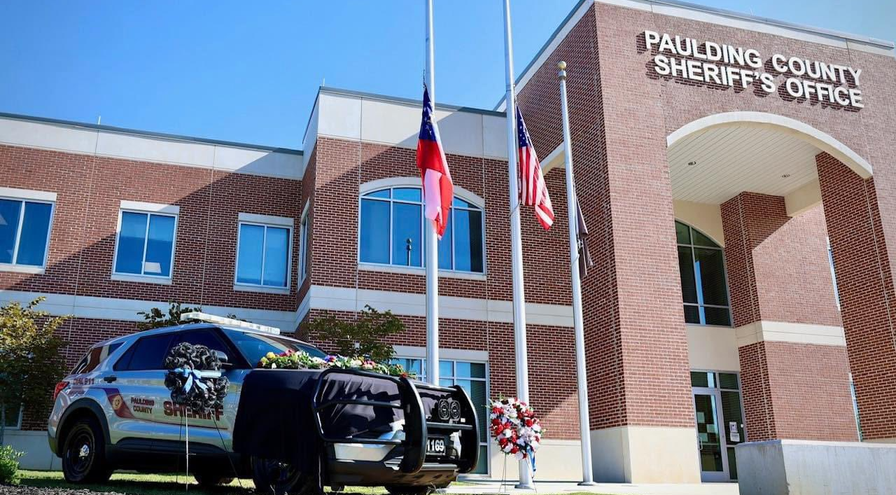


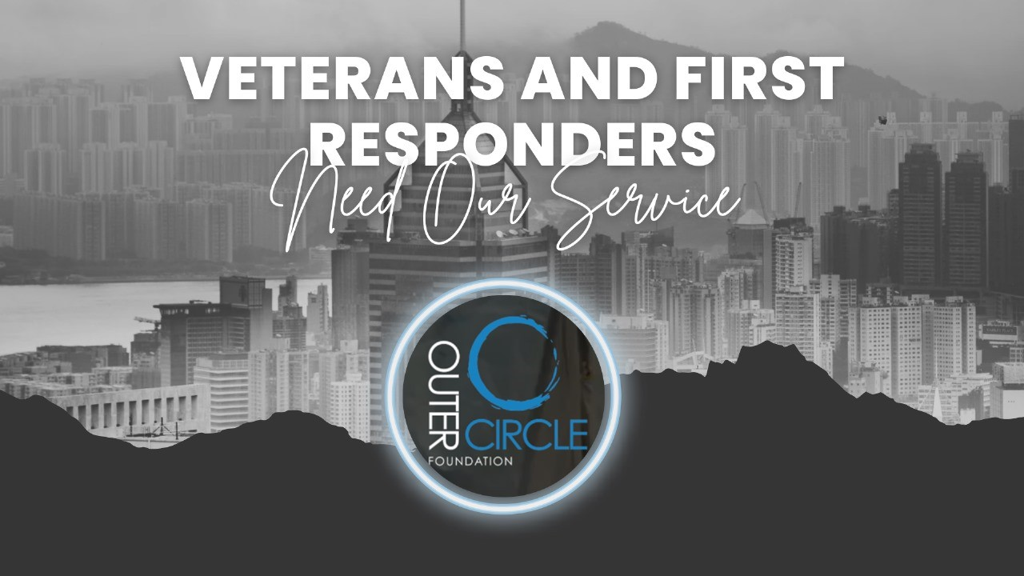

Slide 19




Buffy Payne
Senior Security Consultant/CSO, President FEW
770.335.2169
Buffy.payne@rockdovesolutions.com
Matt Payne
CSO/Founder, Outer Circle Foundation
910.309.5335
matt@outercirclefoundation.org

