Slide 1
DEMYSTIFYING GSA E-TOOLS FOR DOING BUSINESS WITH THE GOVERNMENT
Lynn de Seve, President, GSA Schedules, Inc.
Gabriella Moraniec, Sr. Contracts Mgr. GSA Schedules, Inc.

Slide 2
Agenda
The GSA Multiple Award Schedule Program
SAM Registration
GSA Roadmap
Public GSA eTools
GSA eTools for GSA Contractors only

Slide 3
GSA Multiple Award Schedule Program (MAS)
The “GSA Contract”, “the Schedule”, “GSA Listed…” What is it?
    Indefinite Delivery, Indefinite Quantity (IDIQ)
    Long term, multiple awardees contracts
    Pre-qualification of contractors for products and services
    Represents over 21% of Federal Procurement Spending
    Requires dedication, compliance and outreach to be successful
    Valid for up to 20 years
* Security and IT categories available for Cooperative Purchasing *

Slide 4
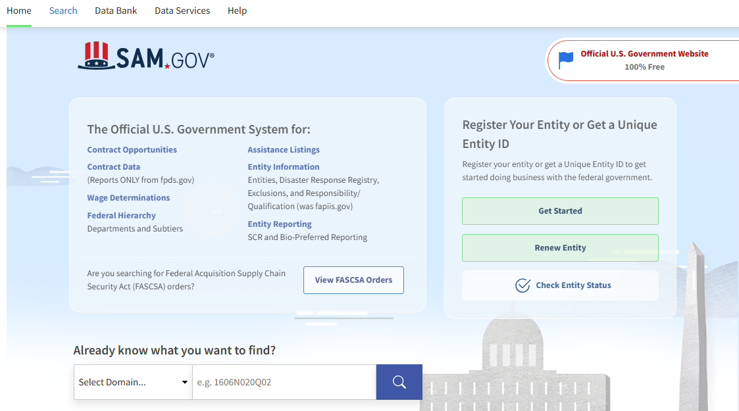
System for Award Management (SAM.gov)
Registration for doing business with the Government
Procurement Opportunities
Department of Labor Resources
Other Resources for Contractors

Slide 5
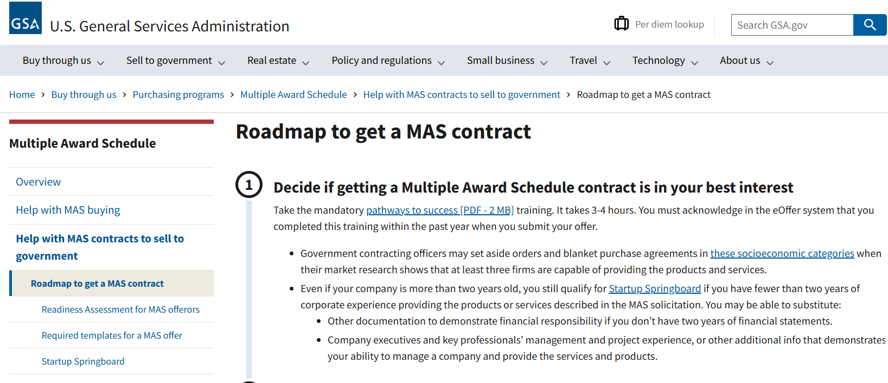
GSA Roadmap
GSA MAS Solicitation
Pathways to Success
Readiness Assessment
Templates for Submitting Required Data
Post award Documents for Current GSA Contractors

Slide 6
Public GSA e-Tools
GSA.GOV for general information about buying and selling to the federal government
VENDOR SUPPORT CENTER for general contract questions, POC info, catalog submission tools 877-495-4849. https://vsc.gsa.gov
GSA E-LIBRARY for a listing of all GSA Contractors, search by key words, SINS, contract holders www.gsaelibrary.gsa.gov
GSA ADVANTAGE for pricing catalog and a search engine for products www.gsaadvantage.gov
FEDERAL PROCUREMENT DATA CENTER for a Database listing of sales info to the Federal Government by Contractor listed by GSA Contract Number, by UEI, by Agencies. www.fpds.gov

Slide 7
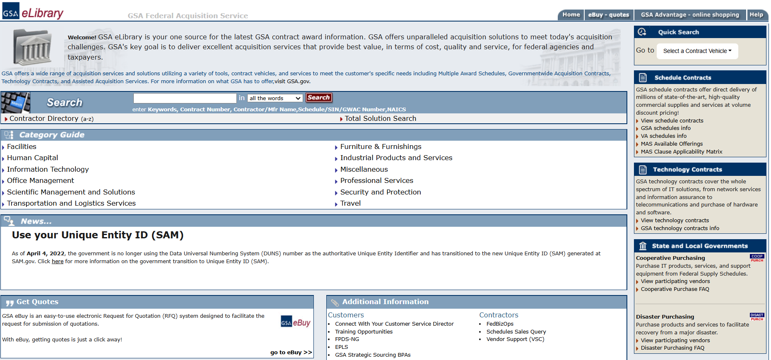
GSA e-Library

Slide 8
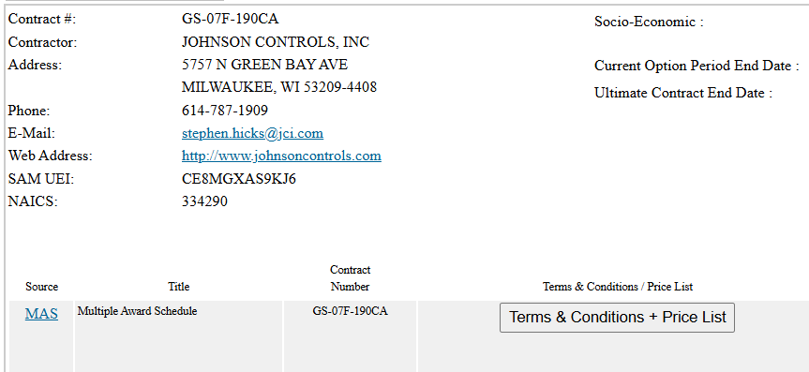
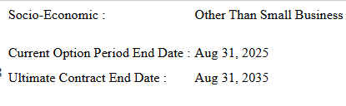
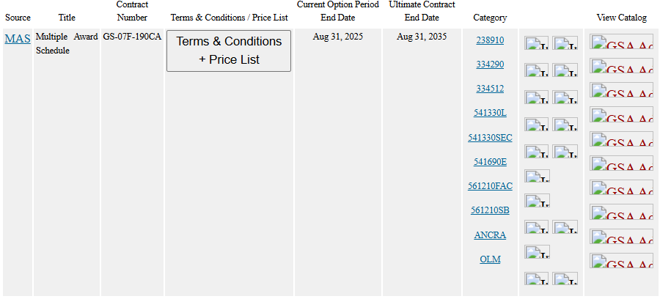
GSA e-Library
Contractor Page

Slide 9
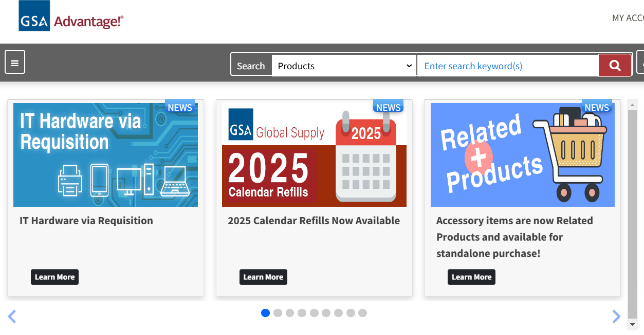
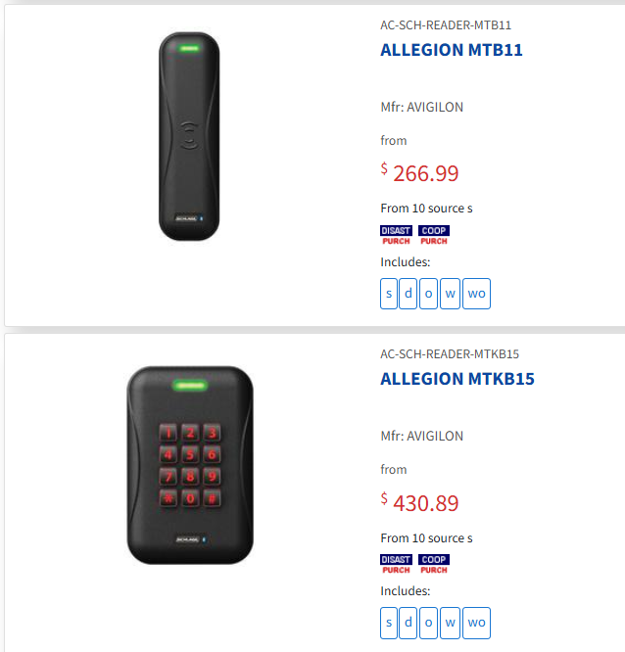
GSA Advantage
Search by product number, advanced search to filter by SIN, manufacturer, and more!
GSA Contractor e-Library page linked to products on a vendor’s contract
Product listings and sources

Slide 10
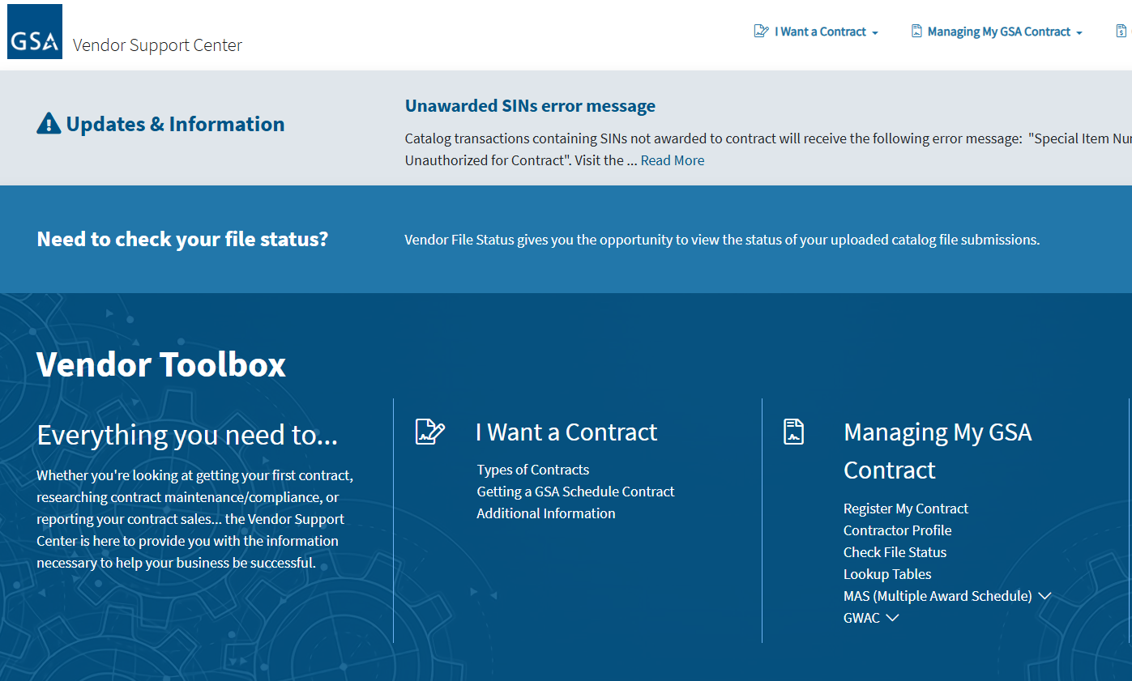
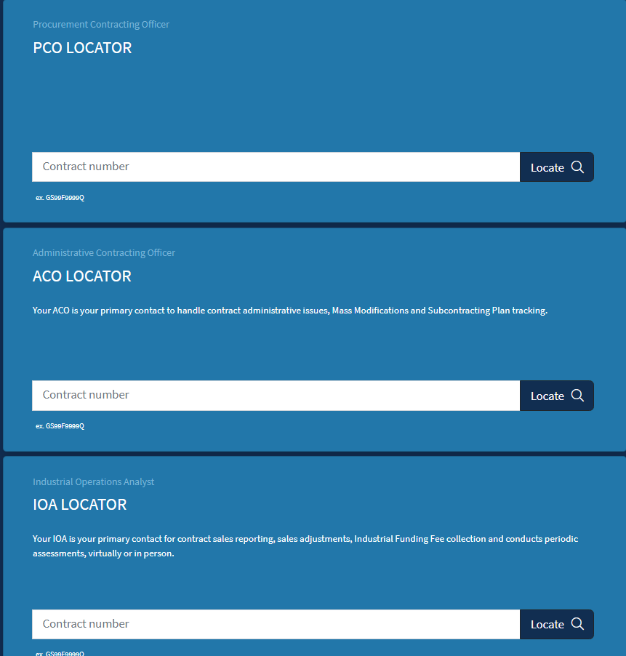
Vendor
Support
Center
https://vsc.gsa.gov

Slide 11
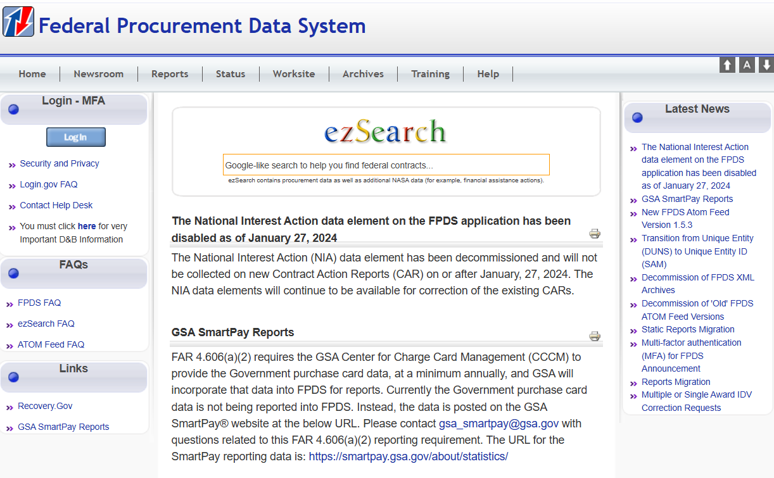

Slide 12
GSA e-Tools for Gov Contractors Only
GSA eBuy for GSA opportunities, based on eligible SIN (www.gsaebuy.gsa.gov)
GSA eMod/eOffer for contract modification and proposals (https://eoffer.gsa.gov)
GSA Sales Reporting for reporting sales per contract terms (https://srp.fas.gsa.gov)
Small Business Subcontracting Reporting for reporting performance on subcontracting goals, if applicable (www.esrs.gov)
PO Portal for retrieving and maintaining GSA orders (www.poportal.gsa.gov)
GSA Roadmap for Contractors (www.gsa.gov/masroadmap)

Slide 13
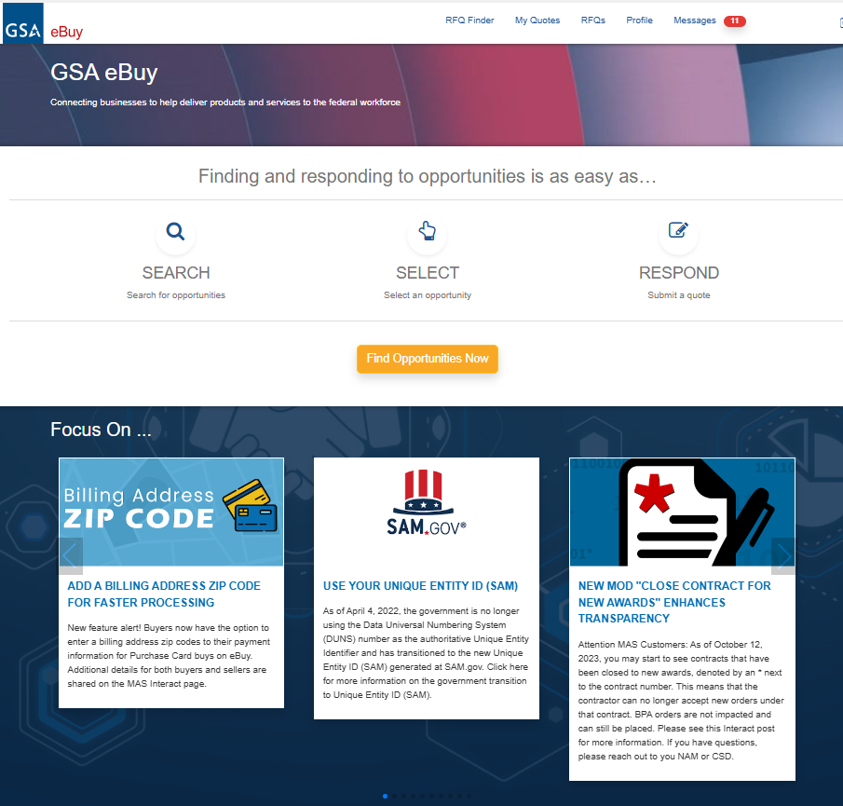
GSA e-Buy!
GSA eBuy, a component of GSA Advantage, is an online Request for Quote (RFQ) tool used by federal, state, and local government agencies to request quotes for a wide range of commercial supplies (products) and services

Slide 14
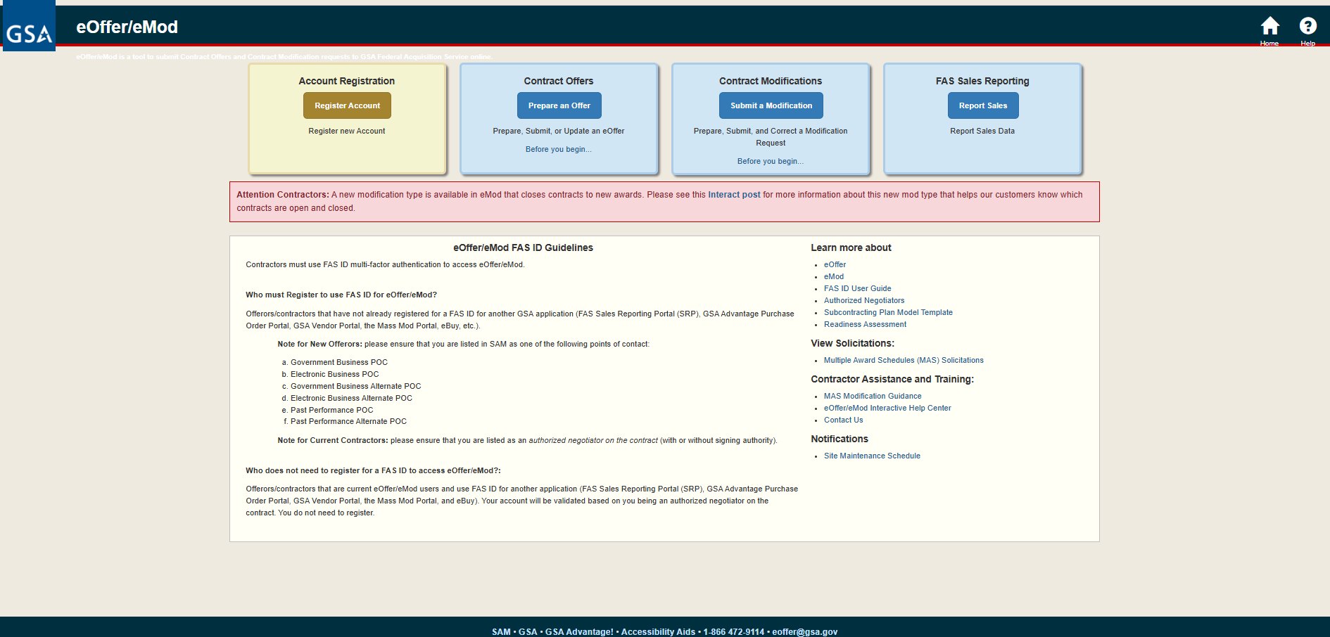
GSA eOffer/eMod

Slide 15
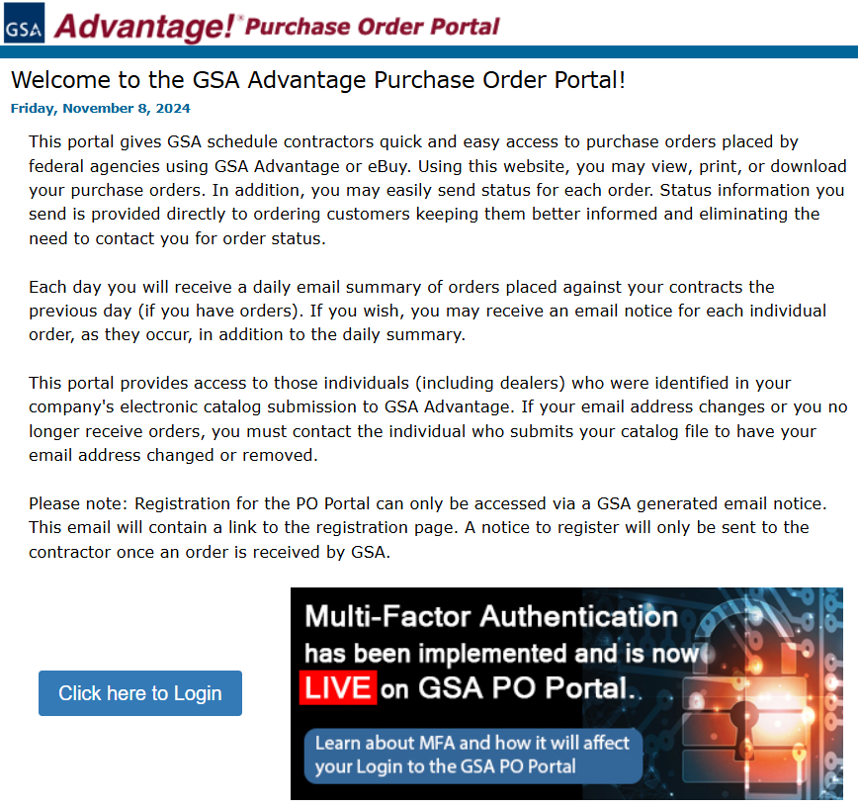
PO Portal
Single sign in
Shopping cart for agencies
Download POs Daily
Post status of shipping and back orders

Slide 16

Q&A
Thank you
Lynn de Seve, President lynn@gsa-schedules.com
Gabriella Moraniec, Sr. Contracts Mgr. Gabriella @gsa-schedules.com
301-805-1300
Please scan the QR code below to complete our survey and share your thoughts and experiences.

