Slide 1

Your Career, Your Journey
Kerri Sutherland, FAST Chair
Notes:
Session Description
In today’s rapidly evolving professional landscape, taking control of your career has never been more vital. Whether you are just starting your journey or seeking to advance to the next level, proactively managing your career path can open a multitude of opportunities for personal and professional growth. This session will explore the strategies and mindsets needed to navigate and thrive in the dynamic world of work, providing you with the confidence and tools necessary to shape a successful career journey on your terms. You will also gain practical insights and actionable advice to enhance your career trajectory, overcome obstacles, and achieve sustained long-term success.
Content Outline
Welcome and introductions – 5 minutes
Career growth strategy and tactics (goals, brand, network etc) – 10 minutes
Growth mindset & L&D – 5 minutes
Overcome challenges, setbacks and change– 5 minutes
Create roadmap/ action plan – 10 minutes
Questions from audience – 10 minutes
Learning Objectives
Identify and leverage career growth opportunities by setting clear goals, continuously developing skills, building a strong personal brand, and leveraging networks.
Foster a career management and growth mindset and learn to overcome career challenges, setbacks, and navigate career transitions with confidence.
Design and implement a personalized career roadmap by creating SMART goals and step by step action plan.

Slide 2

Learning objectives
Identify career growth opportunities by setting clear goals, continuously developing skills, building a strong personal brand, and leveraging networks.
1
Foster a growth mindset and learn to overcome career challenges, setbacks, and navigate career transitions with confidence.
2
Design and implement a personalized career roadmap by creating SMART goals with a step by step action plan.
3
Notes:
Welcome and introductions – 5 mins
Career growth strategy and tactics (goals, brand, network etc) – 10 minutes
Growth mindset & L&D – 5 minutes
Overcome challenges, setbacks and change– 5 minutes
Create roadmap/ action plan – 10 minutes
Questions from audience – 10 minutes

Slide 3






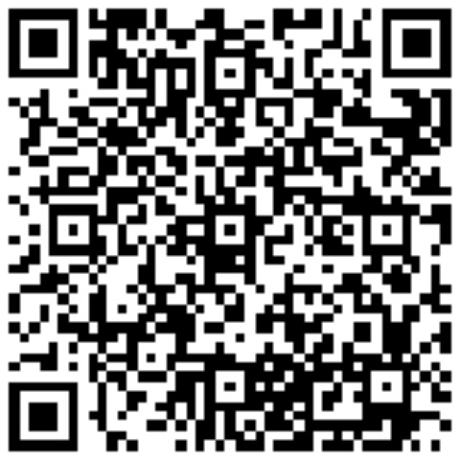

About me
Notes:
Kerri Sutherland has held a human resource business partnership position at Axis Communications since 2017. She holds an MBA with a concentration in human resource management from the University of Texas A&M and is certified as a senior professional by the Society of Human Resource Management. She has more than a decade of successful experience in the field with a primary focus on hiring, employee development and employee engagement. Sutherland’s human resource journey began at various international tech companies, and she currently supports the Americas region at Axis by recruiting and retaining top talent while safeguarding the company’s culture She also sits as the chair for the Foundation of Advancing Security Talent and serves on the board of a local nonprofit humane society. She has facilitated countless training programs which advances her passion for seeing both individuals and businesses succeed in unified goals.
Insert fam/ friends, travel, yoga

Slide 4
25%
33%
Data
Confident about career paths
Know how to advance careers
46%
50%
Satisfied with career development
Can rely on managers for help
Notes:
One in four workers (25%) is confident about their career path. That’s based on a 2022 Gartner survey of more than 3,300 employees.
In addition, the research revealed that fewer than one in three (33%) of workers knows how to advance their careers over the next five years.
Gartner Survey Finds Just 46% of Employees Are Satisfied with Their Career Development.
And the worst part, only half (50%) of the respondents feel they can rely on their managers for help in their career development.

Slide 5
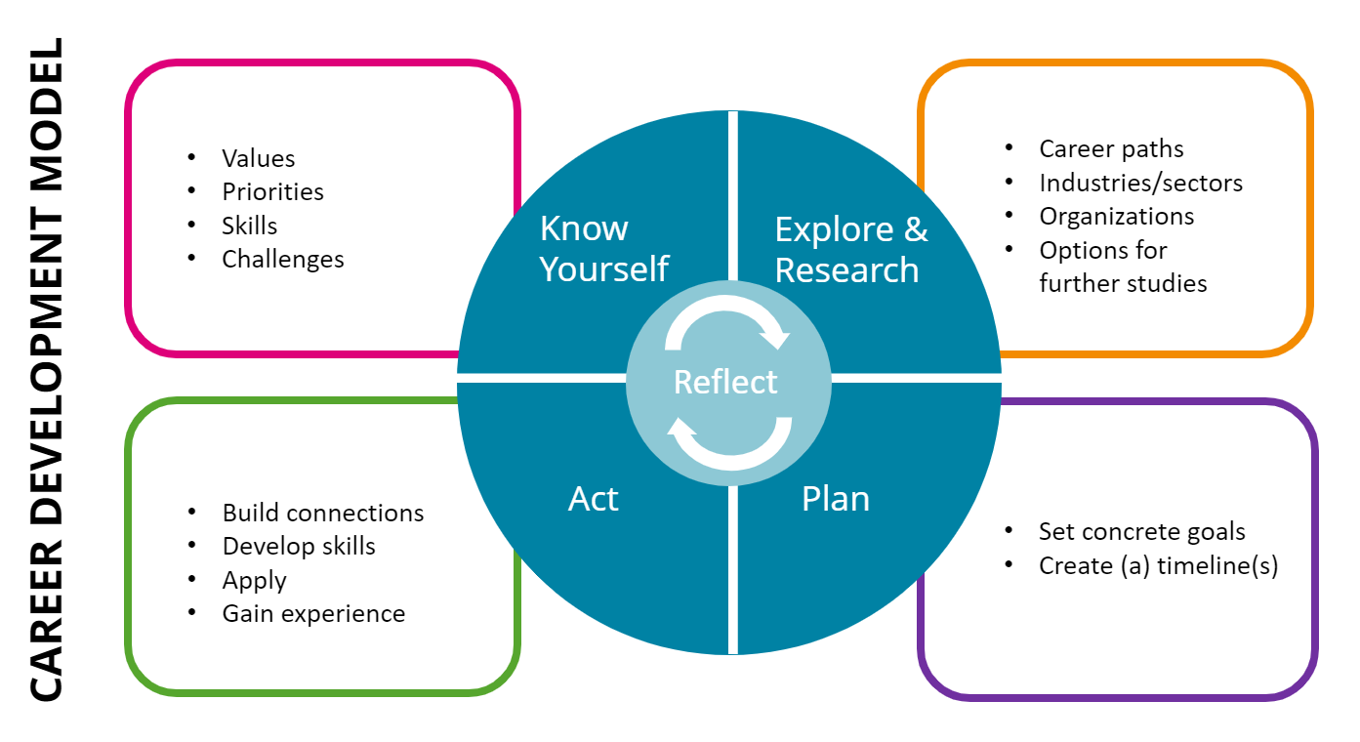
https://au.prosple.com/career-planning/career-development-2024-guide-for-professional-growth
Notes:
*University models* https://careercenter.ceu.edu/undergraduate-career-development
- Almost every university has some type of career model in their career services- I almost used one from Harvard but I liked this image better.
https://www.hsph.harvard.edu/career-services/career-tools/
https://corporateescapeartist.com/how-to-forge-a-career-path-in-your-organization/
Frank Parsons is considered the "father of vocational guidance". His Trait and Factor Theory is about matching your unique qualities with the demands of different jobs. Here's the breakdown: Your Traits are your strengths, interests, and personality.
https://au.prosple.com/career-planning/career-development-2024-guide-for-professional-growth
1. Discover your aspirations & values
To understand your aspirations and values, do deep introspection. Start by considering your interests, passions, and what motivates you. Reflect on past experiences, both positive and negative, to identify patterns and preferences. Ask yourself questions like:
What do I enjoy doing?
What values are important to me in a job?
What kind of work environment suits me best? Is it autonomy, collaboration, creativity, or something else?
Understand your aspirations and values to build a solid foundation for matching your career goals with your fulfilment.
2. Identify needed skills & gaps
Evaluate both hard skills, like technical abilities and industry-specific knowledge, and soft skills, like communication, problem-solving, and leadership. Compare them to your dream job requirements or desired career path. Identify areas where you need to upskill or acquire new knowledge.
Look closely at job descriptions and industry trends to pinpoint these areas. Be specific: software you need to learn, certifications to pursue, or communication skills to strengthen. Ask mentors, colleagues, or peers for honest feedback on your strengths and areas for improvement. This feedback can be highly valuable in pinpointing your skill gaps.
3. Create your personalised development plan
Set clear, specific goals based on your aspirations and identified skill gaps. Break these goals down into smaller, actionable steps so they are measurable and time-bound. Consider using the SMART goal-setting framework to be clear and accountable.
Regularly review and adjust your plan as needed to accommodate changes in your career aspirations or external circumstances.
4. Bridge gaps by continuous learning & upskilling
Embrace a growth mindset – recognise that there is always room for improvement and new opportunities to learn. Take ownership of your development. Actively seek learning opportunities and dedicate time to upskilling, even if it requires personal effort outside of work hours.
Use different resources and support systems to achieve your goals. This can include:
Mentorship
Formal education
Training programs
Self-study materials
Networking opportunities
Make ongoing learning a habit. Stay updated on industry trends, emerging technologies, and relevant skills through reading, attending webinars, or participating in online courses. Don’t forget to track your progress – it will help you gauge your growth and identify areas for further improvement.
Reflect /know yourself
Reflecting on and articulating your values, interests, strengths, priorities, and constraints is important in the career development process. This creates a tailored-to-you foundation as you explore career opportunities, set goals, and identify a suitable direction.
Self Assessments
16Personalities
MBTI – Myers-Briggs Type Indicator, personality inventory
CliftonStrengths Assessment – Formerly StrengthsFinder, a talent assessment tool to help you identify what you’re good at and turn those talents into strengths
ImaginePhD – Career exploration and planning tool for the humanities and social sciences
myIDP – Science Careers, Individual Development Plans
Explore:
There is a wide range of fields and career paths to explore as you begin thinking about and moving towards your future. Proactively investigating what’s out there and speaking to people who have already established a career is a great way to build knowledge, gain clarity, and source inspiration as you forge your own path.
Careers Pathways/Sectors
Career Expos, Employer Info sessions, Panels
Site visits and career treks
Fellowships
Job shadow
Internships/Volunteering
Develop/ Plan
Making concrete, flexible plans will help you move forward with confidence and engage constructively with unexpected turns of events. It’s important to keep your long-term goals in mind and think about how your short-term plans contribute to achieving them.
Resume/CVs, and Cover letters
Navigating Your Career at Harvard Chan
Public Speaking and Presenting
Academic Job Search
Interviewing
International Student Resources
Negotiating Compensation
Apply:
Whether applying for an advertised position or sending an open application, your goal is to demonstrate in a clear and concise manner your interests, skills, experiences, motivation, and cultural fit. This is not an easy task and writing strong applications and being prepared for interviews requires time and effort.
Networking and LinkedIn
Conferences and professional associations
Informational Interviewing

Slide 6









My journey
Know yourself
END
Notes:
Go through story ties back to items above- talk about me in life jacket having no clue…
Know self- values
Career path, industry … HR
Goals, timeline
Act
UNH- 2009
Stop and shop- 2010
Texas A&M- 2011
HEB- 2011
iBasis- 2011-2013
Morpho- 2013-2016
Tracelink- 2015-2016
Axis 2017- present
LHS 2018- present
FAST 2020- present
NEXT….

Slide 7
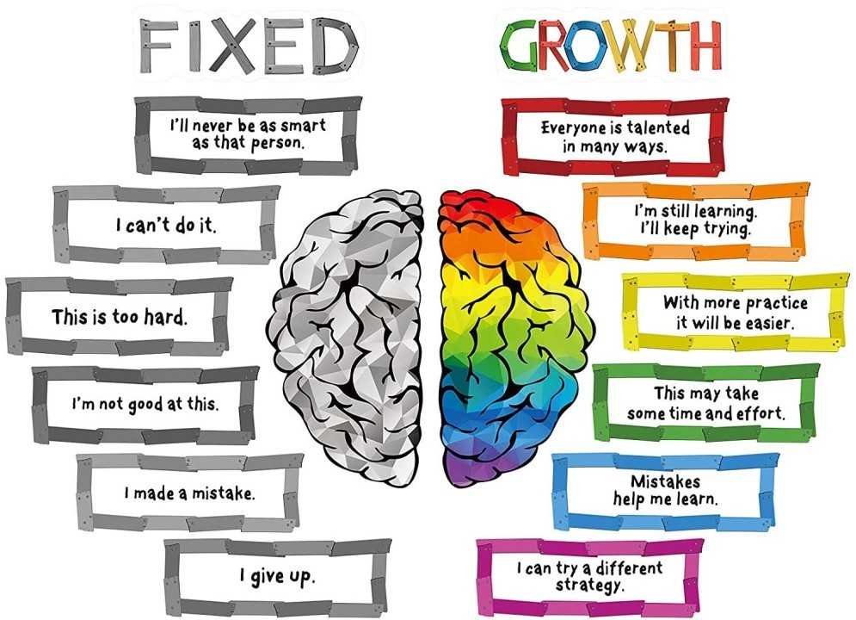
Explore & research
Notes:
https://www.linkedin.com/pulse/developing-growth-mindset-critical-insights-borrowing-alex-firmin-itfie/
Give a understanding of how the brain works, and what is human behaviour.
Ask for examples of both from audience…. Maybe tie back to my journey
A growth mindset is the belief that a person's abilities can be improved through effort, learning, and persistence. People with a growth mindset are more likely to:
See challenges as opportunities to learn and grow
Embrace feedback and learn from mistakes
Continue to learn and grow throughout life
Achieve more than those who believe their abilities are fixed
The term "growth mindset" was coined by American psychologist Carol Dweck in her 2006 book Mindset: The New Psychology of Success.
To develop a growth mindset, you can try:
Talking back to your internal dialogue with a new mindset
Challenging yourself to learn more
Choosing experiences that stretch you
Avoiding the trap of looking for friends or partners who will just shore up your self-esteem
Fixed mindset only works when you have the advantage, the capacaty and the luck not to run in to challanges.
Belive that skills can be learned –
Feedback is usefull –
Setbacks as wakeupcalls.
In kids we prime this behaviour
Fixed Mindset
leads to a desire to look good, so tends to:
Believe that most skills are based on traits that are fixed and cannot change
See effort as unnecessary; something to do when you’re not good enough
Avoid challenges because could reveal lack
of skill; tends to give up easily
See feedback as personally threatening to sense of self and gets defensive
View setbacks as discouraging; tends to blame others
Feel threatened by the success of others;
may undermine others in effort to look good
As a result, they may plateau early and achieve less than their full potential.
Growth Mindset
leads to a desire to learn, so tends to:
Believe that skills can always improve with hard work
See effort as a path to mastery and therefore essential
Embrace challenges and see them as opportunity to grow
See feedback as useful for learning and improving
Views setbacks as a wake-up call to work harder next time
Find lessons and inspiration in the success of others
As a result, they reach ever-higher levels of potential and performance.
Growth mindset relates to the belief that change is possible. Individuals with a growth mindset tend to believe that our essential attributes, such as intelligence or athletic ability, are malleable, and can be developed through hard work and effective strategies, whereas a fixed mindset relates to the belief that these characteristics are fixed (Dweck & Leggett, 1988). It is a theory about responses to challenges or setbacks. The idea had a considerable impact, and has also fostered its critics, primarily in the education environment where it has been applied very broadly; growth mindset interventions have yielded mixed results in terms of outcomes for students, and findings haven’t always been repeated. Whether it is universal is also in question, as cultural influences have been shown to impact the correlation between interventions and outcomes (see Li & Bates, 2019, on how studies in China have shown a null effect).
Carol Dweck, who coined the term, responds to her critics in an interview published in TES magazine (Severs, 2020). She states that it was a mistake for educators to believe it was a complete solution when her popular book was published in 2006. As a result, how it has been taught in schools has been variable, and often over simplified. She cites the problem of teaching the concept and then expecting that the student will act:
“Even though the teacher is not changing the policies and practices in the classroom. It is not about teaching the concept alone, it is much more about implementing practices that focus on growth and learning.”
The nature of the intervention, and how well-crafted it is, is a factor; does it leave students with an idea of how to put the theory into action? Is the approach autonomy supportive rather than didactic and dogmatic?
And yet, despite criticism, multiple studies and meta-analysis has shown that growth mindset interventions can have a positive effect on achievement (Sisk et al, 2018; Yeager & Dweck, 2020). Additionally, said interventions can positively affect resilience and determination. However, it clearly requires more than a PowerPoint slide to encourage individuals to adopt a growth mindset and begin to move the dial in relation to their results.
What makes for an effective growth mindset intervention?
It may be beneficial to go back a step, and look at a preceding idea, Albert Bandura’s theory of ‘self-efficacy’ (1977). This states that an individual’s belief that they can successfully perform a behaviour, and bring about an outcome, will positively impact the effort they will put in, their resilience in the face of setbacks, and the success of the endeavour. In multiple studies and meta-analyses, people with high levels of self-efficacy belief about a given field, correlates with their ability to achieve in that field. Similar to growth mindset, high levels of self-efficacy in individuals have been linked to wellbeing, resilience, and the ability to engage positively with change. Also similar to growth mindset, the theory isn’t perfect; there are instances where high levels of belief may lead to a lack of focus or attention, or even arrogance (see Brender-Ilan & Sheaffer (2019) on how high levels of leadership self-efficacy could have a ‘dark side’.)
To develop self efficacy, Bandura suggested we need the following:
- Mastery experience: If we conduct an activity well, our self-efficacy about that activity will increase. There’s something a bit circular about this point.
- Vicarious experience: If we observe other’s behaviours resulting in positive outcomes, we can both estimates our own capabilities in comparison, and learn from observing their actions.
- Social persuasion: If we are encouraged and supported, we are likely to feel more confident about the endeavour.
- Emotional and physiological states: emotional, physical, and psychological wellbeing will influence our beliefs about our abilities.
Bandura provides a useful guide for how we might also develop a growth mindset in ourselves and those around us, where we perceive this to be advantageous. Bandura’s insights reinforce Dweck’s argument that simply explaining the idea won’t necessarily change behaviour. People may need to observe examples, experiment, reflect on their learning, and be positively encouraged over time. An effective intervention won’t simply be a presentation; the environment we are in, who we observe, how we are supported, and our corresponding emotional states are likely to be key factors in the development of a growth mindset.
A final thought: an aspect of self-efficacy theory is that it tends to relate to specific behaviours and activities. It’s not quite the same as self-confidence, which is a more general belief that we can cope with life. Growth mindset is sometimes interpreted very generally, as something we should have about all aspects of our professional lives, which can be unhelpful. I don’t enjoy networking, I’m not much good at it, I find small talk uncomfortable, and I can’t think of any occasions where it’s resulted in anything positive. I have made peace with the fact that although it may hold my back somewhat, it’s not for me, thank you very much. In fact, making peace with our dislikes and our weaknesses can be very liberating. A focussed interpretation of growth mindset, towards specific aspects of life where we desire or need to change, is perhaps another point that can be borrowed from Bandura’s insights.

Slide 8

Explore & research
Notes:
Evolution – survival
Energy conservation – system 1 and 2
Fight or flight response
Hippocampus
Amygdala
Fontal loben
Stress
Learning community say that learning transfer occurs when you change behaviour according to new knowledge.
Behaviour is based on past memories and sensory input
Declarative – Explicit
Procedural – Implicit (knyta skorna)
Synapsbanor
How does this work? Neurons wire and fire. Paths in the woods.
They change over time.
Constuctive Mind - Need Context – Genomsysrar allt.
Plasticity = ability to change. Generate through wordplay, insights, music, social.
Reflect our environment – Growth mindset!
Change the meaning of the sentence
It doesnt mean i cant do it, it means i will learn how to do it!
Learning and how we view our own ability to learn is at the heart of growth mindset.
Carol Dweck could see how the brain activates when having a growht mindset.
Carol Dweck – Kids didnt fail they got not yet
almond-shaped mass of gray matter inside each cerebral hemisphere, involved with the experiencing of emotions.
What is the main function of the amygdala?
Your amygdala is a small part of your brain, but it has a big job. It's a major processing center for emotions. It also links your emotions to many other brain abilities, especially memories, learning and your senses. When it doesn't work as it should, it can cause or contribute to disruptive feelings and symptoms
If the amygdala senses danger, it makes a split-second decision to initiate the fight-or-flight response before the neocortex has time to overrule it. This cascade of events triggers the release of stress hormones, including the hormones epinephrine (also known as adrenaline) and cortisol.
What happens to your brain during conflict?
The reaction in your brain resides in the amygdala, located near the hippocampus of the frontal temporal lobe in the brain. At the initial moment of conflict our brain cortisol levels release instantaneously, causing us to overreact in zero to sixty seconds.

Slide 9


Slide 10


Slide 11
Yet…
Notes:
Evolution – survival
Energy conservation – system 1 and 2
Fight or flight response
Hippocampus – Närtidsminnet. Kan lära sig huvudräkning (growth mindset) – Begränsad kapacitet i närtidsminnet
Amygdala – Känslocenter, dikterar uppmärksamhet
Fontal loben – medvetna handlingar – tonåringar –
Stress
Learning community say that learning transfer occurs when you change behaviour according to new knowledge.
Behaviour is based on past memories and sensory input
Declarative – Explicit
Procedural – Implicit (knyta skorna)
Synapsbanor
How does this work? Neurons wire and fire. Paths in the woods.
They change over time.
Constuctive Mind - Need Context – Genomsysrar allt.
Plasticity = ability to change. Generate through wordplay, insights, music, social.
Reflect our environment – Growth mindset!
Change the meaning of the sentence
It doesnt mean i cant do it, it means i will learn how to do it!
Learning and how we view our own ability to learn is at the heart of growth mindset.
Carol Dweck could see how the brain activates when having a growht mindset.
Carol Dweck – Kids didnt fail they got not yet

Slide 12



Explore & research
Curious
Resourceful
Persistent
Notes:
Overcome challenges, setbacks and change– 5 minutes (include resilience)
Robert Brinkenhoff 15-70-15
What do the 15 % do that make them change?
Curious - Rangaswamy Srinivasan – IBM laser lab
Resourcefull – Linus Torvalds – Linux –
Persistant – Edison lightbulb
Prime that behaviour. Precis det vi säger till barn
You work cross functionally
If you work with someone where you dont have direct authority.
Internal motivators – Win the lottery, deconstruct things, perfect, fast, or just be able to speak thier mind.
External motivators – salary, bonus etc.
Find the internal motivator!
Sleeping reactivates circuits
Remove unnecesary input
Integrate new and old information
Make sure to do things in the right order.
I know you work alot with developing our operations and and long term things.
That puts a high cognitive load on your mind. Start with that, save emails to the afternoon.
3 levels of learning – Cognitive reinforcement – get people to think about it, questions etc… Haloeffect
Social reinforcment – Get people to talk about the new stuff, on line goups etc
Behavioural reinforcement – prime the behaviour that you want to display, Feedback
Three ways to to think about it, use it in three ways. That generates three neuronpaths ofcourse, spaced with sleep
Three generations – repeat three times….
Fight or flight
Signalsubstanser
threatening– kortesol and adrenaline sick, good short term. But needs rest. And you loose creativity.
Reward – Endorfins and dopamines – primes the brain for preformance.
Happyness advantage – all neurochemicals primes us for preformance, and openess.

Slide 13
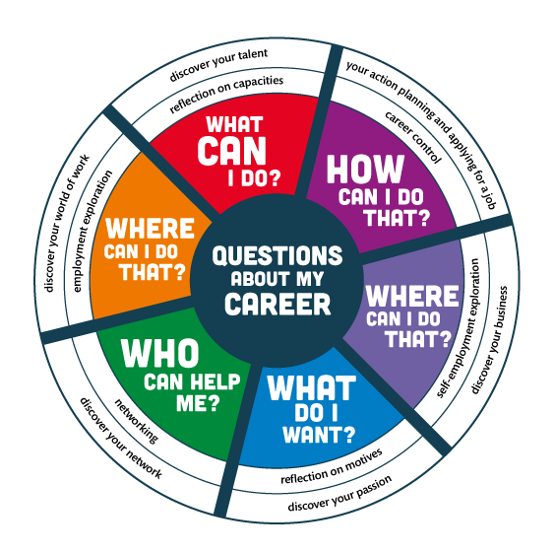
Plan
Notes:
Create roadmap/ action plan – 10 minutes
https://www.google.com/url?sa=i&url=https%3A%2F%2Fau.prosple.com%2Fcareer-planning%2Fcareer-development-2024-guide-for-professional-growth&psig=AOvVaw0zzUkHthPIYQ4D-SB1hykd&ust=1728484723860000&source=images&cd=vfe&opi=89978449&ved=0CBcQjhxqFwoTCNCm_cmB_4gDFQAAAAAdAAAAABAE
https://au.prosple.com/career-planning/career-development-2024-guide-for-professional-growth

Slide 14
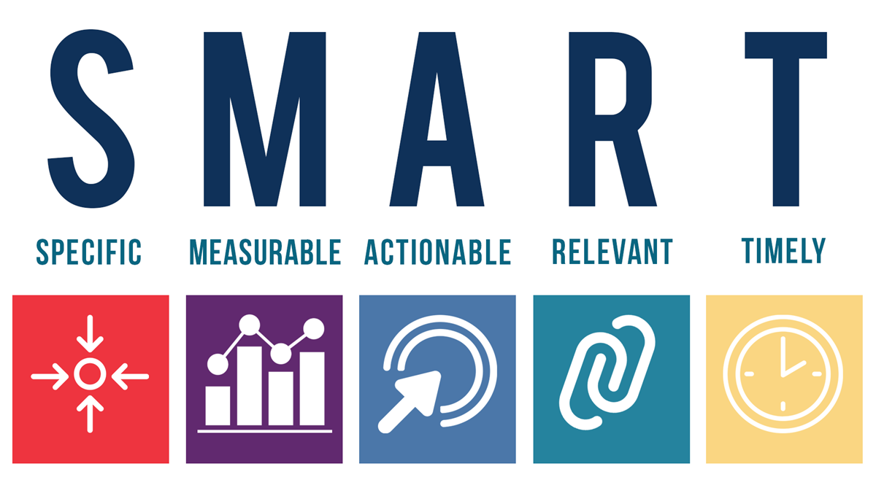
Plan
Notes:
https://www.forbes.com/advisor/business/smart-goals/
SMART Criteria
S
Specific
What will you achieve? What will you do?
M
Measurable
What data will you use to decide whether you've met the goal?
A
Achievable
Are you sure you can do this? Do you have the right skills and resources?
R
Relevant
Does the goal align with those of your team or organization? How will the result matter?
T
Time-bound
What is the deadline for accomplishing the goal?

Slide 15
Career growth strategy & tactics
Act
MBOs/ KPIs
Continuous learning
Mentorship
Personal brand
Networking/ volunteer
Balance
Notes:
Not all encompassing list; tie back to my path
Career growth strategy and tactics (goals, brand, network etc) – 10 minutes
MBOs, KPIs, IDP
Continuous learning – softskills, SIA, formal education
Feedback
Work/ life balance
Mentorship
Personal brand
Networking
Find a mentor
A mentor can help you set goals, challenge you, and hold you accountable. Look for someone who has achieved what you want to accomplish.
Set goals
Set professional development goals to help you decide what to pursue and how to get there.
Develop your skills
Gain new knowledge and skills to pursue better job opportunities, increase your salary, or find a new job.
Build your professional network
Connect with people to learn new ideas and perspectives, and to grow as a leader and colleague.
Choose the right career
Make sure your job aligns with your interests, personality, and values.
Actively communicate
Proactively communicate with your manager to let them know when a task is done and what needs to be done next.
Develop specialized skills
Keep up with industry trends and get relevant certifications to develop specialized skills.
Join volunteer organizations
Volunteering can help you gain experience and skills that can be used in your paid work.

Slide 16
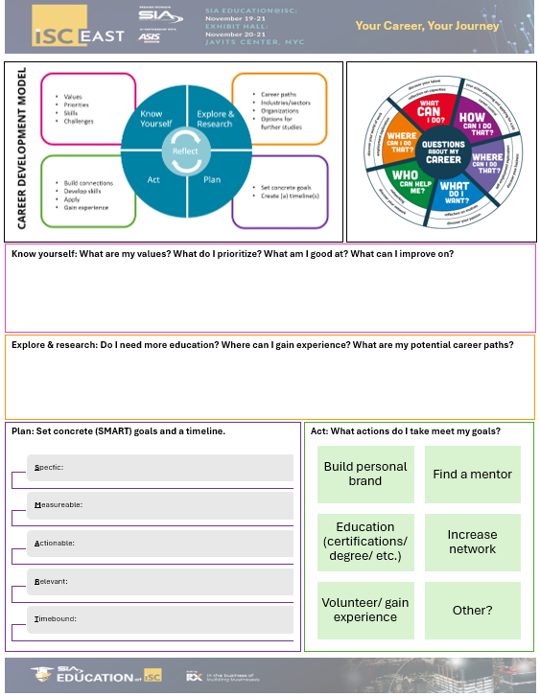
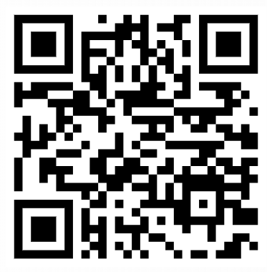
Action plan
Act
Notes:
https://herrmann.com.au/blog/2023/10/how-to-create-a-professional-development-plan-free-template/
https://au.prosple.com/career-planning/career-development-2024-guide-for-professional-growth

Slide 17



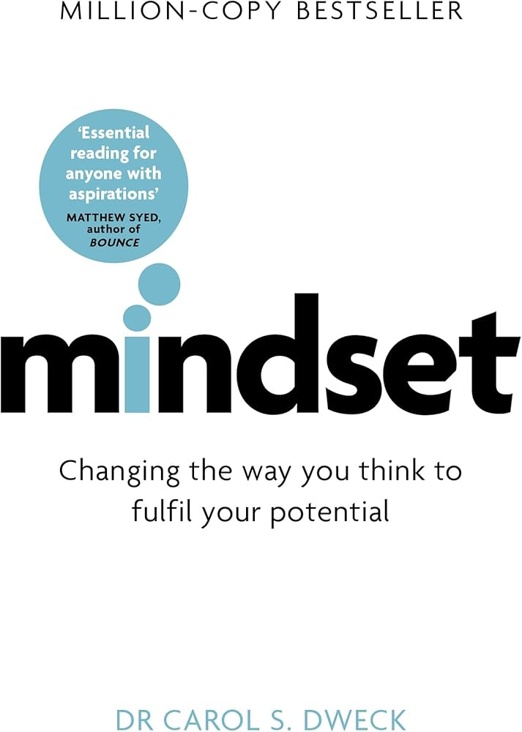

References

Slide 18
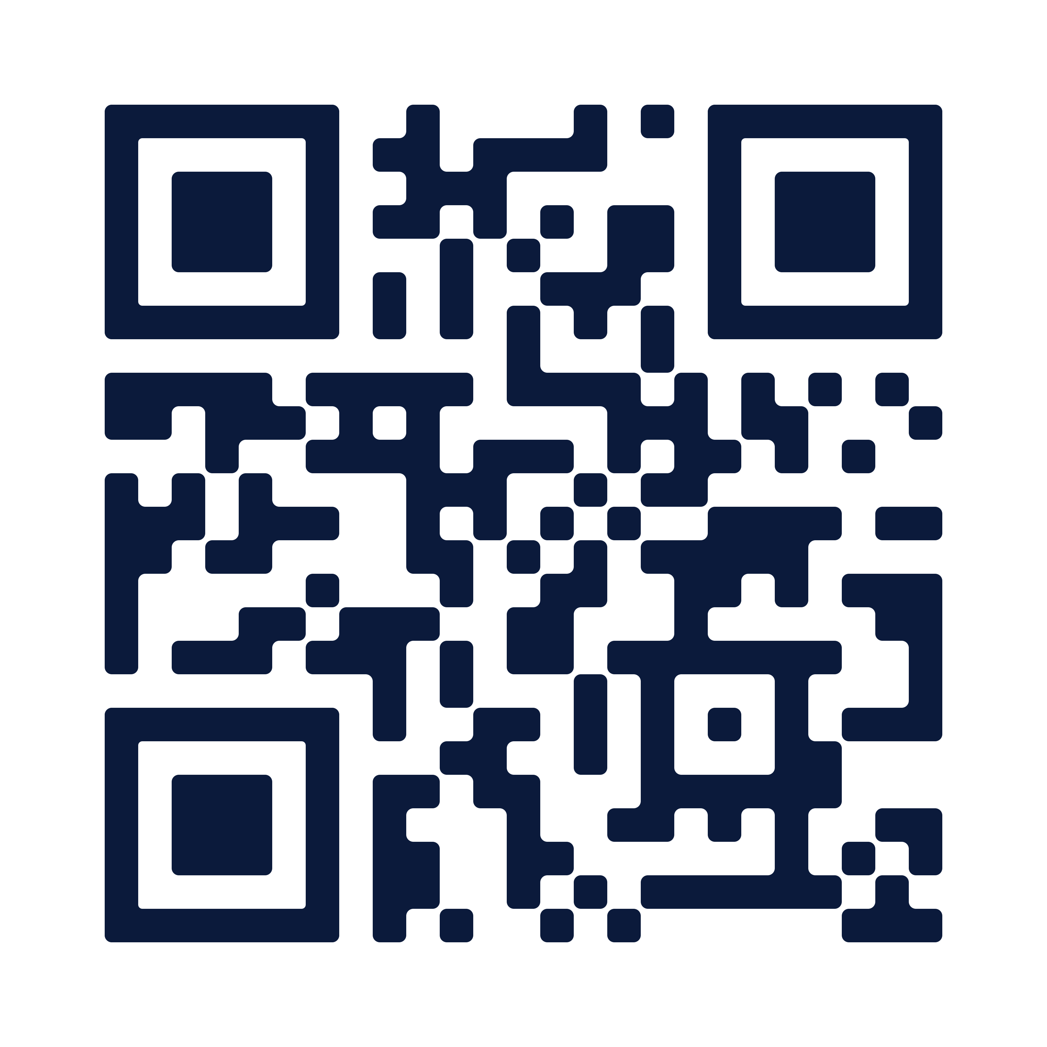
Q&A
Thank you
Please scan the QR code below to complete our survey and share your thoughts and experiences.
Contact me!
Kerri.Sutherland@axis.com

