Slide 1
Emerging Threats and Future Trends: Navigating the Future of Cybersecurity
Brought to You by PSA Security

Slide 2
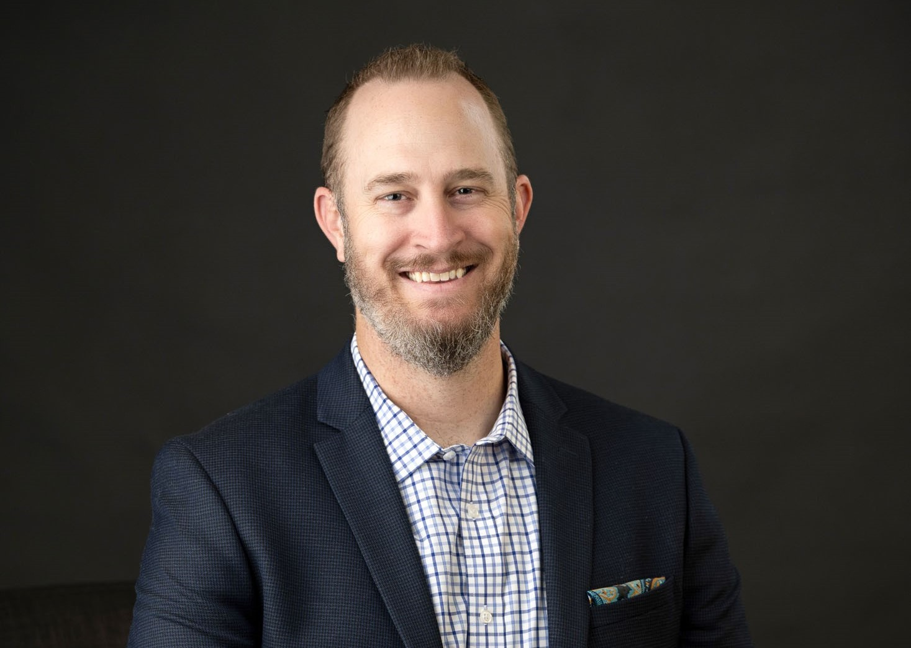

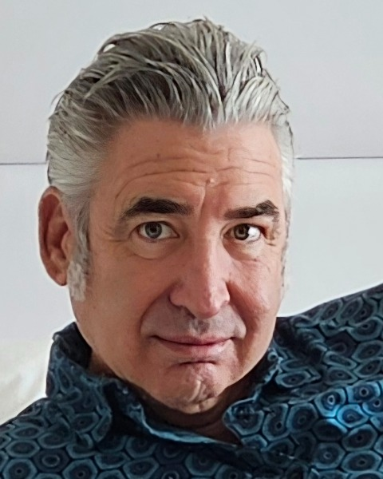
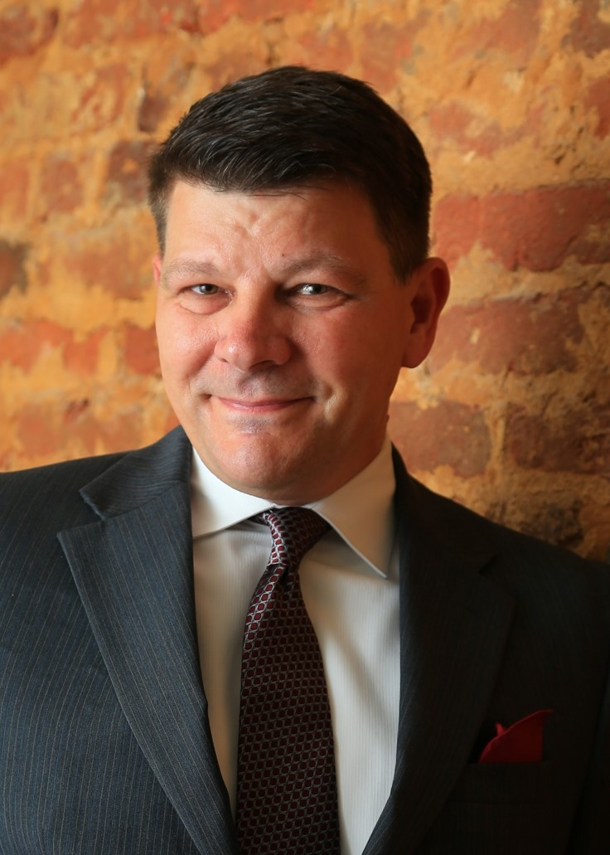
Josh Cummings CISSP, PSP, SICC
EVP, Technology
Paladin Technologies
Antoinette King CISSP, PSP, DPPS, SICC
Principal
Credo Cyber Consulting
Gary Hoffner
Vice President
PSLA Security
Mark Hankewycz CPP, PSP
Principal
M2H Protection

Slide 3
Questions?

Slide 4

Q&A
Thank you
Please scan the QR code below to complete our survey and share your thoughts and experiences.

