Slide 1
The Role of Face Matching and Voice Biometrics in Access Control
Esteban Pastor, Senior Product Manager, ZKTeco USA
Jon Polly, Chief Solutions Officer, ProTecht Solutions Partners
Jonathan Lawry, Principal, Trecerdo

Slide 2
- DISCLAIMER -
The viewpoints that our presenters make are just that… VIEWPOINTS.
They are not the opinions of our institutions, our clients, our friends, our family, our pets, and REALLY… maybe not even us after we get thru this panel presentation.
Long story short – identity is tough, digital transformation technology is changing every day and privacy, trust & consent are critical components moving forward – we hope someone in this room just might say something WE DID NOT KNOW that COULD change our minds on this topic… because NONE OF US KNOW the final outcome of this conversation – OR how all of this is going to come out when we get on the other side!
Should you require specific guidance or expertise in any area discussed during this panel, it is advisable to consult with qualified experts.
Get To The Point Media LLC (AID2entry & BIPABUZZ), ProTecht Solutions Partners, and Wavestore disclaim any responsibility for actions taken based on the information presented.
Any information presented today is for informational purposes only and should not be considered legal advice. Please speak to your attorney to obtain legal advice for your specific legal issues.

Slide 3

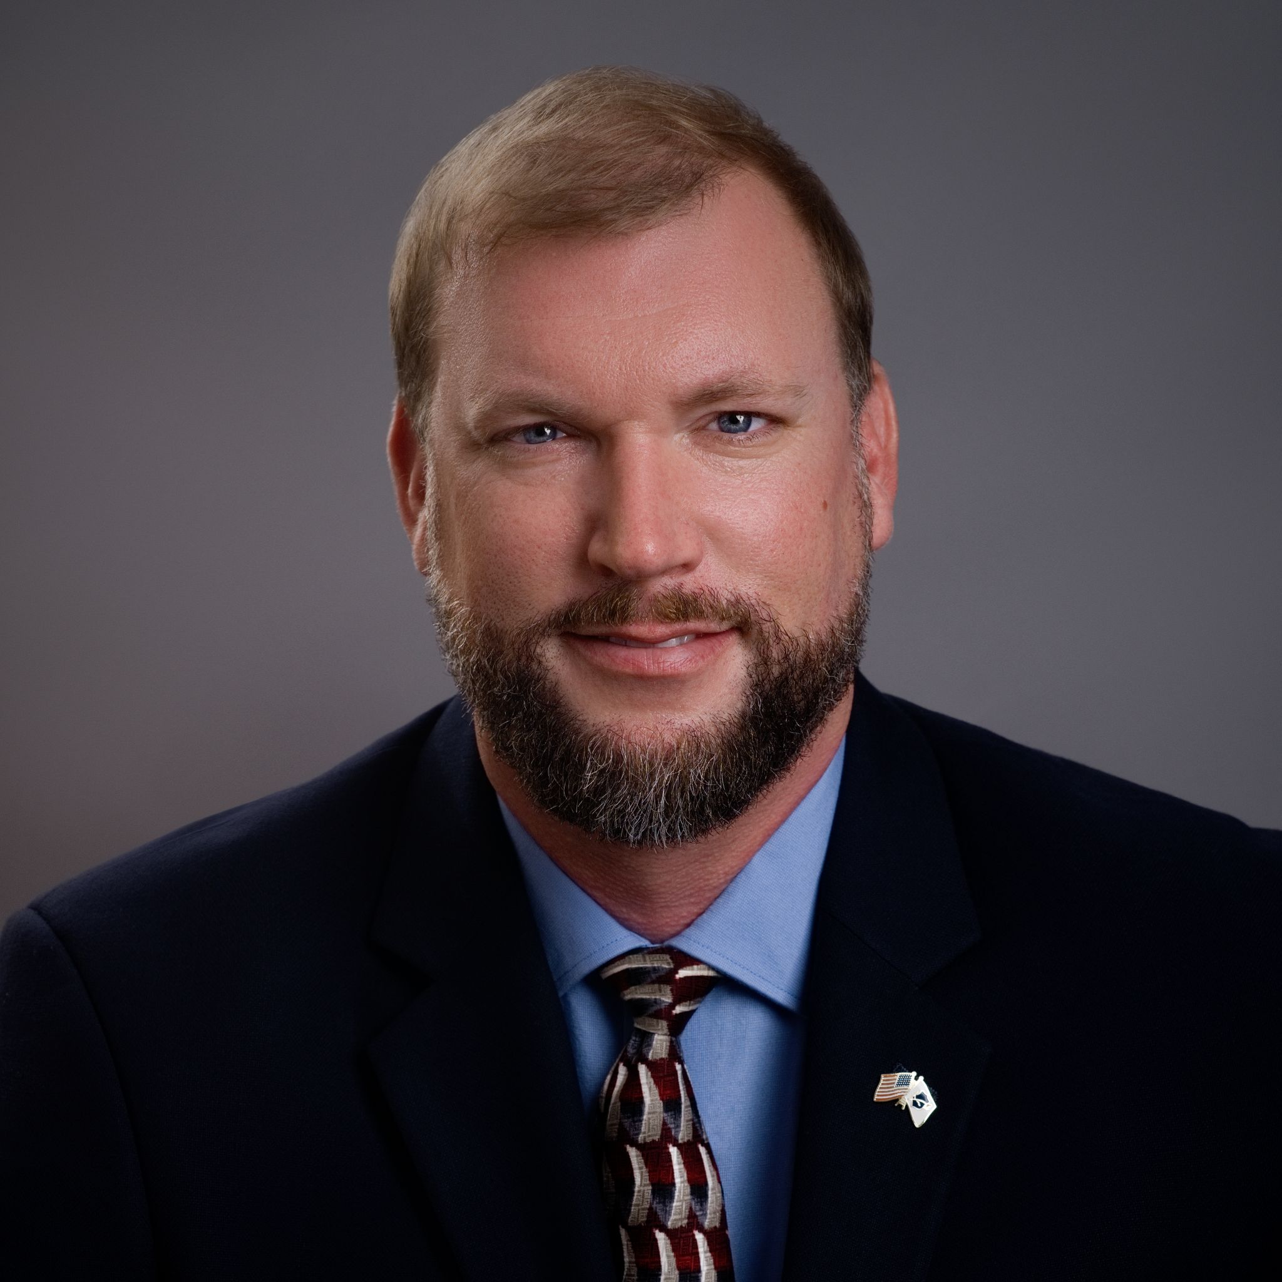

Presenters
Esteban Pastor
Senior Product Manager, ZKTeco USA
Jon Polly PSP, SICC, IC3PM
Chief Solutions Officer, ProTecht Solutions Partners
Jonathan Lawry
Principal, Trecerdo

Slide 4
Poll Time!
Notes:
We’ll make this quick.
Two questions. Just two, unless we come up with more.
By show of hands, who here is an end-user?
Also, by show of hands, who here has or is currently implemented biometric solutions, either as the end-user or as a one of those folks that did not raise their hand last time?

Slide 5
What Are Biometrics
Defining Common Terms

Slide 6
“Biometrics is the measurement
of physiological characteristics like – but not limited to – fingerprint, iris
patterns, or facial features that can
be used to identify an individual.”
Source : National Institute of Science and Technology. Information Technology Laboratory“ ITL Biometrics Overview,” cited at Biometrics | NIST
“Face recognition technology compares an individual’s facial features to available images for verification or identification purposes.”
Source : National Institute of Standards and Technology, Information Technology Laboratory“ ITL Biometrics Overview,” cited at Biometrics | NIST
Notes:
Many of you are familiar with NIST. NIST defines biometrics as the following.

Slide 7
Matching, Identification, and Verification / Authentication
Matching or ‘many-to-one’ (N:1) search matches many biometrics to a database of one.
“Identification or ‘one-to-many’ (1:N) search happens in real time and determines whether the person in the photo has any match in a database and can be used for identification of a person.”
“Verification or ‘one-to-one’ (1:1)matching confirms a photo matches a different photo of the same person in a database and is commonly used for authentication purposes
Source : National Institute of Standards and Technology. Information Technology Laboratory, “ Facial Recognition Technology” (Feb 2020) cited at https://www.nist.gov/speech-testimony/facial-recognition-technology-frt-0
Notes:
Really there are three primary categories of Biometrics: Matching, Identification (or Recognition), and Verification (or Authentication) depending on what part of the world you are in.
Quickly, matching is done to find a cursory match with a low threshold and a low accuracy. Very quick, like scanning a football stadium and finding my face everywhere.
We’ve all heard of facial recognition. That is the second category. Typically done in real-time looking for a small sampling database.
For Access Control, we will be parking at Authentication or Verification, again depending on what part of the world you are in.
Authentication is a 99.3% threshold that the person who presents their biometric is the right person.

Slide 8
BIOMETRIC PROS AND CONS
PROS
Relative Ease of Enrollment
Relative Ease of Application
Frictionless Technologies
Increasing Accuracy
  Enhancements in Machine Learning
  2D to 3D Technology
Enhancements in Image Capture
Liveness Verification
CONS
Accuracy
Bias
Personal Identifiable Information Concerns
Expectation(s) of Privacy
Tracking / Geoslavery
Regulatory Mandates (BIPA, CUBI, EU AI Act)
Acceptable Failure Rates
Notes:
There are lot of pros and cons for biometrics.
The one best statement I did hear from Donata Stroink-Skillrud was that the biometric is the last option. If someone steals your biometric, what is the recourse? You don’t get a do-over. You lose a card or a phone, you replace it. You lose a biometric, you get plastic surgery.

Slide 9
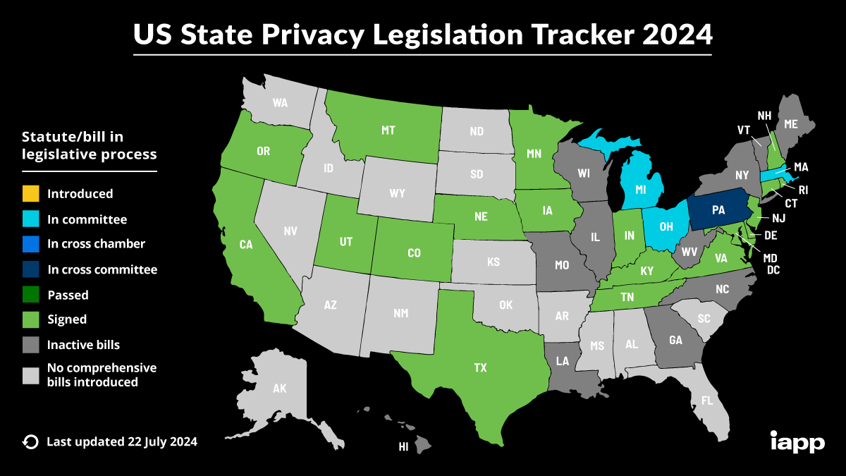
Used with permission from IAPP.ORG
Notes:
According to the IAPP, here is a diagram of states that currently are facing privacy legislation.
Now, I want to be clear here. Biometric technologies typically involve some version of artificial intelligence / advanced analytics that almost always goes hand in hand with privacy concerns.

Slide 10
Reasons FOR Discussion
FRICTIONLESS FOR THE WIN
Notes:
Let’s Start with Esteban. ZKTeco manufacturers a number of biometric readers and technologies. Tell us why end-users are leading out with biometrics?
Jonathan counter
Jon follow-up

Slide 11
Reasons NOT FOR Discussion
IS THIS JUST THE NEXT PSIM?
Notes:
Jonathan, I’ll hand this one to you to start out. We’ve already heard some great reasons for biometrics in access control. What are the concerns?
Esteban, thoughts?
Jon to follow-up

Slide 12
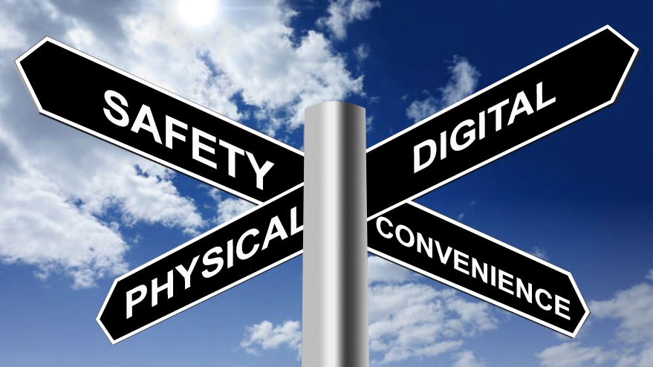
ART OF THE POSSIBLE
PRIVACY
TRUST
CONSENT
Notes:
Now, let’s talk the fun stuff. What’s possible… but lets do so with the guardrails we just mentioned in place.

Slide 13

Q&A
Thank you
Please scan the QR code below to complete our survey and share your thoughts and experiences.

