Slide 1
Optimizing Self-Sovereign Identity (SSI) on Various Platforms within PIAM Navigating the Future of Security and Privacy in Digital Transformations
Travis Willis & Joey Yanire, Business Development, LEGIC Identsystems LTD

Slide 2
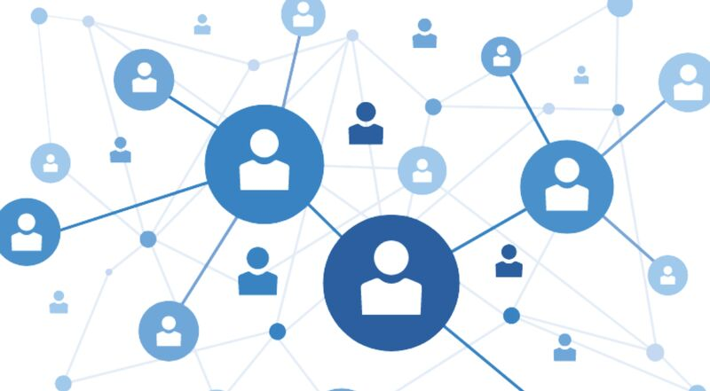
What is Identity?
Today, nations and corporations conflate driver’s licenses, social security cards, and other state-issued credentials with identity; this is problematic because it suggests a person can lose their very identity if a state revokes their credentials or even if they just cross state borders.
There is Digital Identity, Decentralized Identity, and Self-Sovereign Identity. DI, DCI, SSI. These are overlapping. Digital Identity is a broad term, covering all the human and non-human/machine identities in the digital world.
Identity in the digital world is tricky. It suffers from the problem of centralized control, but it’s simultaneously very balkanized: identities are piecemeal, differing from one Internet domain to another.

Slide 3
Understanding Self-Sovereign Identity (SSI)
Definition: A decentralized identity model where individuals own and control their personal data.
Key Features: User-centric, privacy-enhancing, secure.
Benefits: No central authority, reduced identity theft, seamless verification across platforms. Receiver only gets pertinent information.
Data
Attestation
Date of birth
Passport No
Drivers License
Bank Statement
Payroll Slip
Above 18 years
American Citizen
Authorized to drive
Has US Bank account
Is employed

Slide 4
SSI: Internet Identity Layer
Critical Need for a Secure Identity Layer
The internet lacks a secure method for identity verification, leading to increased cybercrime and loss of trust.
Self-Sovereign Identity (SSI) Solution:
SSI offers a decentralized approach, using blockchain technology to secure identities and transactions.
Infrastructure Comparison
The shift to SSI is likened to historical technological shifts.
Technological Foundations
Cryptography, distributed networks, and cloud computing underpin SSI’s security and functionality.
Challenges
SSI adoption faces hurdles in interoperability and decentralized key management.

Slide 5
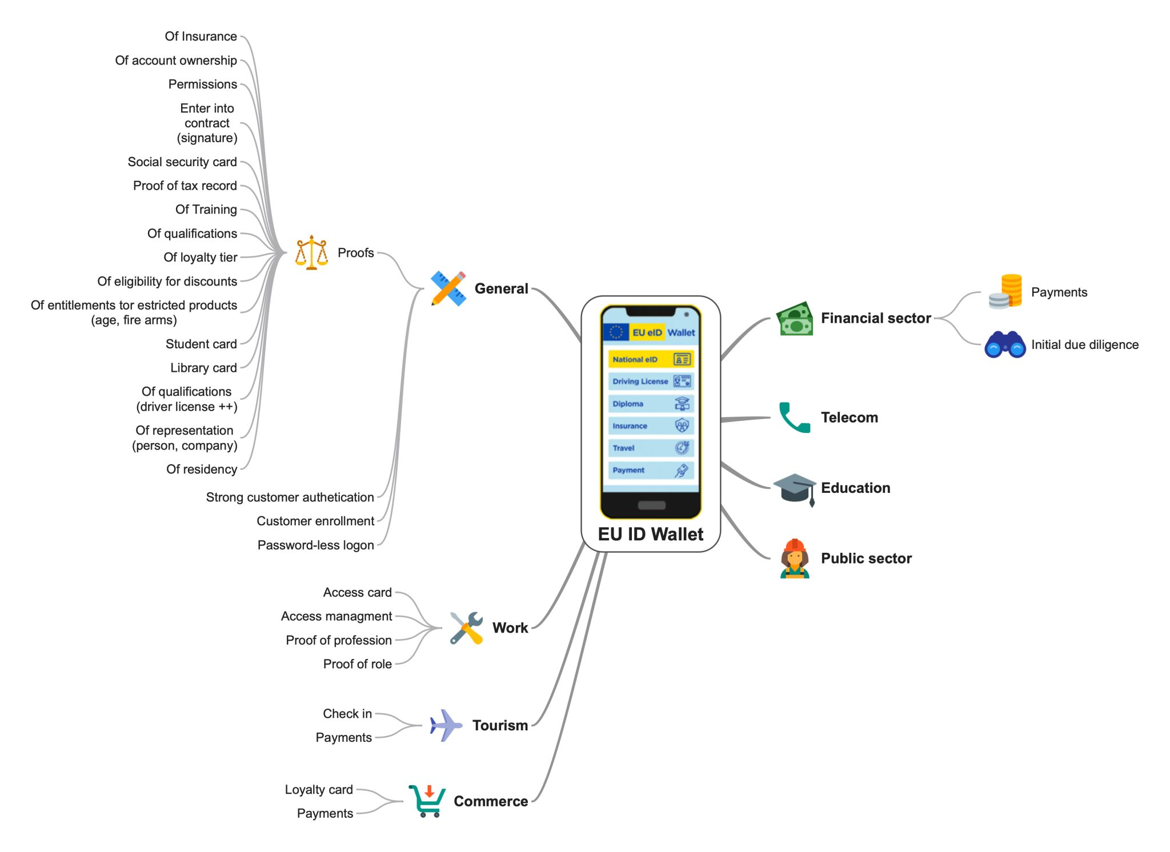
SSI: Example Scenarios
Direct examples to PIAM
As more and more of our “interactions” move online we need better tools to manage our data and maintain our privacy. The European Union is leading the way when it comes to SSI and its implementation.
In the US NIST is now working to better define and propose architecture for SSI to operate in and function within globally.

Slide 6
Fit everything you need into just your phone - YouTube

Slide 7
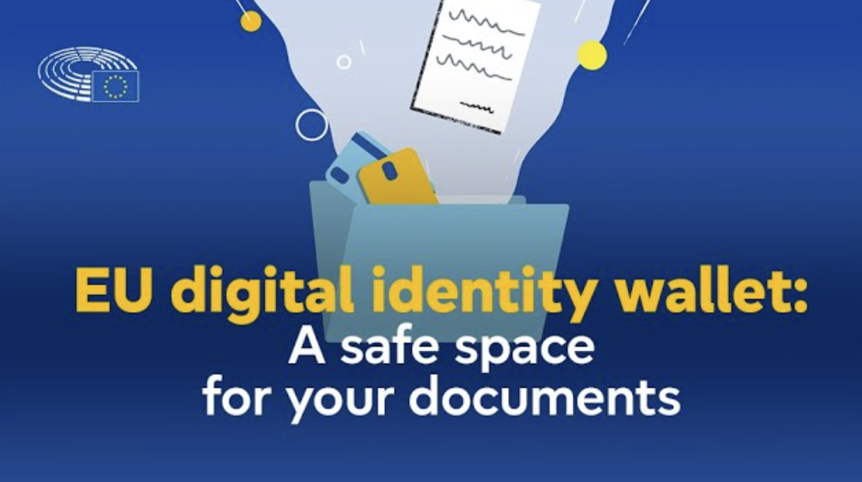
SSI: Fit everything you need into just your phone

Slide 8
SSI: Key Components and Benefits
Key Components
Decentralized Identifiers (DIDs)
Unique, persistent identifiers owned by the user.
Verifiable Credentials
Digital documents that are cryptographically secure, privacy-respecting, and tamper-proof.
Infrastructure-Level Solution
Operates at a foundational level, providing robust digital trust like the internet’s role in data sharing.
Fraud Reduction
Decreases identity fraud.
Reduced Onboarding Costs
Streamlines verification processes.
Improved E-commerce Sales
Enhances customer experience.
Workflow Automation
Reduces manual intervention.
Enhanced User Experience
Simplifies authentication processes.
Regulatory Compliance
Helps meet data security regulations.

Slide 9
Introduction to SSI in Physical Identity Access Management
Physical access controls are increasingly being integrated with identity and access management (IAM) solutions leading to (PIAM).
SSI provides a more secure, private way to manage identities across various platforms, enhancing user trust and security.
In a 2023 survey, 36% of organizations integrated their physical access control with IAM systems, bridging the gap between digital and physical security for enhanced protections.
IAM integrations simplify user access, encouraging compliance with security protocols while safeguarding both digital and physical access.

Slide 10
Current Identity Access Management (IAM) Challenges
Per Gartner’s Erik Wahlstrom SVP IAM reducing IAM technical debt is a critical task for organizations that need to move to forward with PIAM initiatives in 2024. These challenges include:
- Challenge No. 1 — Custom, homegrown and siloed IAM tools. - Challenge No. 2 — Nonstandard and legacy enterprise applications. - Challenge No. 3 — Incomplete discovery processes. - Challenge No. 4 — Poor IAM hygiene. - Challenge No. 5 — Complex and incomplete enrollment of applications and services.
Self Sovereign Identity (SSI) provides a streamlined pathway to address these challenges in a new and more comprehensive way. The frameworks being put forth by eIDAS and NIST can be leveraged now to implement SSI in enterprise environments.

Slide 11
SSI as an answer to Enterprise Questions for PIAM
How can I implement best practices and standardize my security organization?
How do I lower my liability and maximize asset protection?
How do I future-proof my entire security investment?
How can I leverage my existing security infrastructure on a global scale?
How can I reduce manual processes that can be labor intensive, repetitive and may have potential errors?
How do I optimize my resources, technologies and security operations?
How can I keep up with government of organizational and industry regulations?
How can I easily monitor infractions and proactively enforce my security policies and rules?
How can I regularly report and audit my security landscape?
How can I secure user provisioning of RFID cards and key fobs, PKI smart cards and mobile tokens?

Slide 12
Optimizing SSI on Various Platforms
Unified Identity Protocols
Implement protocols that support SSI across different access control systems to ensure compatibility and interoperability.
Enhanced Privacy Controls
Utilize zero-knowledge proofs to enable identity verification without exposing underlying personal data.
Integration Strategies
Integrate SSI with existing ID management systems through APIs that support DID and verifiable credentials.
Security Measures
Employ advanced encryption and biometric verification to safeguard identities and access permissions.
User Education and Training
Conduct regular training sessions for users on the importance of digital identity security and the functionalities of SSI.

Slide 13
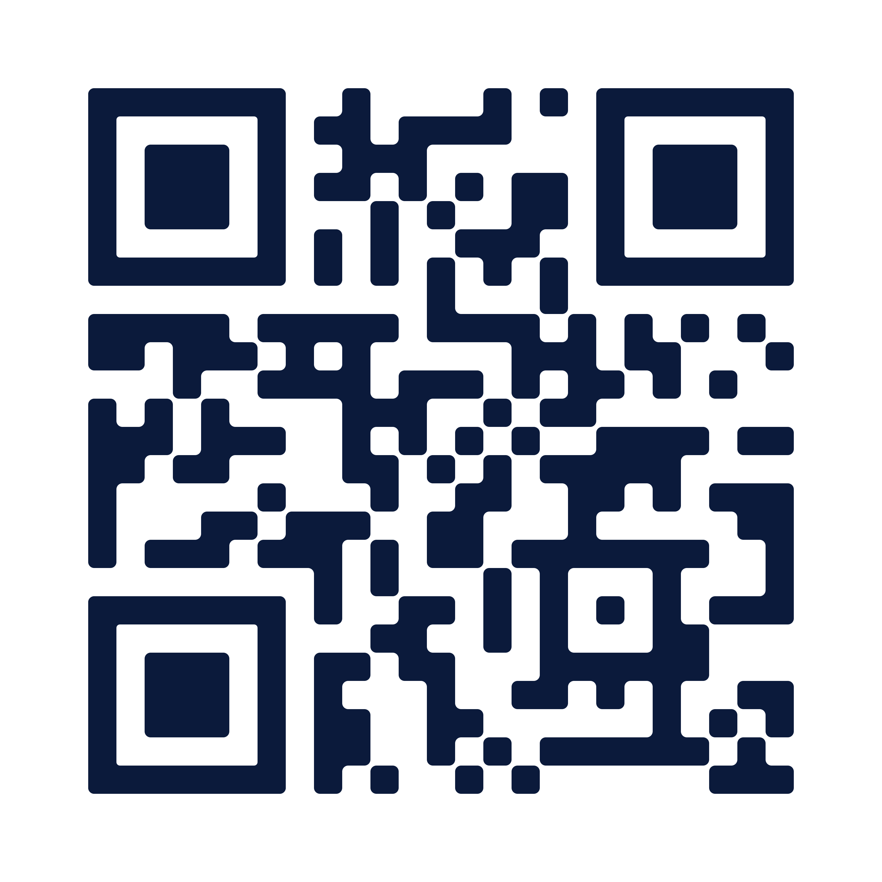
Q&A
Thank you
Please scan the QR code below to complete our survey and share your thoughts and experiences.

