Slide 1
Lessons Learned Deploying Large Scale Loss Prevention Solutions Across Multiple Sites
Joe Hinrichs, Vice President of IT and Product Development, Bailiwick, An ePlus Technology, inc. Company

Slide 2
Introduction
  Joe Hinrichs
    VP IT & Product Development at Bailiwick, An ePlus Technologies, inc. Company
      Technology innovator for more than 25 years
  Focus of this session is how to successfully deploy LP solutions across multiple sites
    Challenges
    Strategy
    Implementation
    Data Analytics
    Use Cases
Notes:
I’ve spent most of my career innovating with technologies to support everything form start-ups to Fortune 500 clients.
My company has performed 100’s of successful Loss Prevention solutions nationwide for the industries we serve:
Retail, Hospitality, Quick Serve and Casual Restaurants, Logistics, Convenience Store, to name a few.
The convergence of IT and Security is real.

Slide 3
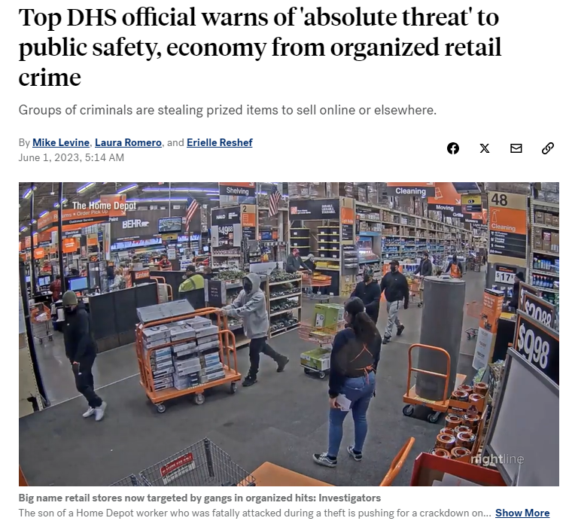
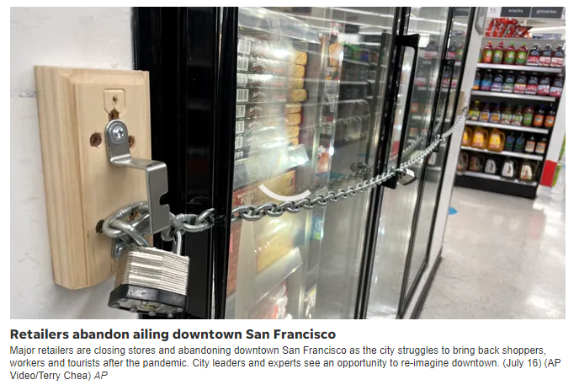
What to Listen for
  Key aspects of loss prevention strategies deployed for Fortune 500 clients
    Unique challenges
    The importance of consistency
    Scale
    How to measure success
Notes:
We partner with our Clients to understand their specific challenges and work on programs to address them.
Many retailers are struggling to keep their stores stocked due to shelf swiping. So, they are locking up display cabinets.
In California, theft under $950 is considered a misdemeanor and typically not tried. It can be dangerous to attempt to intervene.

Slide 4


Key Challenges
Facing Multi-Site Deployments
  Maintain or improve experience for client’s customers
  Adjusting for different threats
  Consistent deployment with inconsistent local regulations
  Efforts should improve operational efficiencies, not negatively impact them
Notes:
Customers expect the same or similar experience at all like Banners
Different threats like: Personal Harm, ORC, Shrink, Property. - Impacts to People, Property & Assets
Local regulations always need to be considered and researched prior to a rollout to avoid setbacks
End game should make for a better or “unchanged” experience for customers and employees

Slide 5
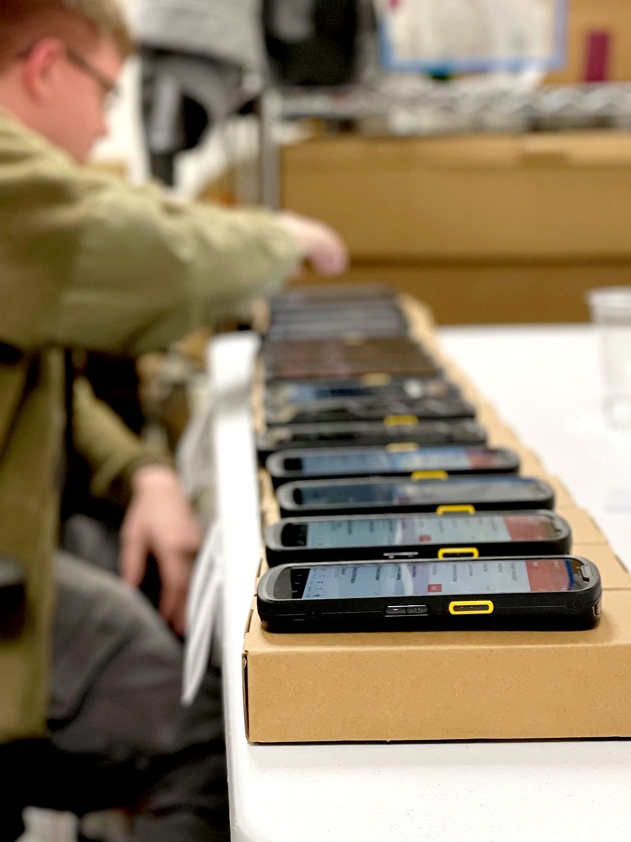
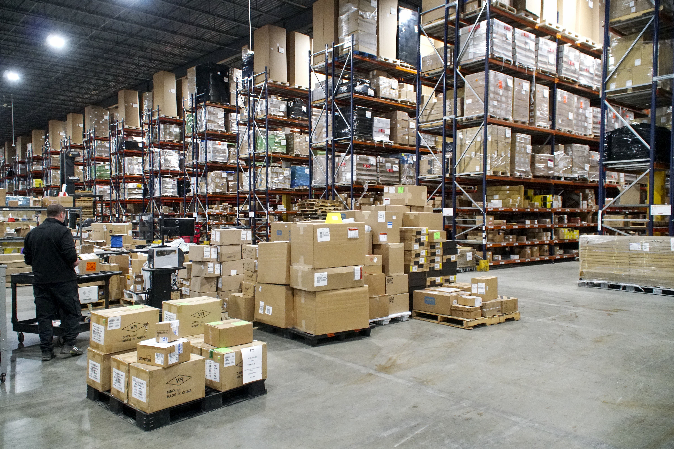
Integration Center
Don’t Miss this Critical Success Driver
  While large corporations create successful distribution operations to stock shelves and supply operations, these same distribution channels are not conducive to technology deployment
  What do Integration Centers do?
  Key components of a successful Integration Center
    Scalability
    Inventory management
    Device Configuration
    Kitting
    Shipping
Notes:
Rolling out at scale requires consistency.
Need to appropriately track any hardware or software
We prefer to unbox, setup and test every item to ensure expected results
Then we kit it all together in a logical configuration to make it easy for the onsite tech to effectively and efficiently do their work
We avoid drop shipping because you miss the config and testing confirmation to validate all is working prior to install

Slide 6
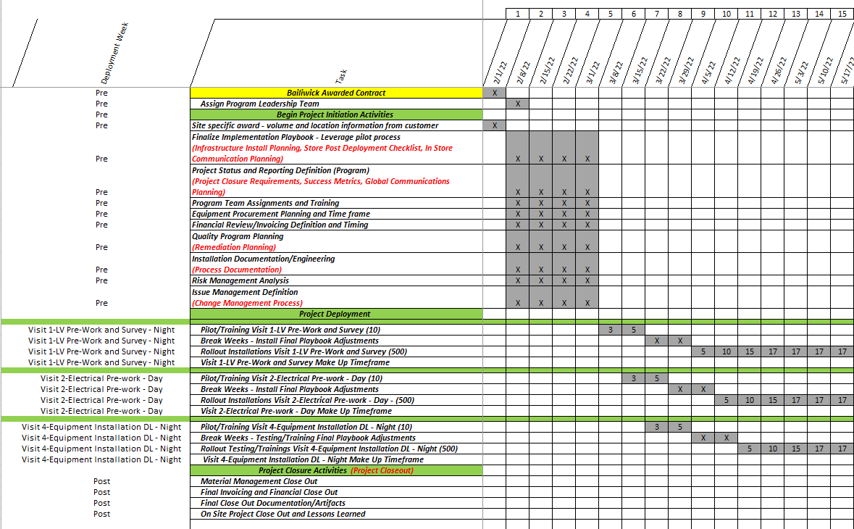
Strategy Development
Plan the endgame before you start so you can exceed expectations
  Conduct risk assessments
  Set clear objectives and KPIs
  Budgeting and Resource Allocation
  Set clear and realistic timeframes
Notes:
Security Strategies are like insurance. True value isn’t known until needed.
Measure shrink.
Create a case utilizing video evidence.
Send an automated notification based upon defined business rules.

Slide 7
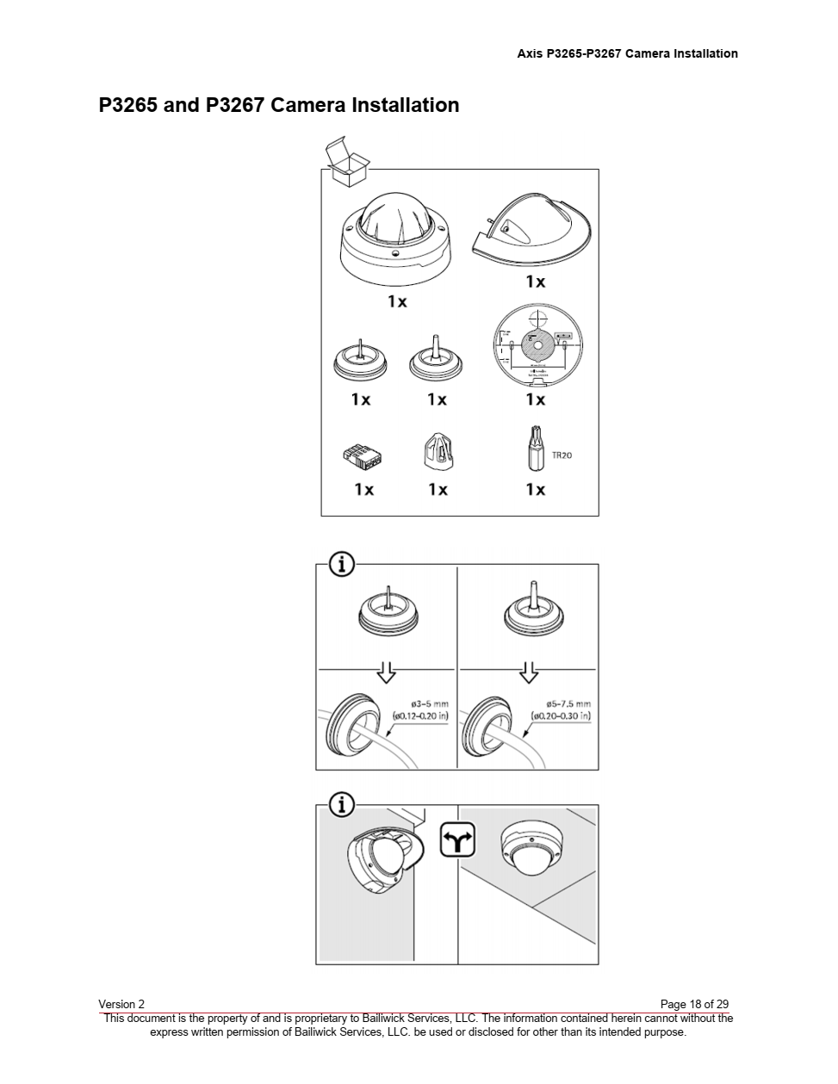
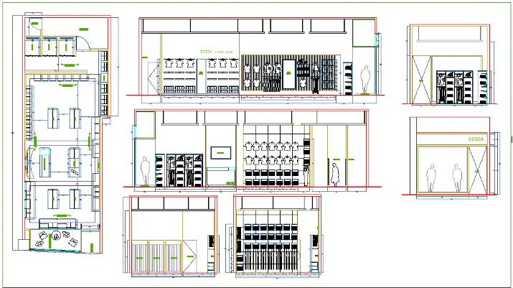
Implementation Phase
It all Matters
  Site surveys and needs assessments
  Customize solutions for different sites
  Training and ongoing support
Notes:
Site surveys are important especially if cameras are involved. Creation of a shot guide to ensure consistent capture of an area based upon a defined floorplan. Take into account angels, lighting, environment (rain/snow) protection depending upon indoor/outdoor scenarios. Training includes communications to the employees about what is being installed, why and the benefits expected. If this is to combat shrunk, just knowing that a location is surveilling or monitoring the store will reduce shrink.

Slide 8
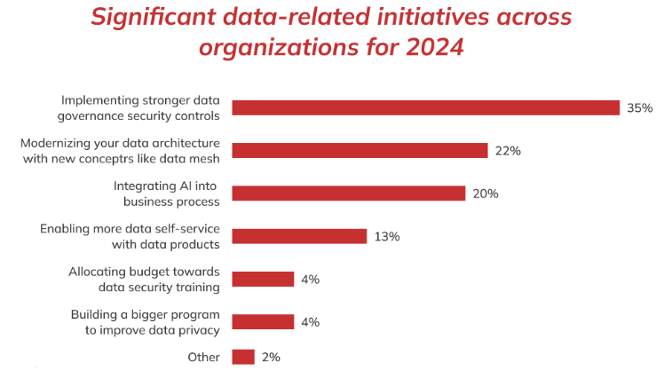
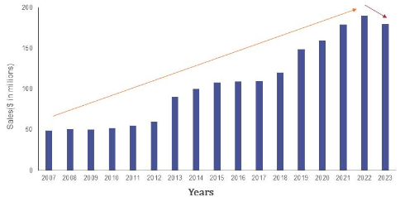
Storytelling with Data
Data Analytics help Define Success
Defining Success
  Key performance indicators for loss prevention
  Measuring effectiveness and ROI
Data Analysis
  Utilizing data analytics for continuous improvement
  Reporting and communicating results to stakeholders
Notes:
Personal safety cases. Register theft. Inventory shrink. – define measurable elements to track success.

Slide 9
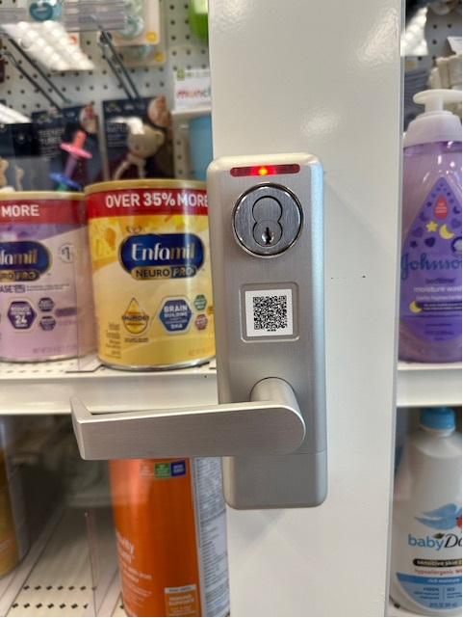


Real World Examples
Are Digital Smart Locks a Fit
Digital Smart Lock Displays to secure high-theft inventory
Notes:
Commercial grade ADA approved handle
Can be opened with a Scanner or Smart phone
Visual LED indicator that the door is unlocked
Audit trail of who opened the door and for how long it was opened
Can tie open request to camera to capture a visual of what occurred during that open sequence

Slide 10
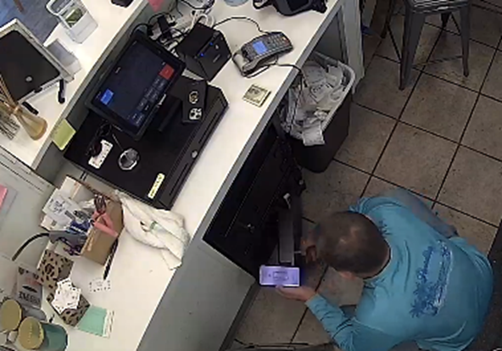
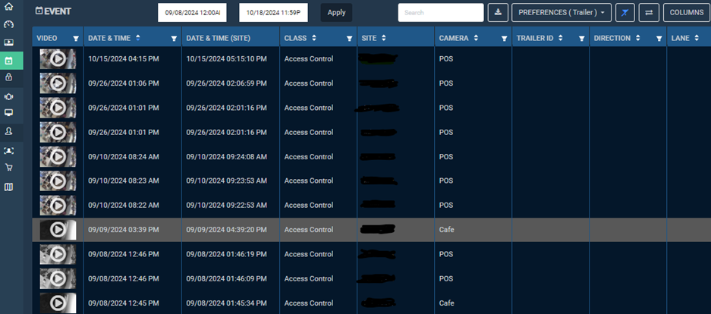
Real World Examples
Smart Safes Protect your Assets
Smart Safes
  No keys
  Full audit tracking
  Visual confirmation
Notes:
Smart App to operate the safe
Business rule triggers with visual confirmation
Safety training for company best practices
Validation of drops, etc.

Slide 11
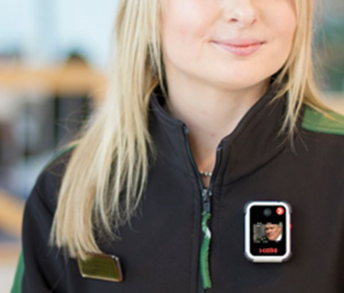
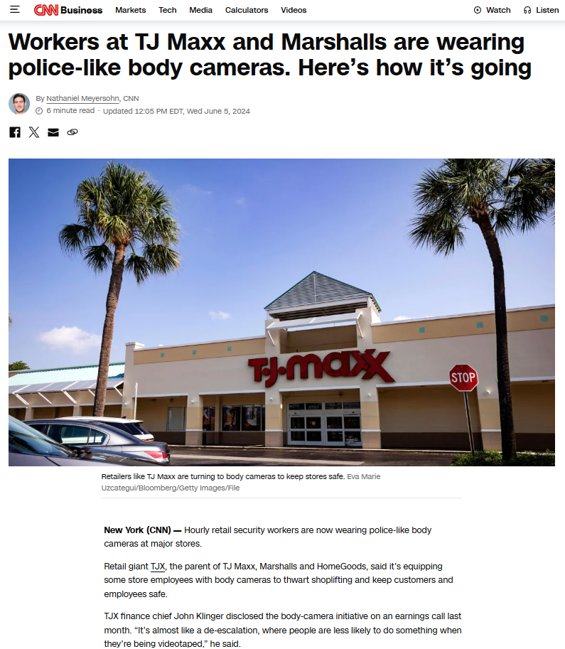
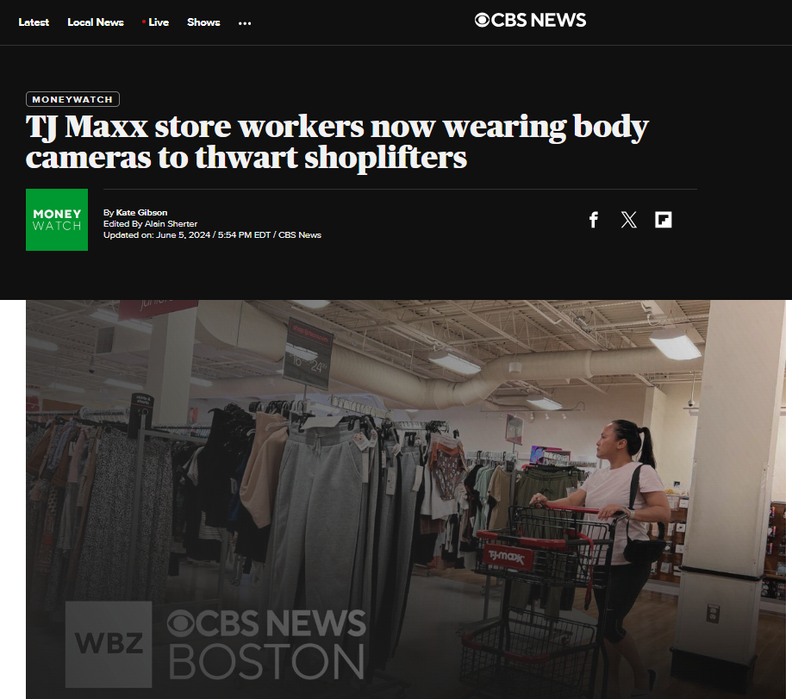
Real World Examples
Body Cameras Deployed in Record Time
Body camera deployment
Integration center critical for accurate device configuration deployment speed
Notes:
Dynamic surveillance coverage
Personal safety
External and Internal theft deterrent

Slide 12
Food for Thought
Successful loss prevention deployment requires significant planning
Are you open to new and evolving technologies?
Will the loss prevention solutions increase efficiency (or not reduce the user experience)?
Are you assuming that one size fits all?
Experience – do you have the right people or partners to deliver?
Have you determined how a successful outcome should look?
Notes:
Experience – A common pitfall is assuming you can “Do It Yourself”. Or hire deployments by area or region and expect that everything will tie together nicely.

Slide 13

Q&A
Thank you
Please scan the QR code below to complete our survey and share your thoughts and experiences.

Slide 14

Q&A
Follow up with Joe Hinrichs at jhinrichs@bailiwick.com
Connect with Bailiwick

Slide 16
Introduction
Who is Bailiwick?

