Slide 1
Can It Be Seamless? Planning for a Smooth Access Control Migration
Steve Hasson – Subaru of America – Manager, Real Estate & CFS
Paul Russell – HID - Director, OEM Accounts- North America
David Ellis – Genetec - Regional Director, Enterprise - East

Slide 2

#1
In 2024 Genetec State of Physical Security Report, the top type of project end users planned to invest in was
access control

Slide 3
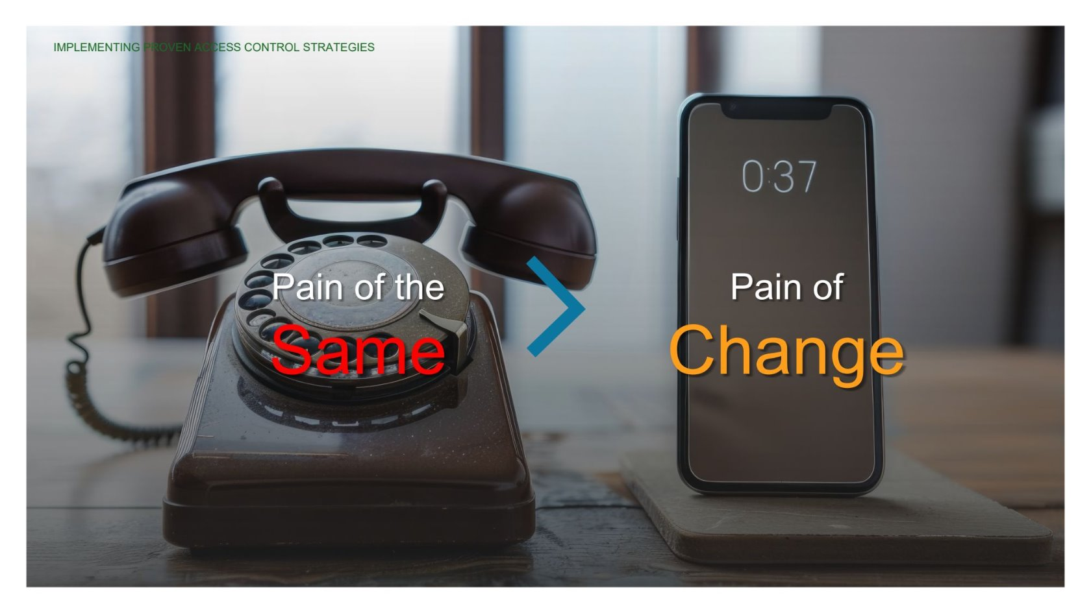

Slide 4

Challenges
Stakeholders
Project management & coordination
Hardware Migration
What to do with existing data bases?

Slide 5

Benefits
Centralization
Cybersecurity
Support for next generation credentials
Possibility to migrate to open architecture
Possibility to move to SaaS or Hybrid

Slide 6
Hear from our panel

Slide 7

Q&A
Thank you
Please scan the QR code below to complete our survey and share your thoughts and experiences.

