Slide 1

Combating Labor Shortages in Physical Security: Attraction, Selection, and Engagement
Brooke Erickson, Chris Staniforth, Victoria Hayes, Lori Hudnall

Slide 2



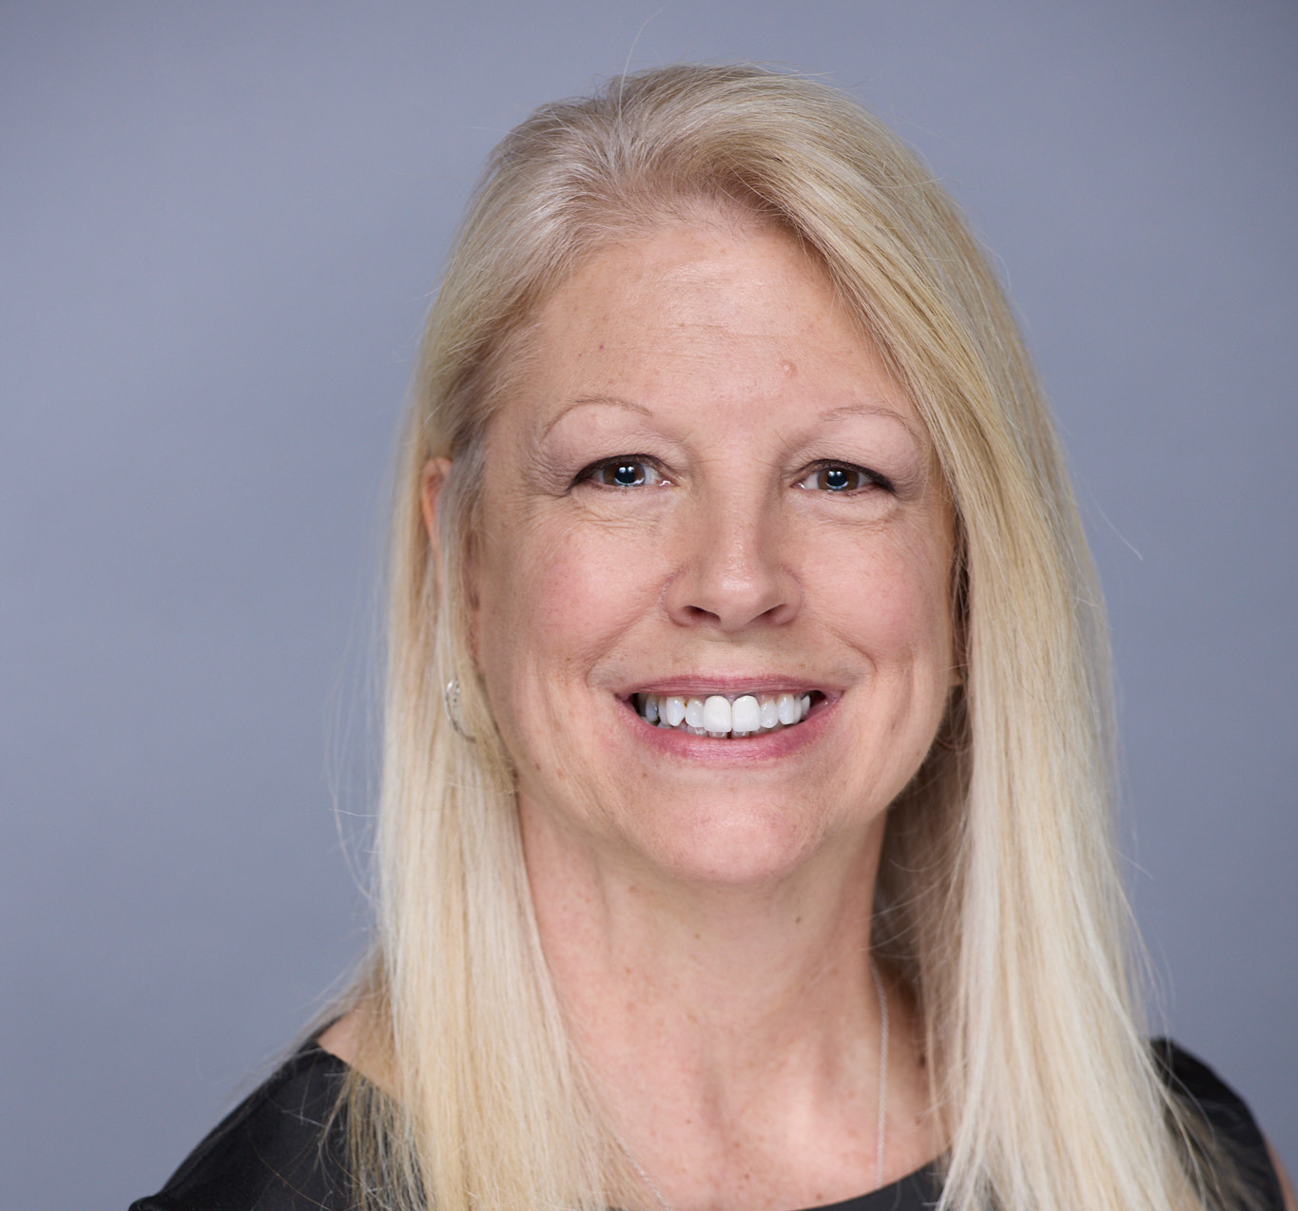
Brooke Erickson
Director of Learning & Development
PSA Security Network
Victoria Hayes
HR Director
HID Global
Chris Staniforth
President
ALC Consulting
Lori Hudnall
Vice President, Human Resources
Sage Integration

Slide 3

Q&A
Thank you
Please scan the QR code below to complete our survey and share your thoughts and experiences.

