Slide 1
Dealing with Today’s Active Shooter / Assailant Workshop Session
David LaRose, MSCJ, CHPA, CPP. Healthcare National Director, GardaWorld
Bernard Scaglione, CHPA, CPP, CHSP. Associate Principal, Cerami & Associates

Slide 2
LEARNING OBJECTIVES
Understand how businesses, employees, and individuals should respond to specific incidents, while recognizing the 'duty of care' obligations that can expose companies to liability for inaction, poor decision-making, or insufficient training.
Analyze the “run, hide, fight” method and its effectiveness in different scenarios, considering potential liability risks.
Examine various active assailant scenarios to improve planning and response strategies.
B

Slide 3
DEFINITIONS
Active Shooter– an individual actively engaged in killing or attempting to kill people in a confined and populated area; in most cases, active shooters use firearms(s) and there is no pattern or method to their selection of victims. (Definition used by DHS, FBI and most federal agencies)
Active Assailant – a person or group of persons actively engaged in killing or attempting to kill or cause serious bodily injury to a person or group of persons.
B

Slide 4
DEFINITIONS
Some organizations are amending their policy definition to:
Active Shooter Hostile Event Response (ASHER) - Response to an incident where one or more individuals are or have been actively engaged in harming, killing, or attempting to kill people in a populated area by means such as firearms, explosives, toxic substances, vehicles, edged weapons, fire, or a combination there of.
D

Slide 5
SOMETIMES THERE IS A PATTERN
Surgeon killed by son who believed doctor killed his mother
Attorney killed by client because lost his case
Supervisor killed by employee who might / was fired
Teacher killed by student or student killed by student who picked on him
Husband killed wife and her lover at work
Ex-employees return to work to kill their bosses, supervisors or anyone who offended him
B

Slide 6
SOME STATISITCS
Number of incidents within 2019-2023 five-year period
• 2019: 30
• 2020: 40
• 2021: 61
• 2022: 50
• 2023: 48
6/17/16 Orlando, FL 49 Killed 53 Injured
10/1/17 Las Vegas, NV 59 Killed +500 Injured
2/14/18 Parkland School 17 Killed 17 Injured
5/31/19 Virginia Beach 12 Killed 3 Injured
3/22/21 Boulder, CO 10 Killed 1 Injured
2/22/22 Charleston, MI 2 Killed 14 Injured
1/21/23 Monterey Park, CA 12 Killed 9 Injured (Dance Studio) Targeting ex-wife, attempted second mass shooting
9/05/24 Winder, GA. 4 Killed 9 Injured
2018 426 Mass shootings 528 Killed 1549 Injured
2019 374 Mass shootings 346 Killed 1149 Injured
2020 614 Mass shootings 446 Killed 2515 Injured
2021 693 Mass shootings 312 Killed 750 Injured
2022 647 Mass shootings 670 Killed 2443 Injured
2023 656 Mass Shootings 754 Killed 426 Injured
2024 484 Mass Shootings Jan-Sept
D
MassShootingTracker.org

Slide 7
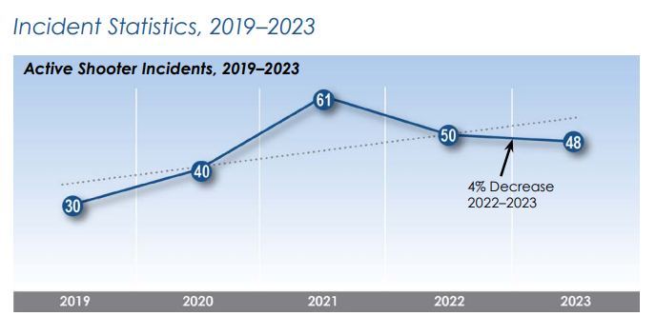
2023 FBI DATA
Summary The number of incidents in 2023 (48) decreased by 4% from 2022 (50). For the five-year period 2019–2023, data shows an upward trend despite the decrease between 2021 and 2023.
D

Slide 8
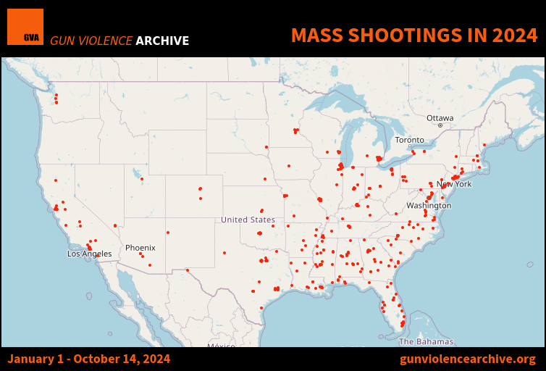

Slide 9
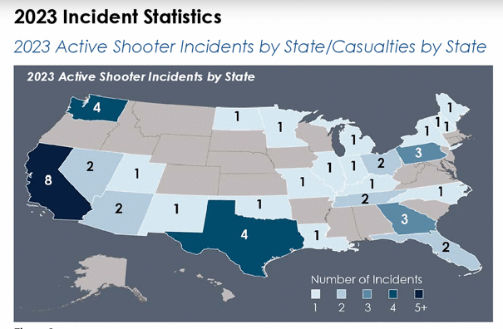
2023 FBI DATA BY LOCATION
D

Slide 10
WEAPONS OF CHOICE
80% of active shooters use guns
72.9% handguns
18.5% rifles
8.6% shotguns
20% of armed assailants use other deadly means
Baseball bats
Knives, swords
Hatchet
Box cutters
Vehicles
D

Slide 11
WEAPONS OF CHOICE
80% of active shooters use guns
72.9% handguns
18.5% rifles
8.6% shotguns
20% of armed assailants use other deadly means
Baseball bats
Knives, swords
Hatchet
Box cutters
Vehicles
D

Slide 12
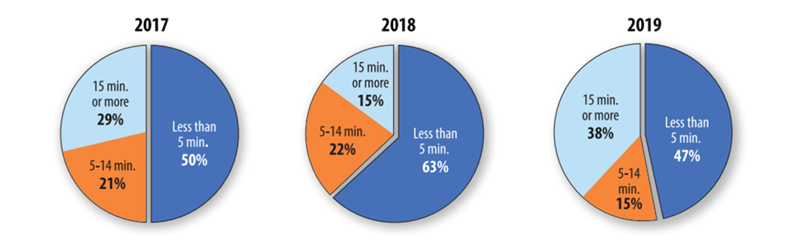
REALITY OF THESE ATTACKS
Average response time by law enforcement is 3 minutes
Average shooting lasts 12 minutes
Planned Parenthood shooting lasted - 5:14 hours
Washington Navy Yard – 1:09 hours
How long does it take to completely search your business?
What are you doing to protect yourself and those around you for 12 minutes?
What are you doing to protect yourself and those around you for hours?
B

Slide 13
PLAN FOR DIFFERENT SCENARIOS
Attack a Co-Worker
Attack a former or current spouse
Attack a former or current manager
Attack anyone who works there
Crash vehicle into building
Shoot way in
Police chase subject to the business
Suicide after Attack
Suicide without attacking anyone
Walk off when done
Barricade/Hostages
Surrender/arrest
IED’s or firebombs
Employee is attacked while working at home
B

Slide 14
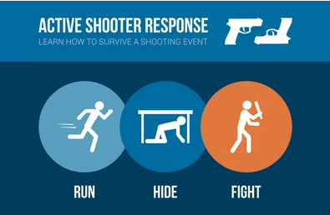
OPTIONS FOR SURVIVAL
Run, Hide, Fight (City of Houston) Preferred by DHS
Avoid, Deny, Defend (ADD)
Alert, Lockdown, Inform, Counter, Evacuate (ALICE)
Accept, Assess, Act, Alert (4 A’s)
Educate, Evade, Escape, Engage (4 E’s)
Avoid, Barricade, Counter (ABC’s)
Civilian Response to Active Shooter Events (CRASE)
Secure, Preserve, Fight (Newest in Healthcare)
B

Slide 15

CAN YOU OR CAN’T YOU
Can a nurse leave their patients?
Can a teacher leave their students?
Can a security officers leave their post?
Can an employee leave the guests right in front of them, who look to the employee for guidance and assistance?
Can the 12.6% of the US population who are severely handicapped – run, hide or fight?
Can we protect employees working from home?
B

Slide 16
DRILLS OR EXERCISES
D

Slide 17
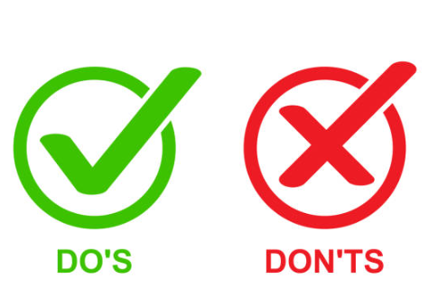
DRILLS OR EXERCISES
What are the do’s and don’ts to exercising your plan?
Controlled Environment
Discuss the Plan
Educated Staff on Survival Options
D

Slide 18
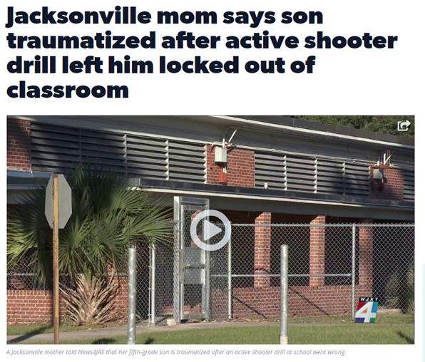
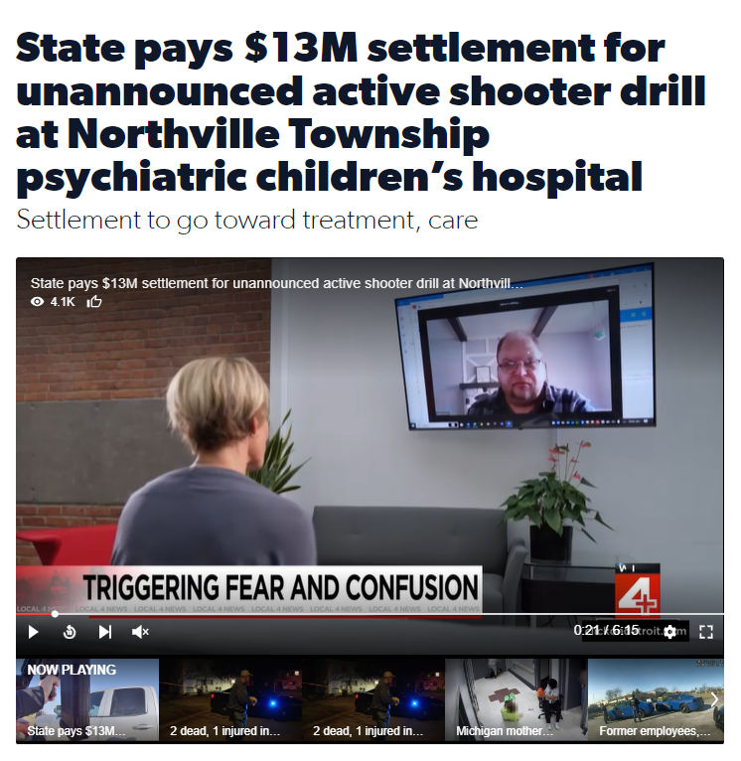
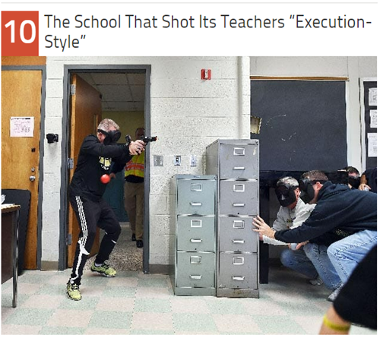
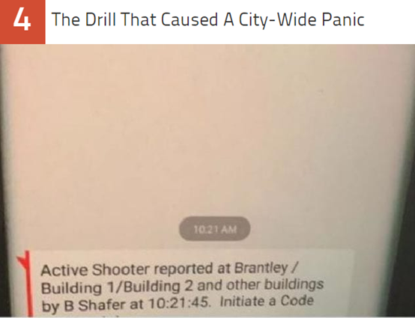
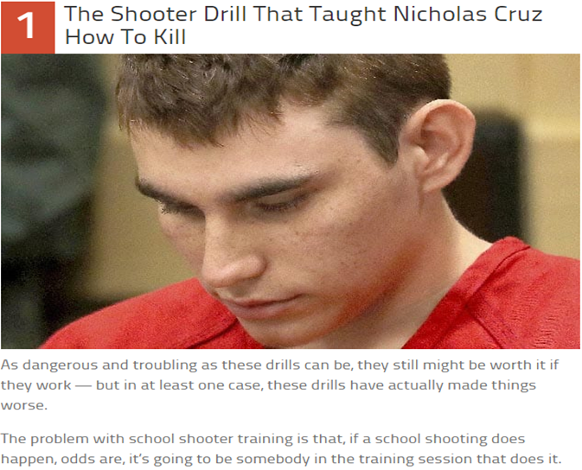
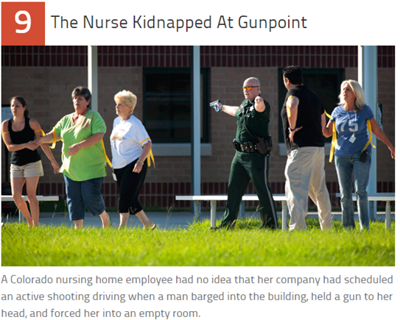
D

Slide 19
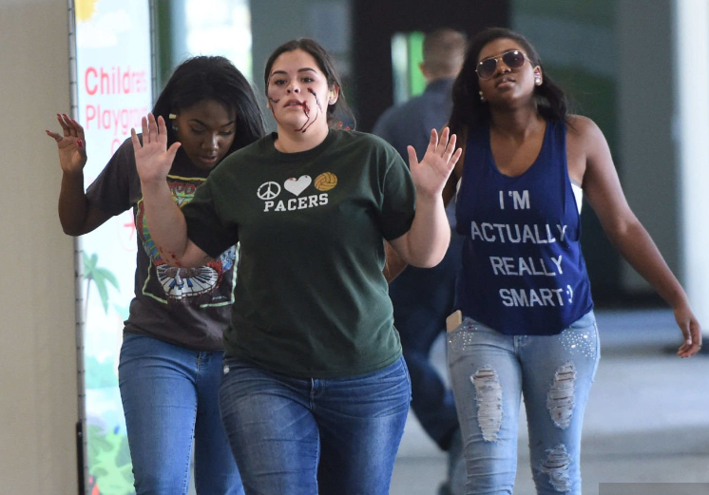
SHOULD ACTIVE SHOOTER DRILLS BE CONDUCTED
D

Slide 20
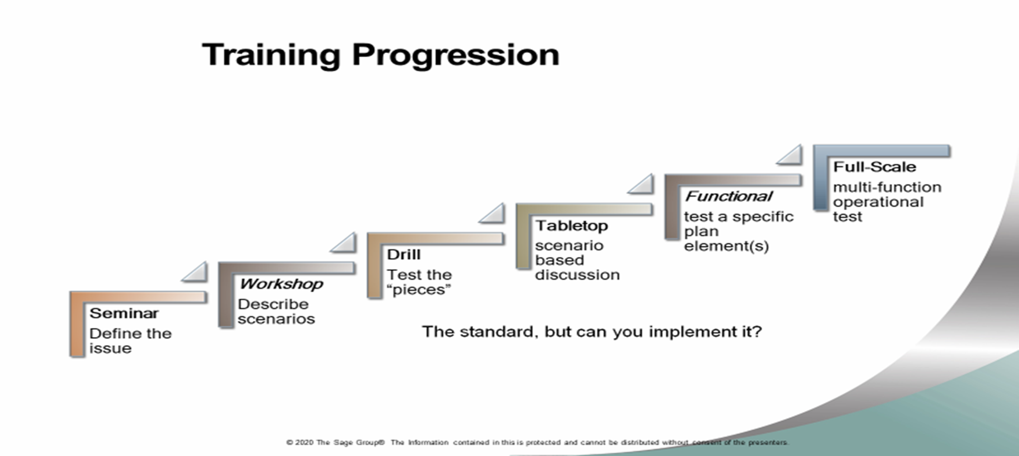
TRAINING PROGRESSION
D

Slide 21
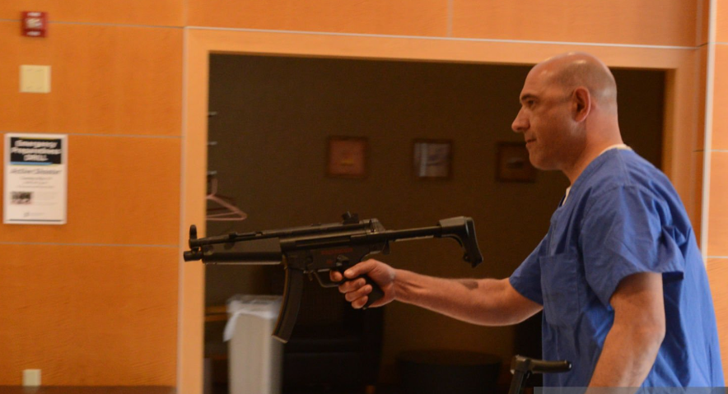
CONDUCTING AN ACTUAL DRILL
Can you safely control the environment?
Simulated or actual training weapons involved?
Firing of simulation weapons?
Safety officers clearly identified controlling the exercise?
Internal / external confusion…social media
D

Slide 22

WORKSHOP #1
What Would You Do?
B

Slide 23
SENARIO #1
Today you are the security director for a company that occupies a high rise building in New York. Building is 52 stories with over 20,000 people who work within the building.
B

Slide 24
SENARIO #1- QUESTIONS
What preparations should the property have in place to handle an active shooting?
Do employees have a “duty of care” to help all employees, customers and contractors under emergency situations?
How would you notify law enforcement of an event? What processes would you put in place for this notification?
B

Slide 25

SENARIO #2
What Message Do You Send?
D

Slide 26
SENARIO #2
You are the Manager On Duty (MOD) of this building, what message would you send over the PA system to all employees, guests, contractors, and vendors right now if a middle-aged white male has just fired two shots to the left, two shots to the right, two shots at the main entrance of this building…he is wearing a red shirt and black hat?
Develop the exact message that would be released.
YOU HAVE 30 SECONDS
D

Slide 27
WHAT MESSAGE DID YOU SEND?
Message over how many systems or platforms.
Message Content:
Code Silver
Lockdown
Evacuate or Run
No message
What about people from foreign countries?
How will people be helped who didn’t hear the message?
What about 12.6 % of the US population that is severely handicapped?
D

Slide 28

WHAT YOUR MESSAGE SHOULD BE
Relevant
Effective Warning:
  Clarity to recipients
  Details of the emergency
  Urgency of the message
  Exact location of the threat
  Directions
  Timely updates
D

Slide 29
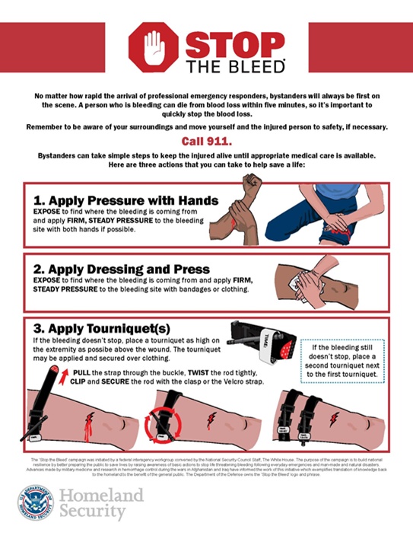
STOP THE BLEED CAMPAIGN
Stop the Bleed is a national awareness campaign and
call-to-action. Stop the Bleed is intended to cultivate
grassroots efforts that encourage bystanders to become trained, equipped, and empowered to help in a bleeding emergency before professional help arrives.
https://www.dhs.gov/stopthebleed
B

Slide 30

Q&A
Thank you
Ben Scaglione, CPP, CHPA, CHSP
Associate Principal
Cerami & Associates
Phone: 646-983-3138
Email: bscaglione@ceramiassociates.com
Blog: securehospital.net
Books: Security Management for Healthcare:
Proactive Event Prevention and Effective Resolution
Healthcare Security: Solutions for Management, Operations, and Administration
David LaRose, MSCJ, CHPA, CPP
Healthcare national Director
GardaWorld
Phone: 239-851-2545
Email: David.larose@garda.com
m
Please scan the QR code to complete our survey and share your thoughts and experiences.

