Slide 1
Integrated Systems and Human Verification
The Critical Missing Piece in AI-based Threat Monitoring
Alejandro Ramirez, Founder and Chief Product Officer, Cobalt AI

Slide 2
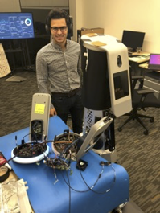
About Me
•Founder & CPO of Cobalt AI
•BS Mechanical Engineering
•BS Business Management
•Stanford University Innovation Fellow
•Operationalizing AI in PhySec for 7 years
•Deployed hundreds of AI-based systems

Slide 3

Agenda
AI Applications
AI Limitations
Human Judgment
Integrated System
Practical Considerations
Notes:
Image source; Adobe stock - owned

Slide 4

The rise of AI

Slide 5
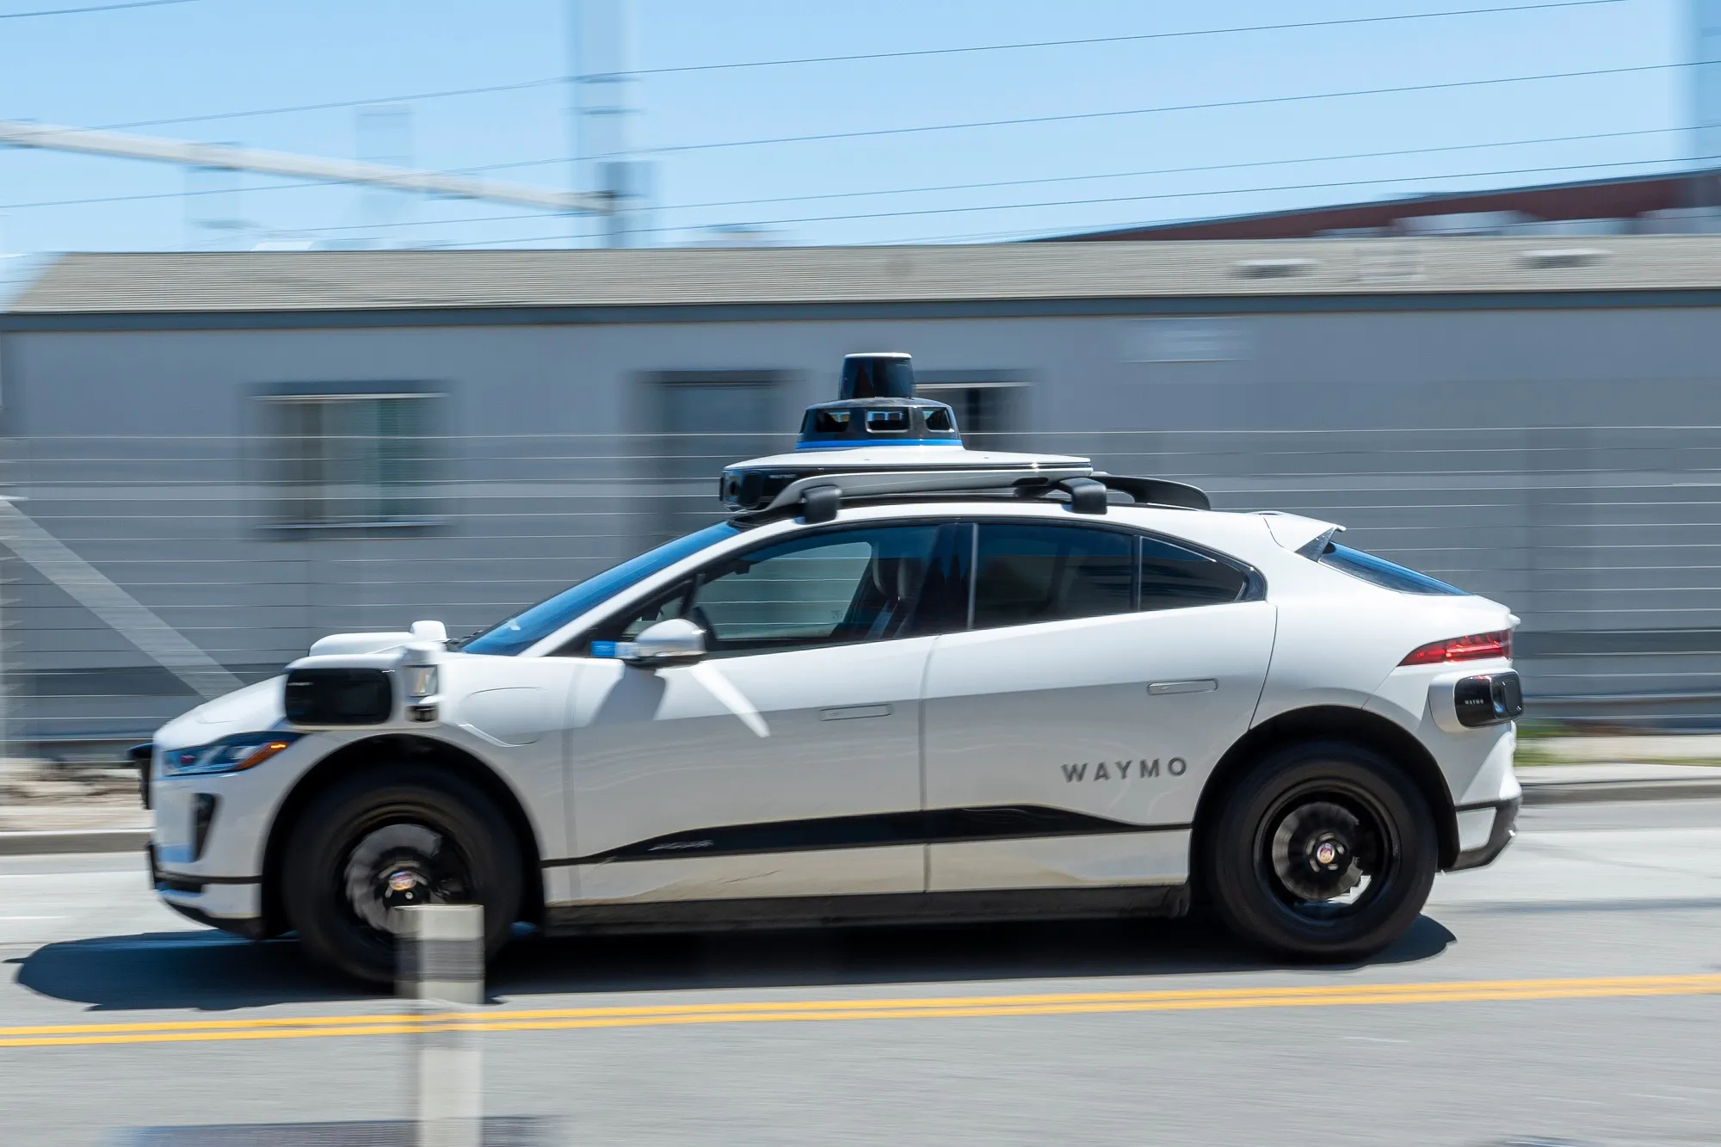
The role of AI
Source: Bloomberg News

Slide 6





AI Applications in Physical Security
Video Surveillance
Intrusion Detection
Predictive
Threat Analysis
Perimeter Security
Incident Management & Reporting

Slide 7




AI-driven Outcomes
Reactive to Proactive Risk Mitigation
Accelerated
Threat Response
Data-driven
Decision Making
Operational
Efficiency

Slide 8

Limitations of AI
Notes:
Like a young child, AI models can mimic learning and improve over time but lack deep understanding, curiosity, or abstract thought.

Slide 9
AI uncovers hidden insights within existing data
Notes:
It’s not for taking decisive action

Slide 10

Who will decide what to do?
Notes:
AI is going to uncover all of this, who will triage and act upon these insights?

Slide 11
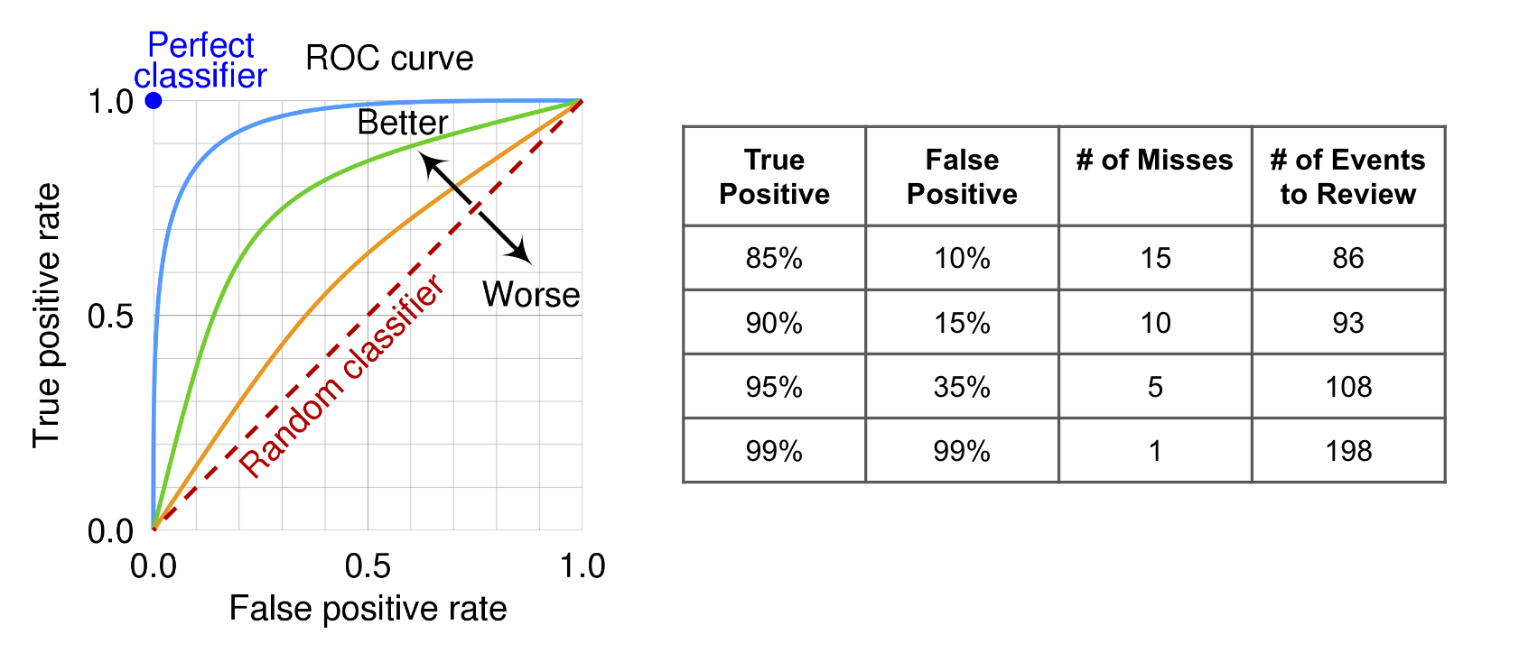
AI is not perfect
Notes:
Consider adding visual example slides below this

Slide 12
AI generates noise
Monthly AI-generated Events
Data to review
240 per Secure Door
75 per Interior Camera
150 per Exterior Camera
# of AI Analytics

Slide 13

Human Judgement in the Loop

Slide 14
Human Judgement in the Loop
AI
Business Logic
AI
Human
Action

Slide 15
AI needs an Integrated Security System
Sensors
Database
Detection
Logic
Verification
Action

Slide 16
The Current Security Ecosystem
Current Challenges
Sensors
Database
Detection
Logic
Verification
Action
Many sensor types streaming data in several formats to disparate systems

Slide 17
The Current Security Ecosystem
Current Challenges
Sensors
Database
Detection
Logic
Verification
Action
Data is decentralized and structured inconsistently

Slide 18
The Current Security Ecosystem
Current Challenges
Sensors
Database
Detection
Logic
Verification
Action
Implement the correct AI model for the application and configuring it correctly

Slide 19
The Current Security Ecosystem
Current Challenges
Sensors
Database
Detection
Logic
Verification
Action
Rules engine to fuse detection data and apply rules and policies

Slide 20
The Current Security Ecosystem
Current Challenges
Sensors
Database
Detection
Logic
Verification
Action
Not designed to combine AI and human verification as part of decision making process

Slide 21
The Current Security Ecosystem
Current Challenges
Sensors
Database
Detection
Logic
Verification
Action
Communicating with other systems and triggering automated actions based on severity

Slide 22
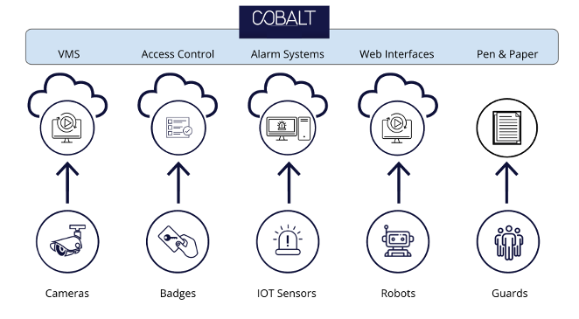
Cobalt AI as an example

Slide 23
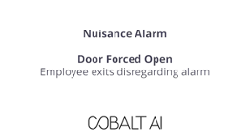
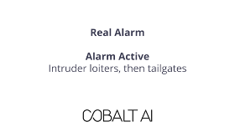
Cobalt AI as an example
Notes:
Could show the same scenario with subtle changes and talk about how the AI would not have detected the difference (would need Ryan’s help)

Slide 24
Practical Considerations
Be mindful of selecting and configuring AI
Prioritize pairing AI with a highly integrated platform
Consider the end users total cost of ownership
Build close relationships with the “manufacturers”

Slide 25

Q&A
Thank you
Please scan the QR code below to complete our survey and share your thoughts and experiences.

